Slide 1
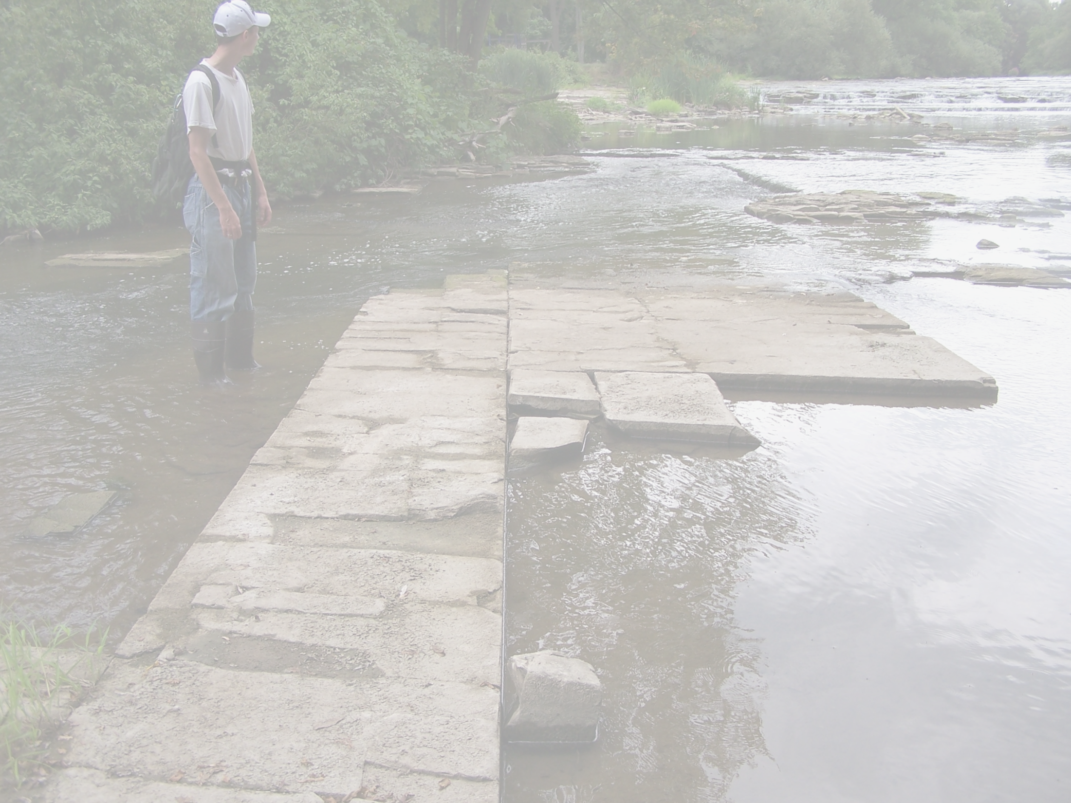
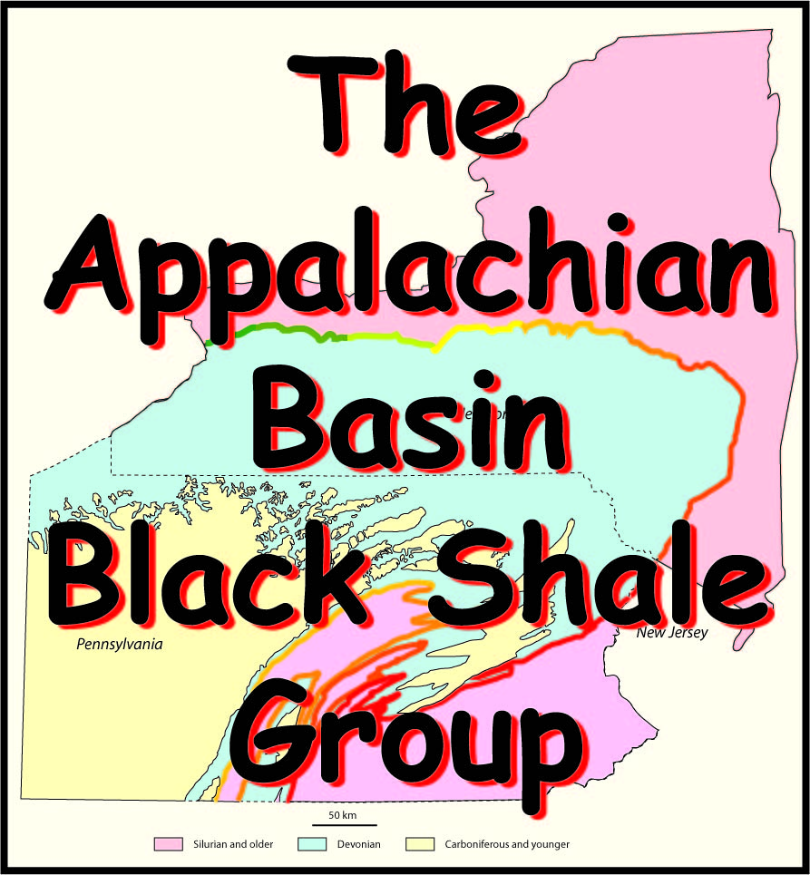
12. Fracture Development vs. TOC

Slide 2
An Industrial Affiliates Group
To assist in the development of the emerging gas play in the Devonian black shale basin of Pennsylvania and New York.
All data including figures and maps that come with this collection of slides is proprietary and for the exclusive internal use of members of the ABBSG affiliates group.

Slide 3
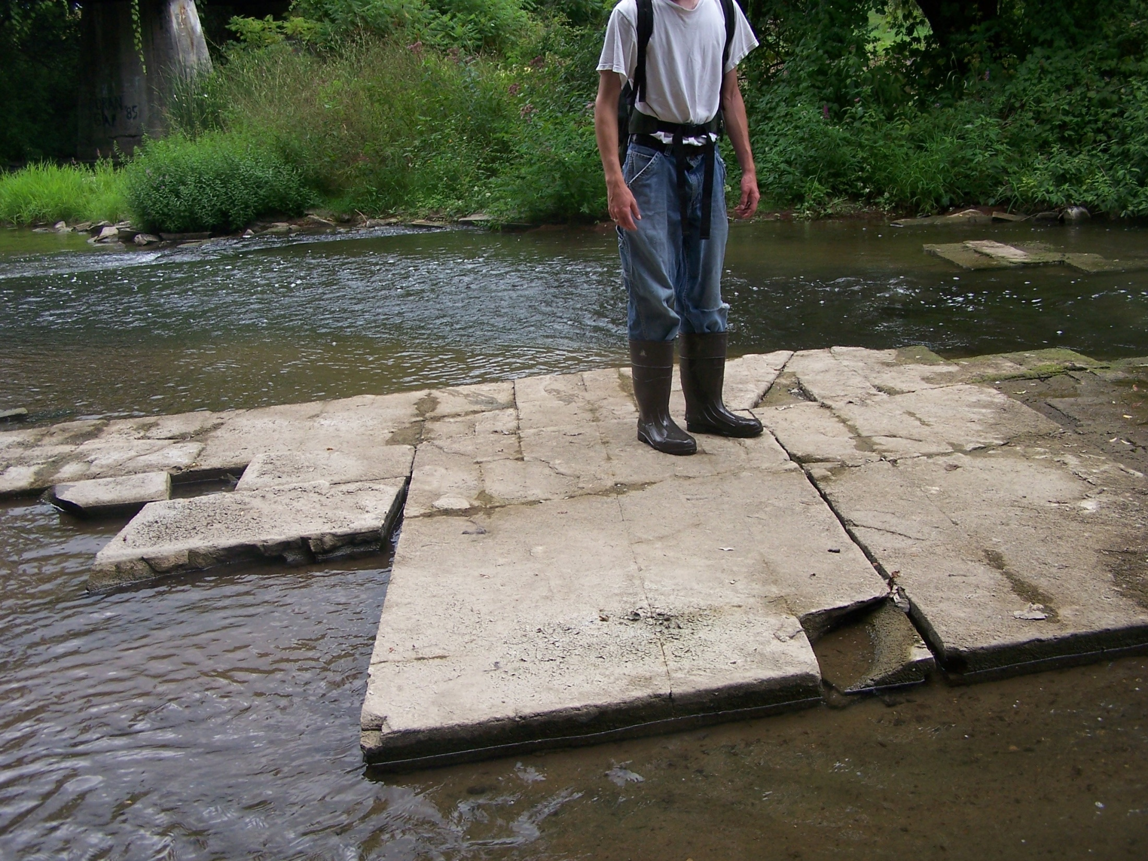
Looking WSW Leroy, New York
The Marcellus is a fractured reservoir! Fractures allow for connectivity between matrix porosity and the well bore.
J₁
J₁
J₁
J₁
J₁
J₁
J₁
J₂
J₂
fracture porosity
matrix porosity
J₂
Photo: Gary Lash
Marcellus (Appalachian Plateau, NY)
Notes:
Horizontal Drilling means exploiting fractures.
Explain Anisotropy: The reason for directional drilling.

Slide 4
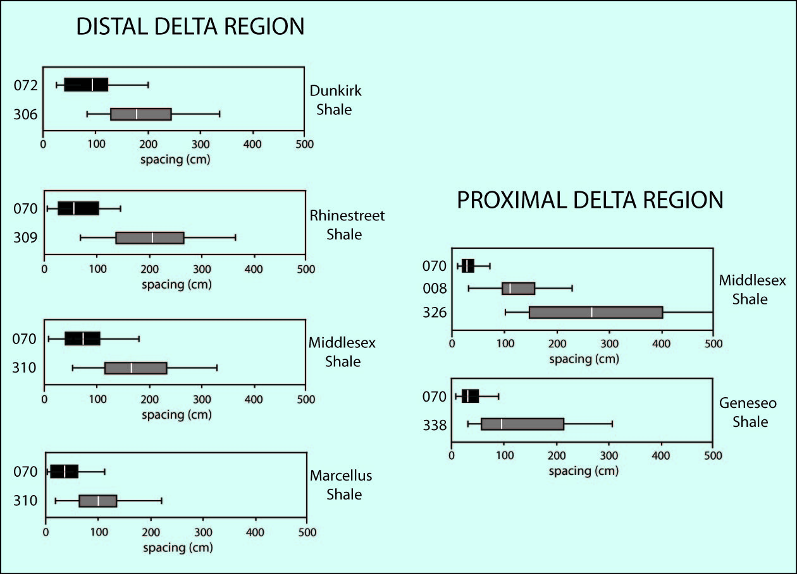
Fracture density: Devonian black shale
Because of its higher density, J₁ should better connect matrix porosity with production wells!
high density
low density
data from Lash & Engelder, 2008
high density
low density
J₁
J₂
north of Ithaca, NY
south of Buffalo, NY
Lesson: the behavior of the Marcellus is repeated in other black shale of the Appalachian Basin

Slide 5
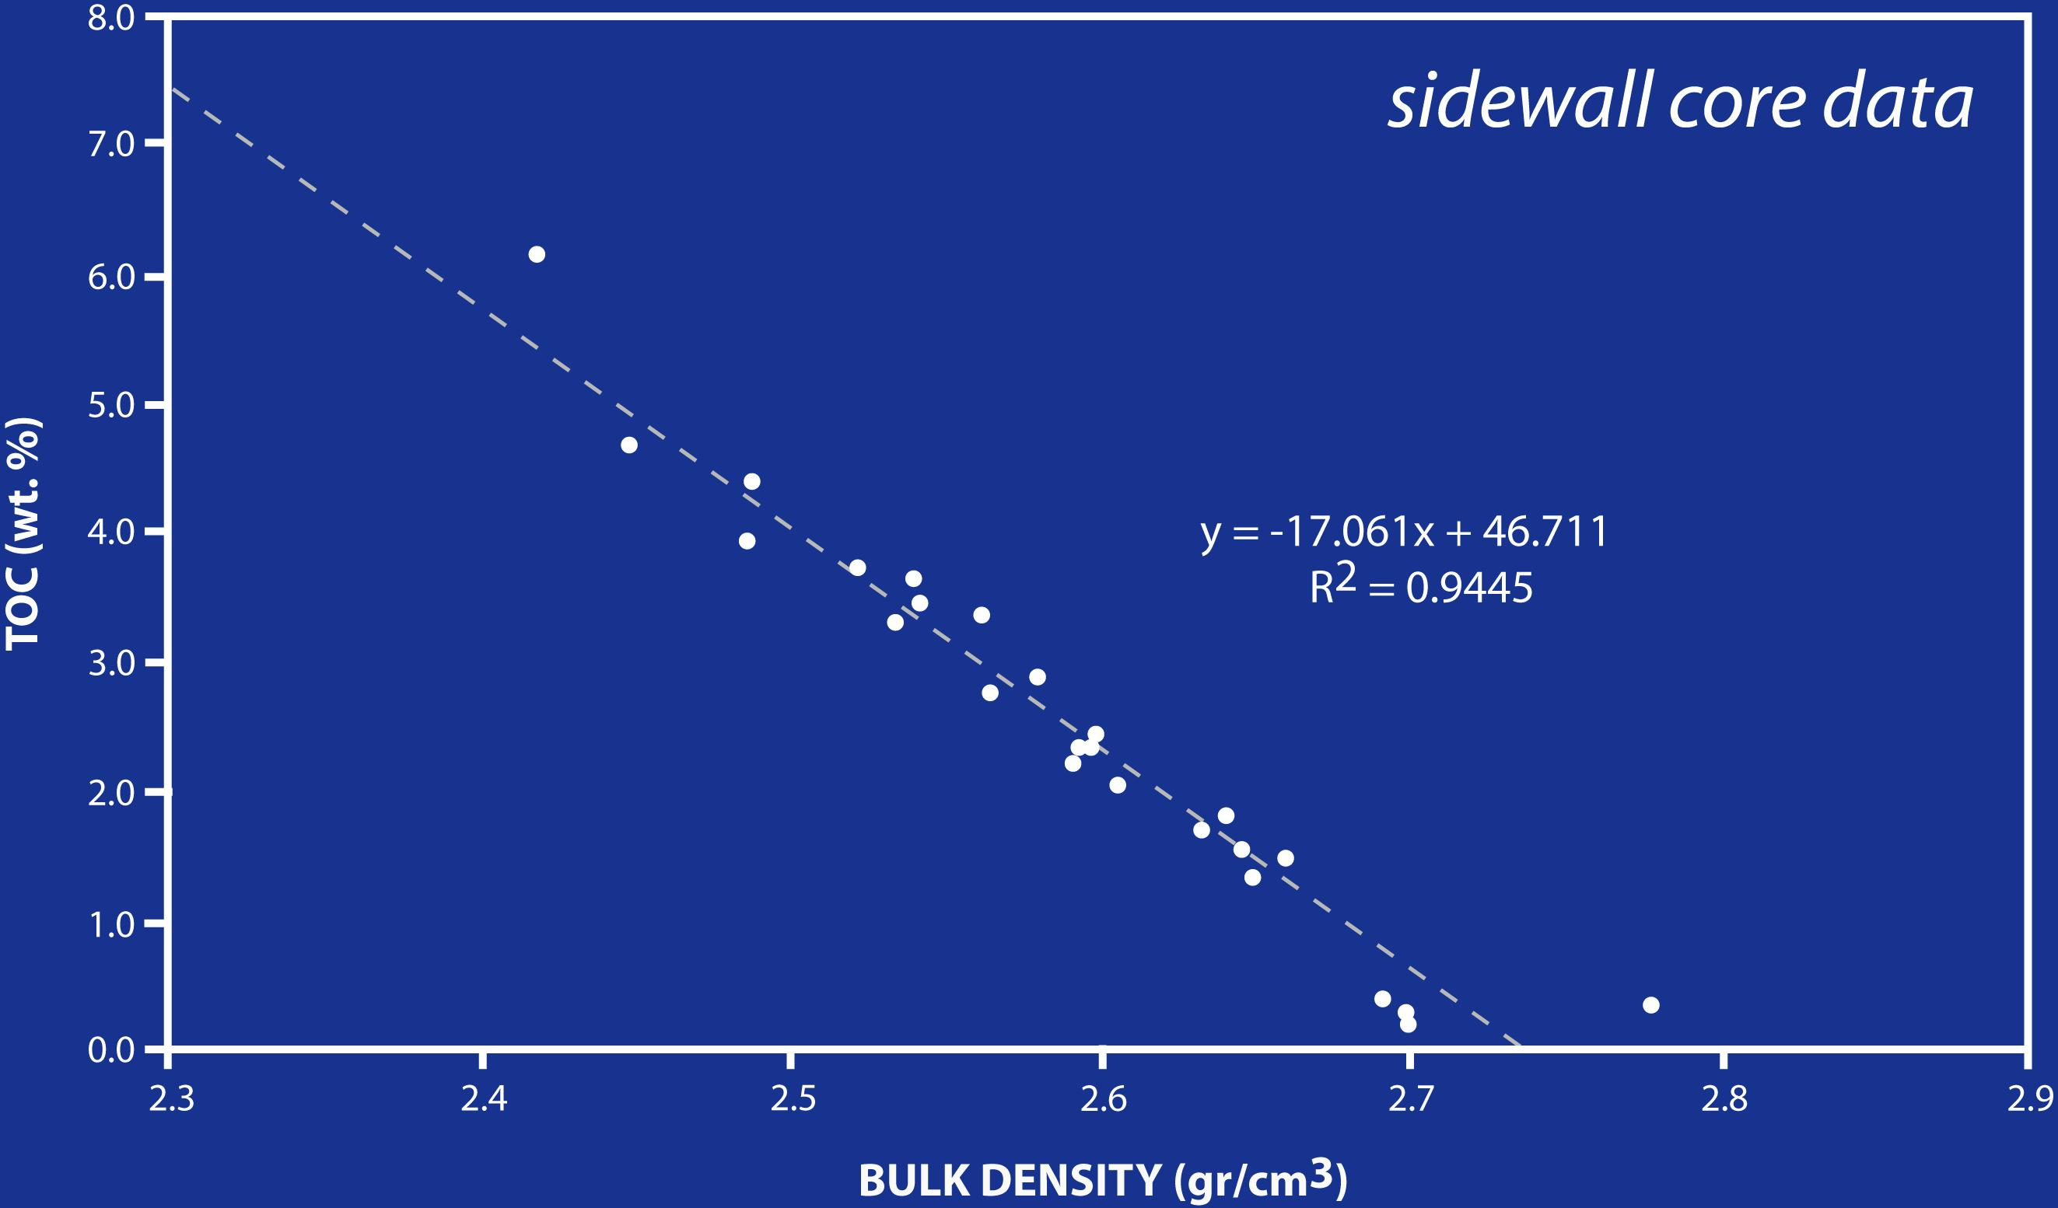
Geneseo Black Shale
TOC = 1.5%; ρ_{B}=2.65 gr/cm³

Slide 6
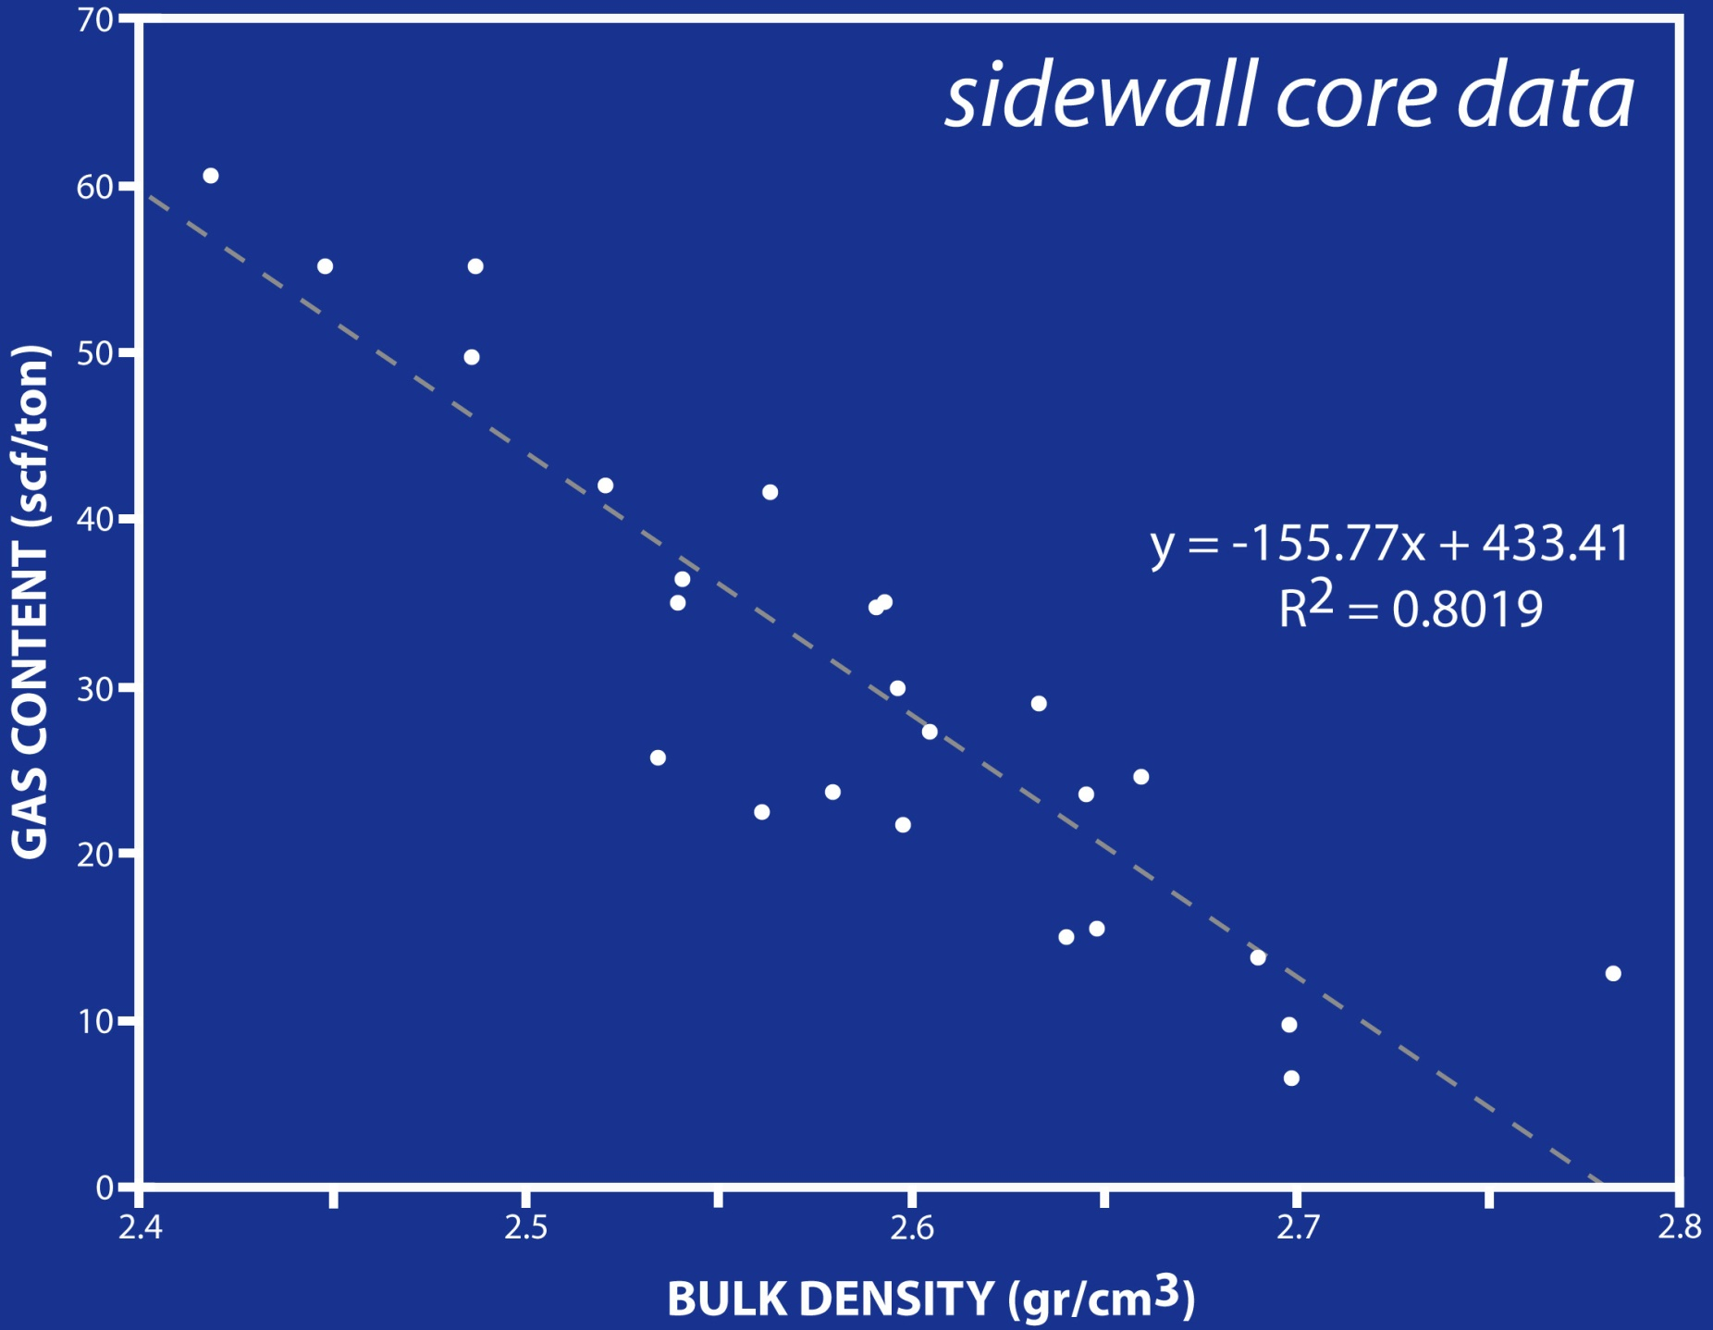

Slide 7
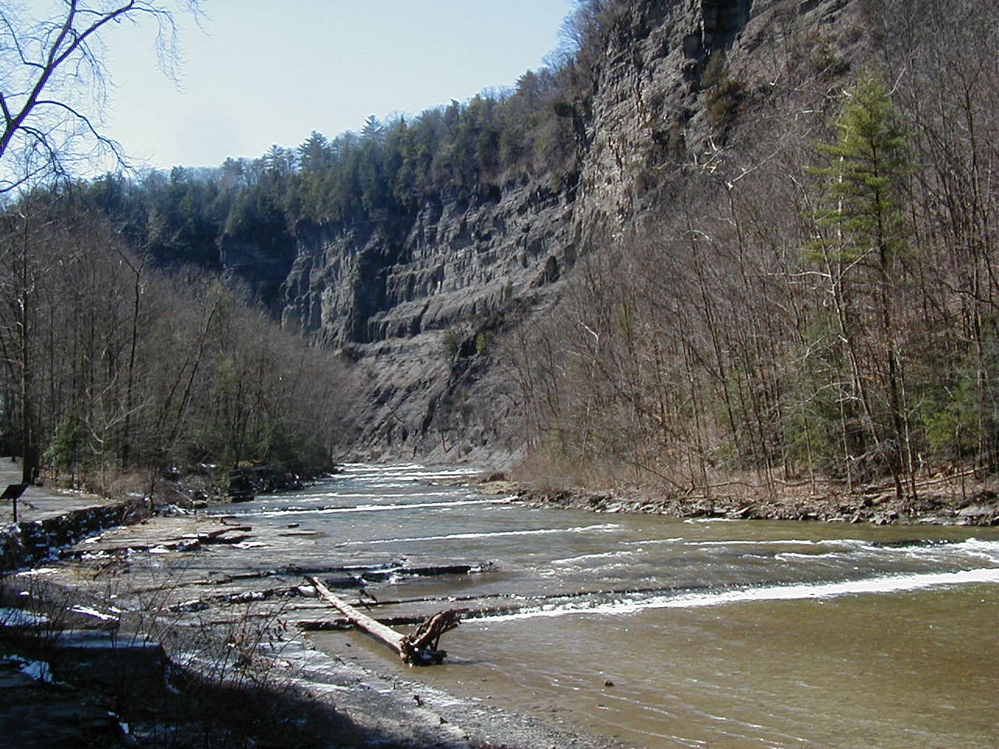
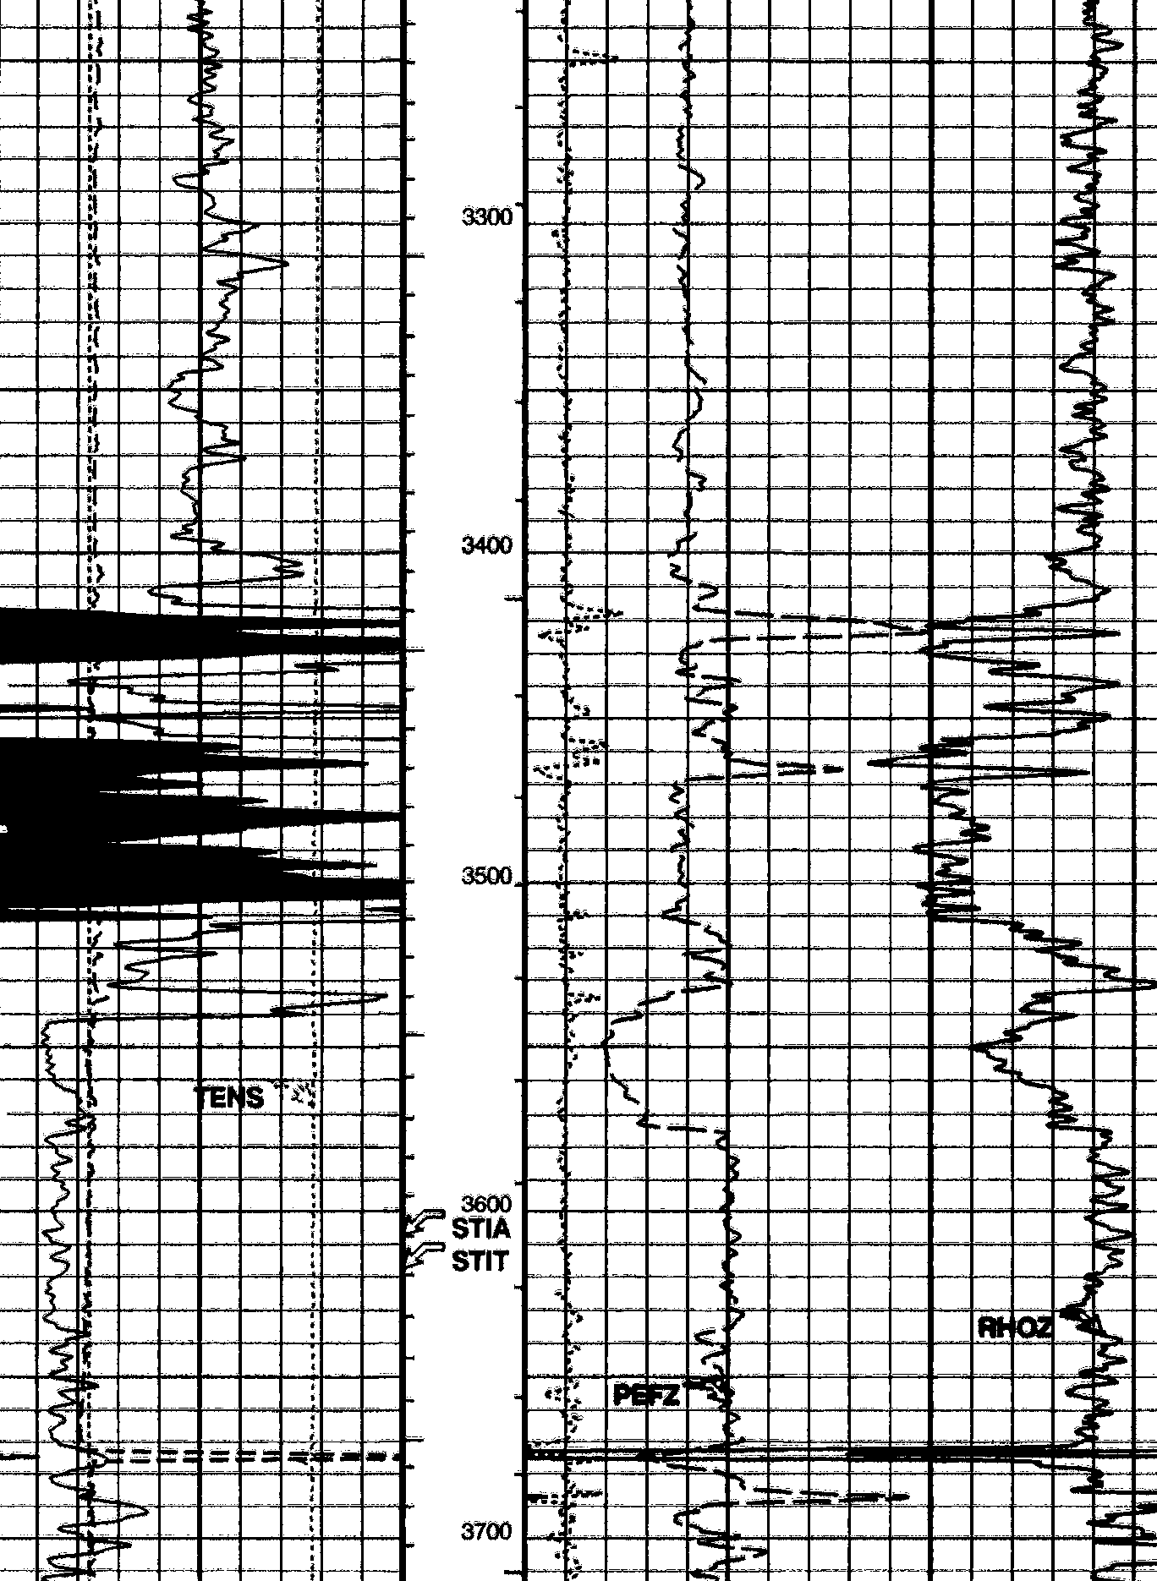
Taughannock
Taughannock Falls Ithaca, New York
gray shale
black shale
High radioactivity
analog for Marcellus
Outcrop data from Younes & Engelder, 1999; Lash et al., 2005
Notes:
Anyone from Cornell…. I would be glad to take you on a day trip through the geology in the vicinity of Ithaca because the story of the J1 play can be clearly demonstrated in that area.

Slide 8
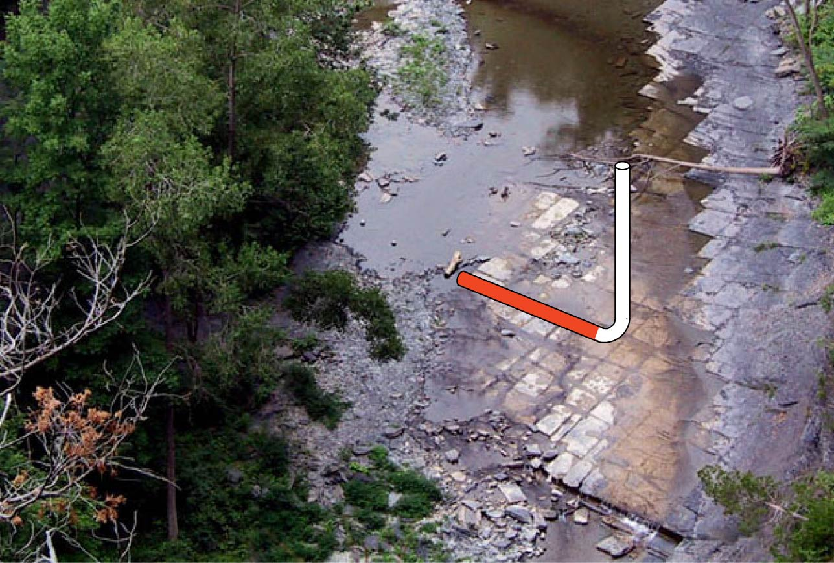
S_{H}
J₁
Target J₁: Horizontal Drilling Perpendicular to Contemporary Tectonic Stress (S_{H} = ENE)
N
S_{H}
Geneseo-Burket (Devonian black shale)
Taughannock Falls State Park, Trumansburg, N.Y.

Slide 9
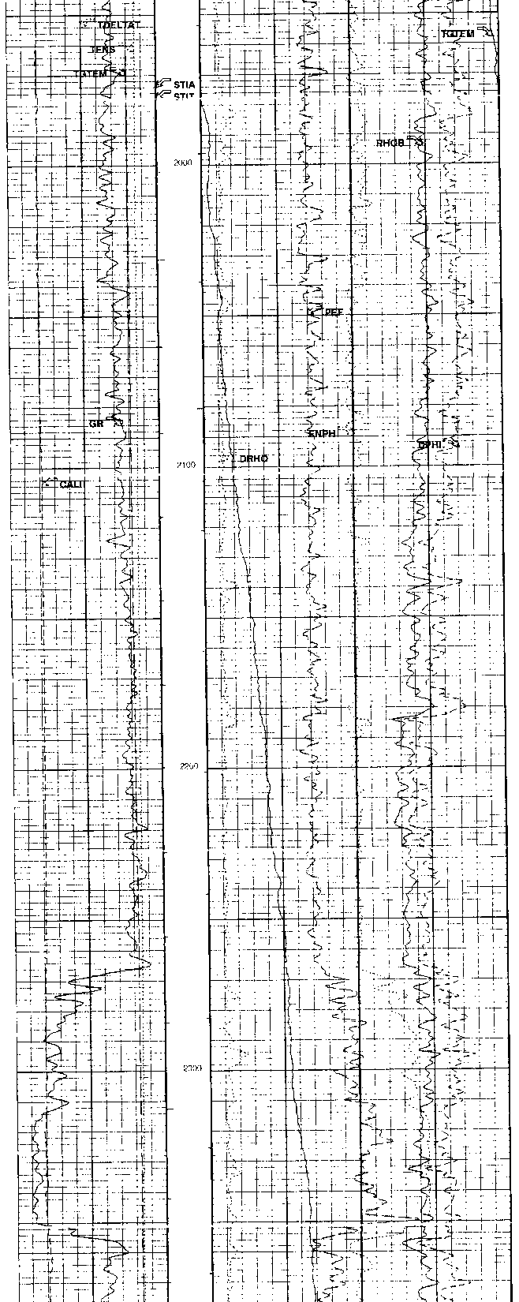
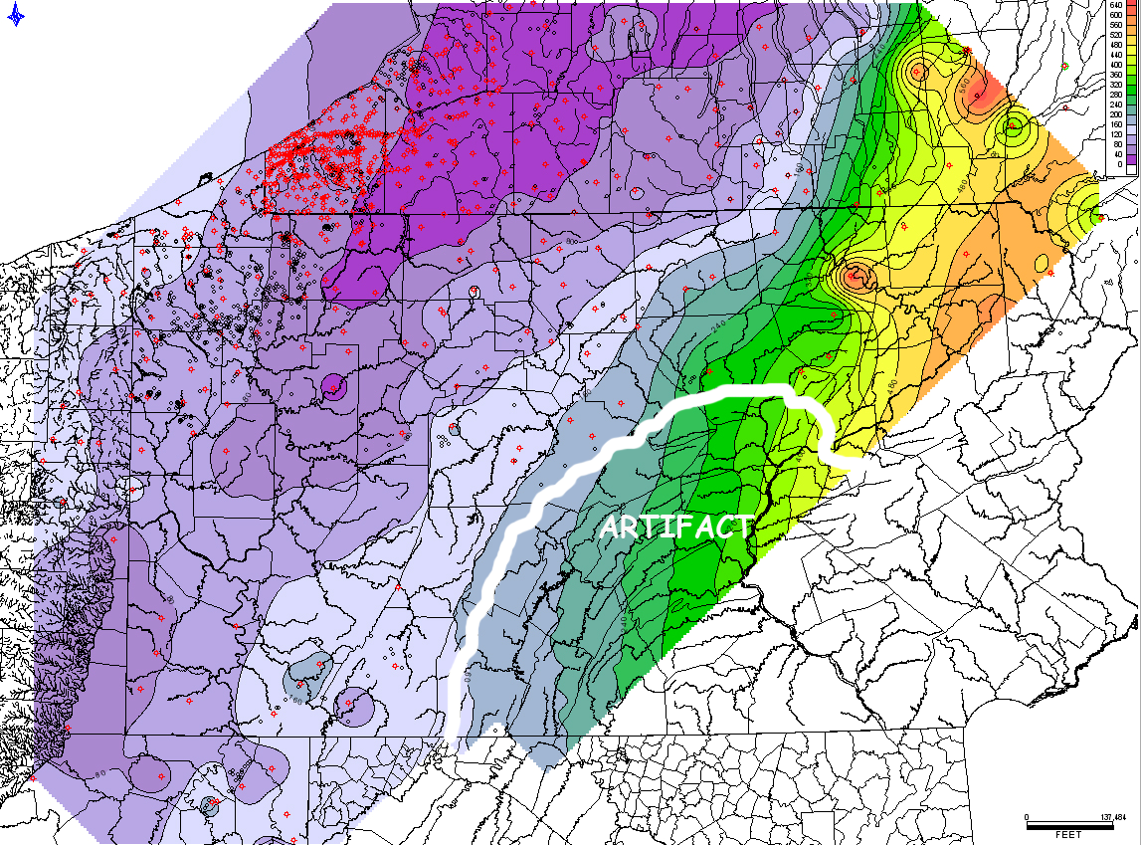
Bulk Density Density Porosity
Chemung 21701 (Koabel #1)
Talisman
Gamma Ray
Genesee Gray
Genesee Black
Tully
Marcellus Isopach (measured between Stafford above and Onondaga below)
Hamilton Group

