Slide 1
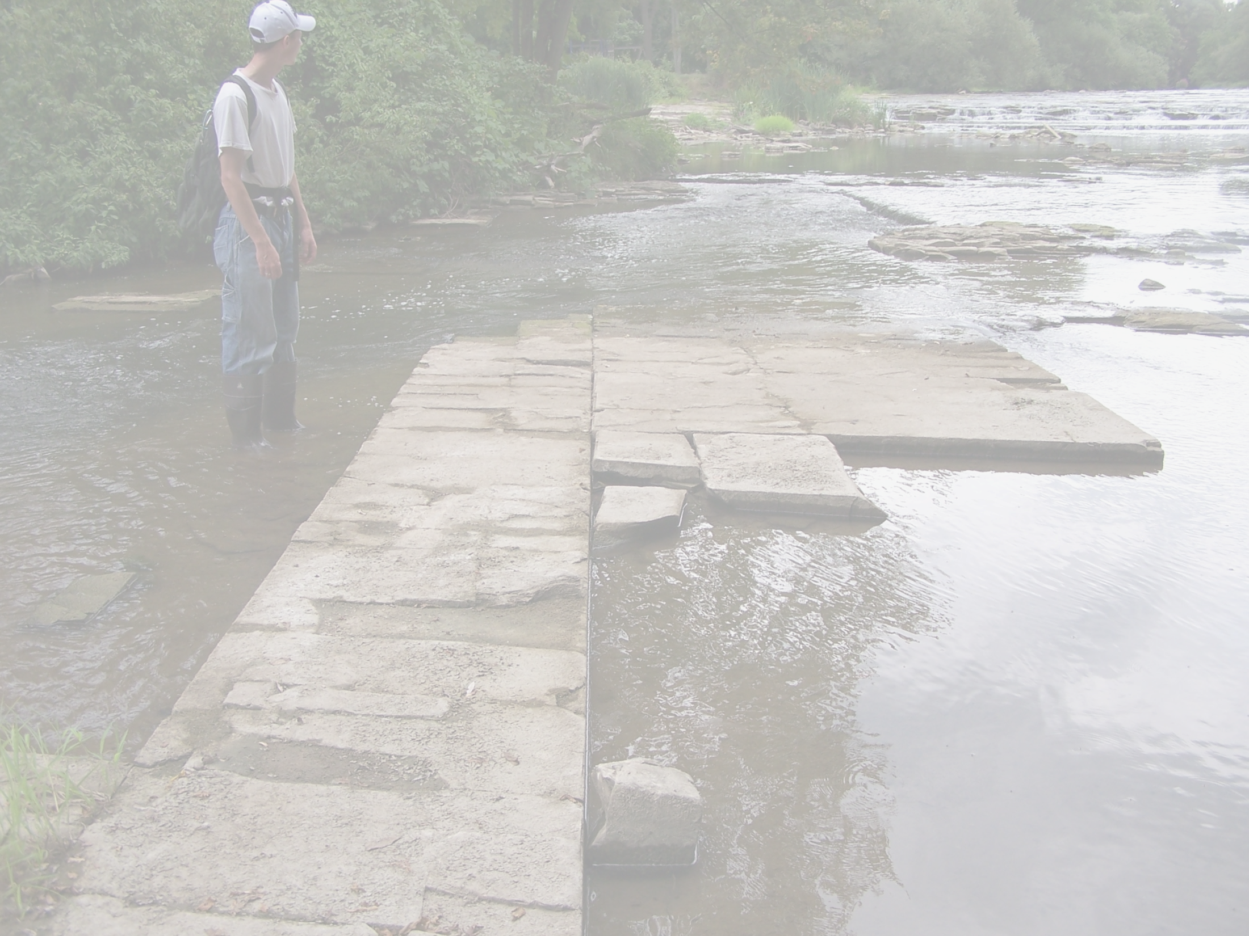
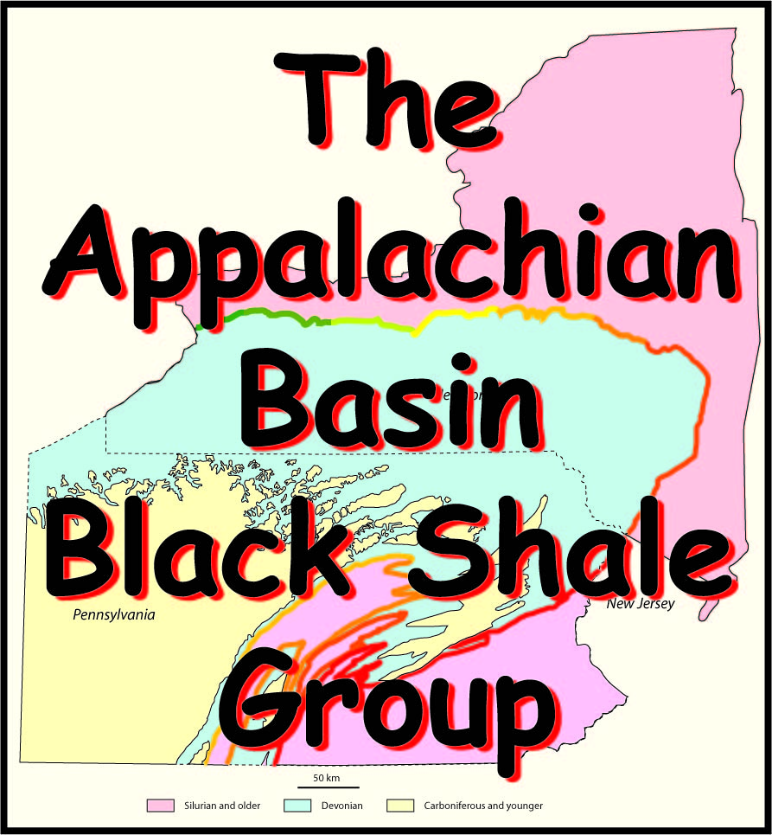
10. Natural Hydraulic Fracturing

Slide 2
An Industrial Affiliates Group
To assist in the development of the emerging gas play in the Devonian black shale basin of Pennsylvania and New York.
All data including figures and maps that come with this collection of slides is proprietary and for the exclusive internal use of members of the ABBSG affiliates group.

Slide 3
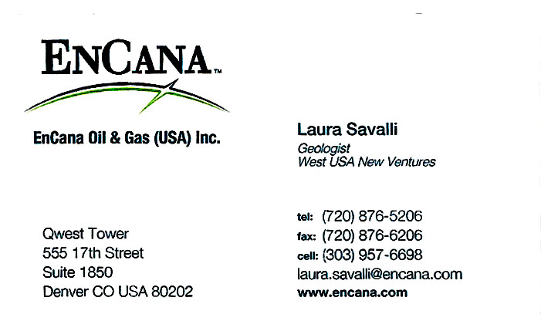
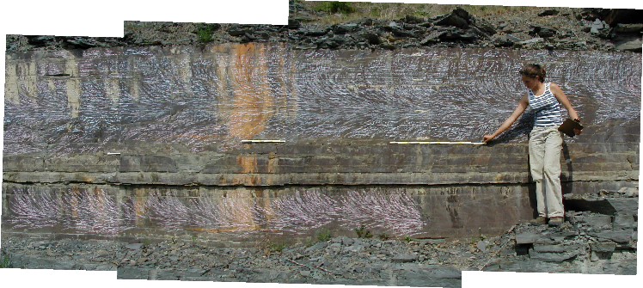
Laura Savalli
joint face
Documented the relative rate of propagation of joints in the Appalachian Basin

Slide 4
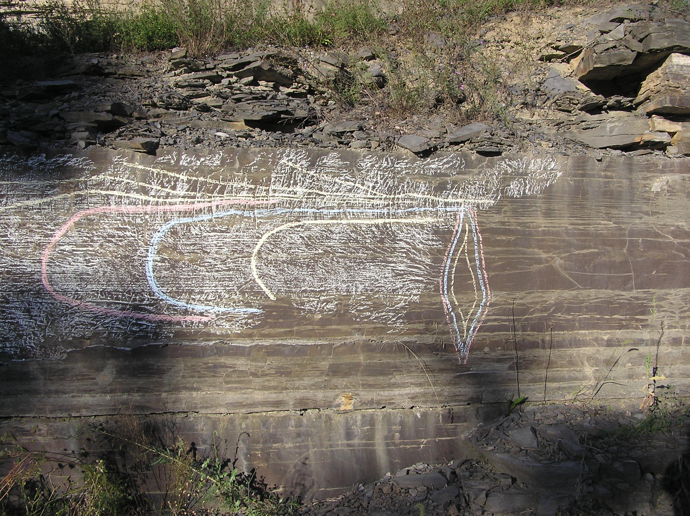
cross section of joint during growth
Savalli & Engelder (2005, Geological Society of America Bulletin)

Slide 5
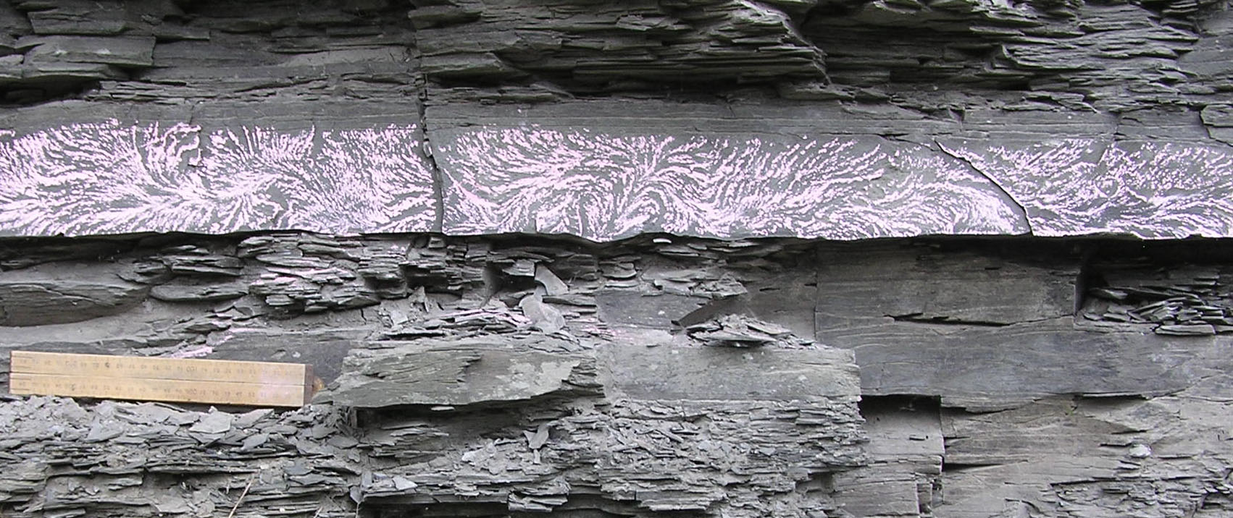

Slide 6
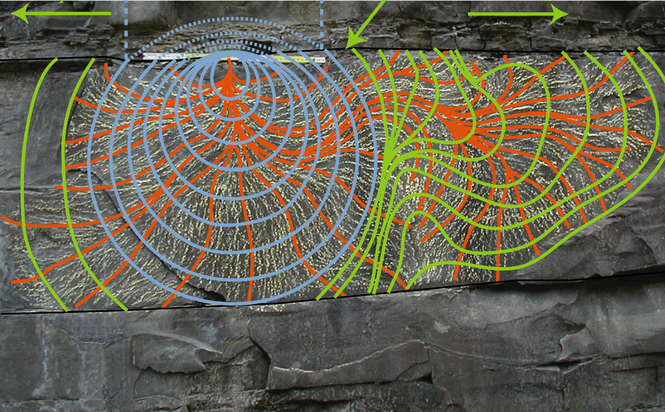
1 meter
rupture front through a number of time increments

Slide 7
Natural Hydraulic Fractures in the Marcellus!
Other evidence supporting this conclusion?
  Fracture barriers
  Incremental propagation (Boyles Law: P₁V₁ = P₂V₂)
  Fracturing from natural boreholes
What was the driving fluid?
  A fluid the the compressibility of methane

Slide 8

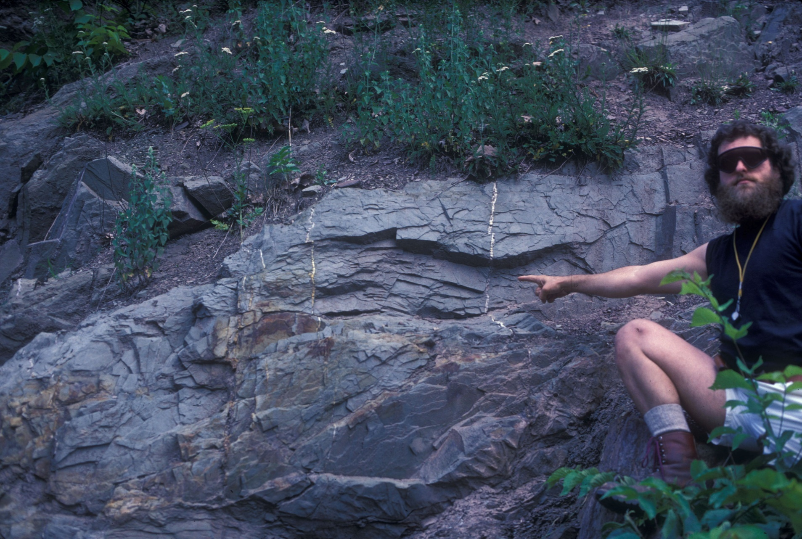
Alfred Lacazette
Recognized that joints in Appalachian Basin shale were hydraulic fractures driven by high pressure CH₄!

Slide 9
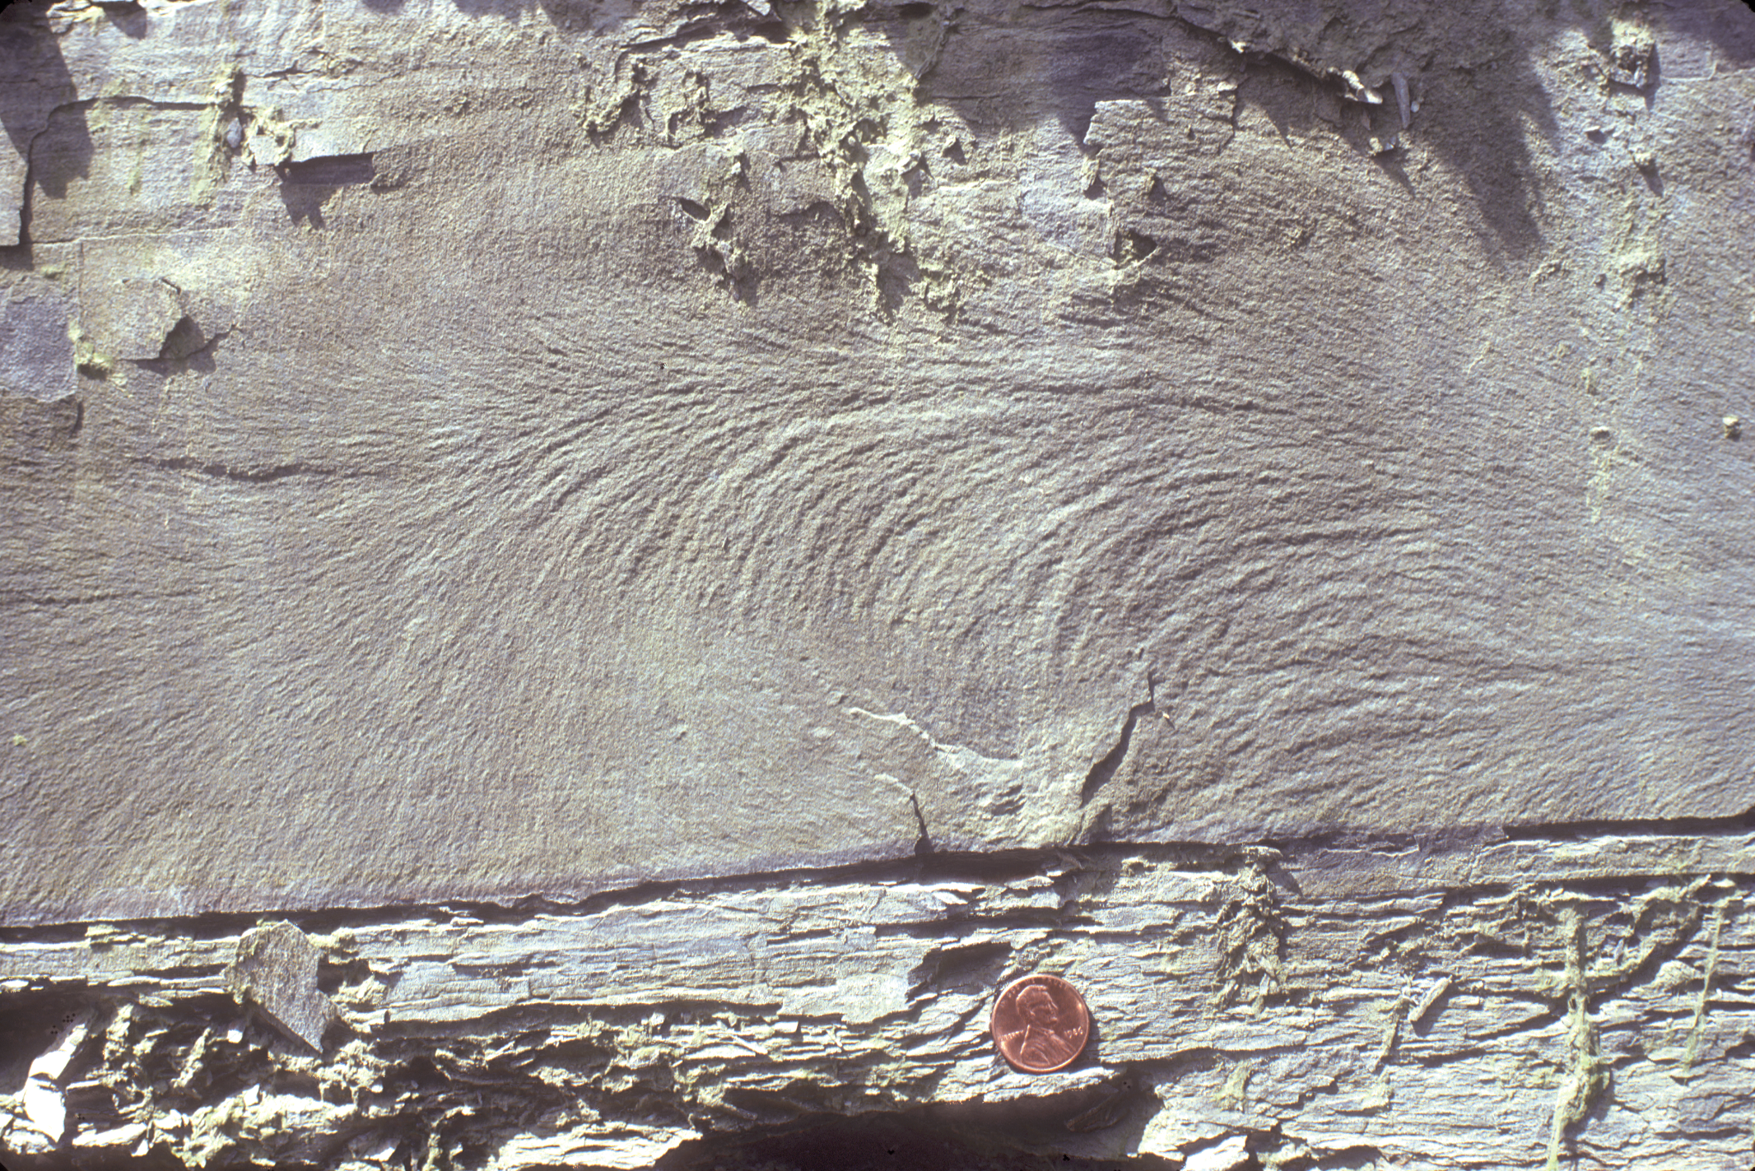
Plumose Joint Surface Morphology
Propagation direction is right to left
J₂

Slide 10
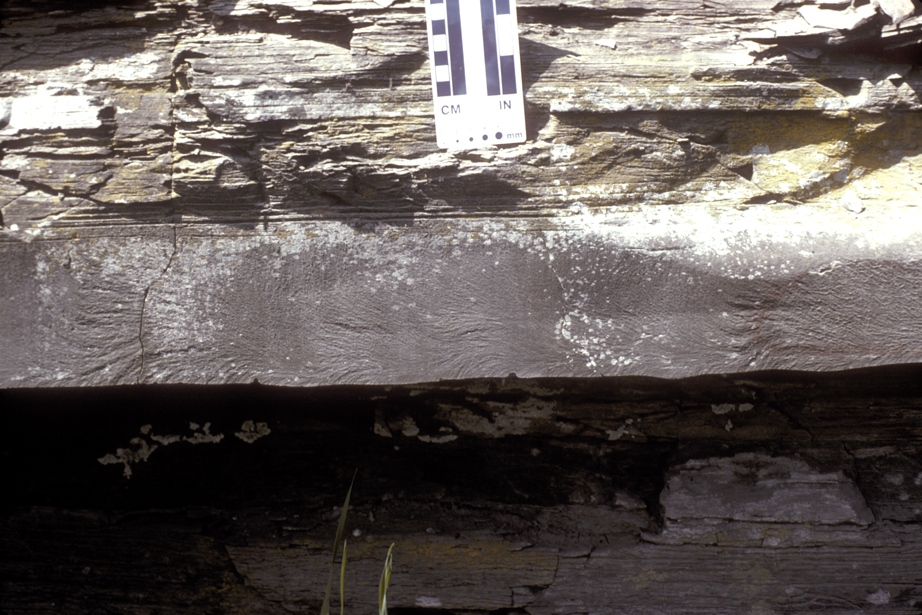
Montour
¹J₂
Propagation direction is right to left

Slide 11
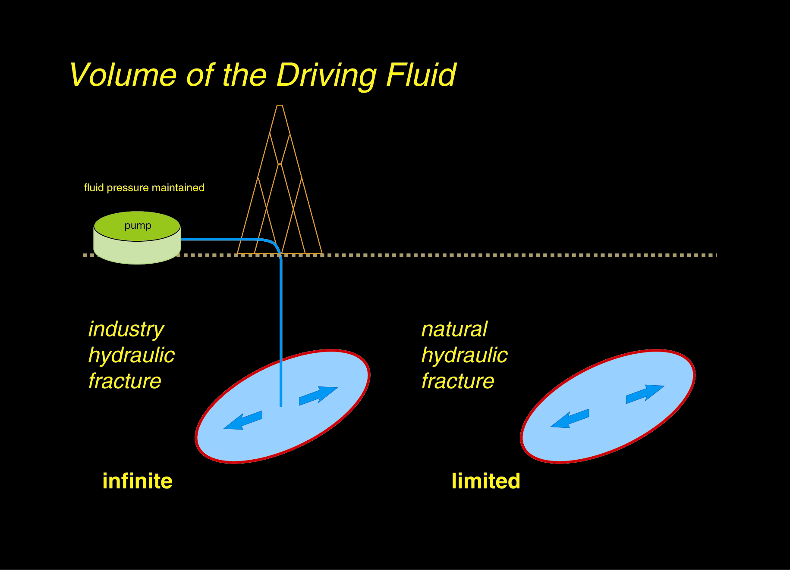
Dike Mode
Early siltstone NHF
J₂
J₂
Late shale NHF

Slide 12
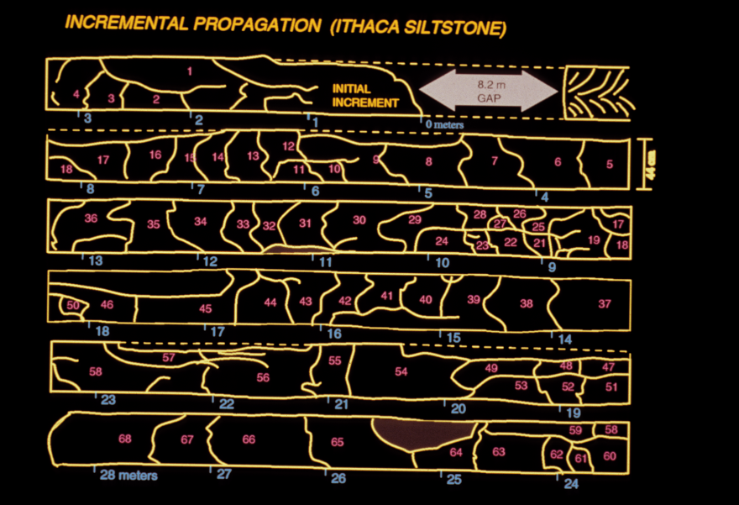
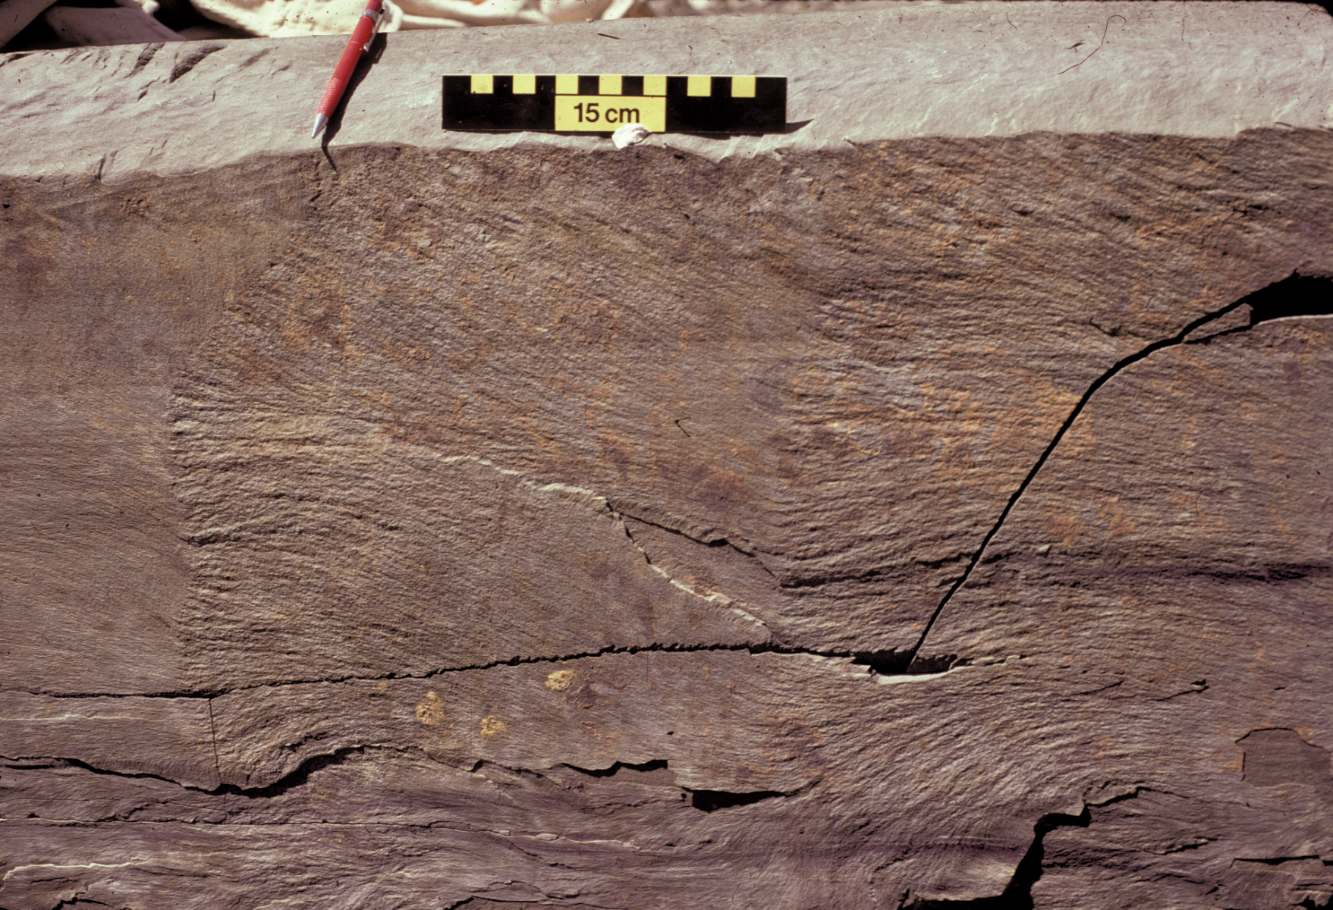
The Joint
¹J₂
Propagation direction is right to left

Slide 13
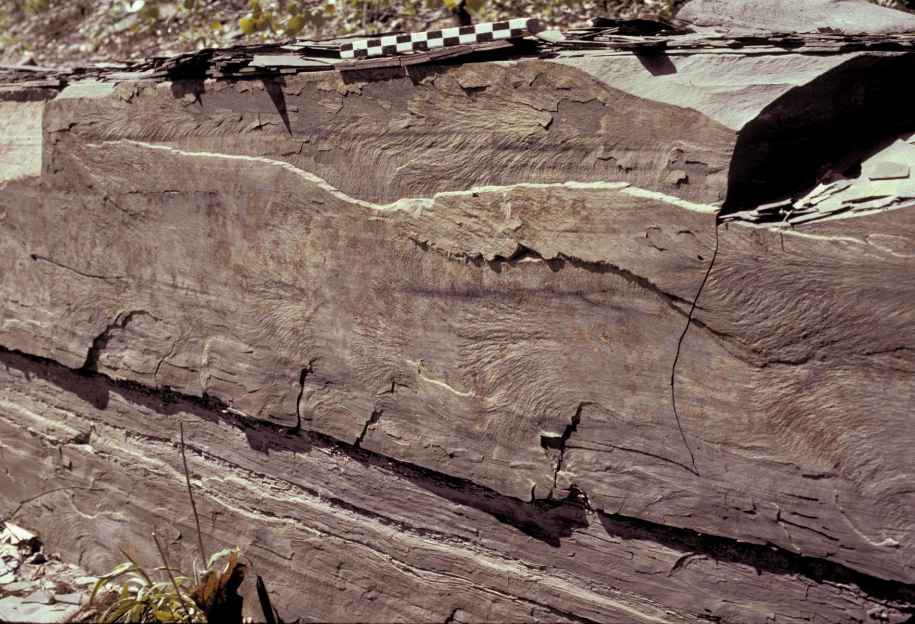
The joint
¹J₂

Slide 14
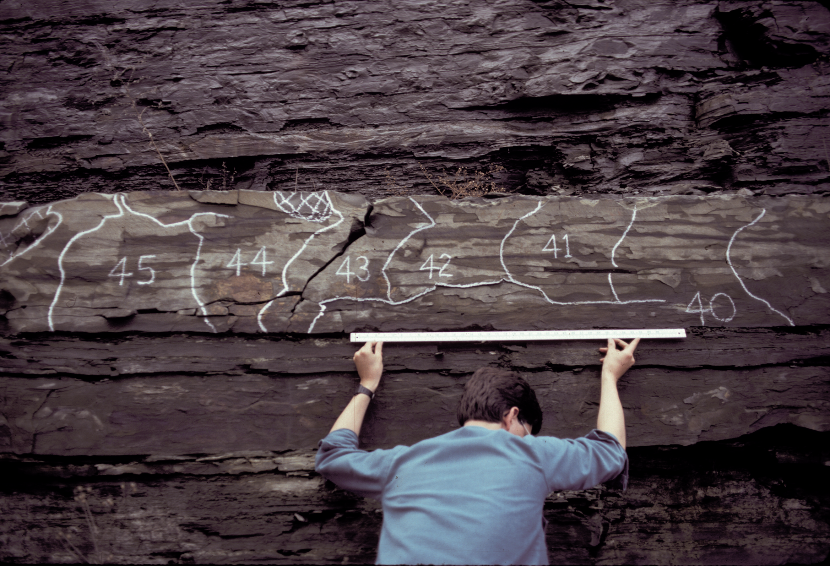
Paul Scott
¹J₂

Slide 15
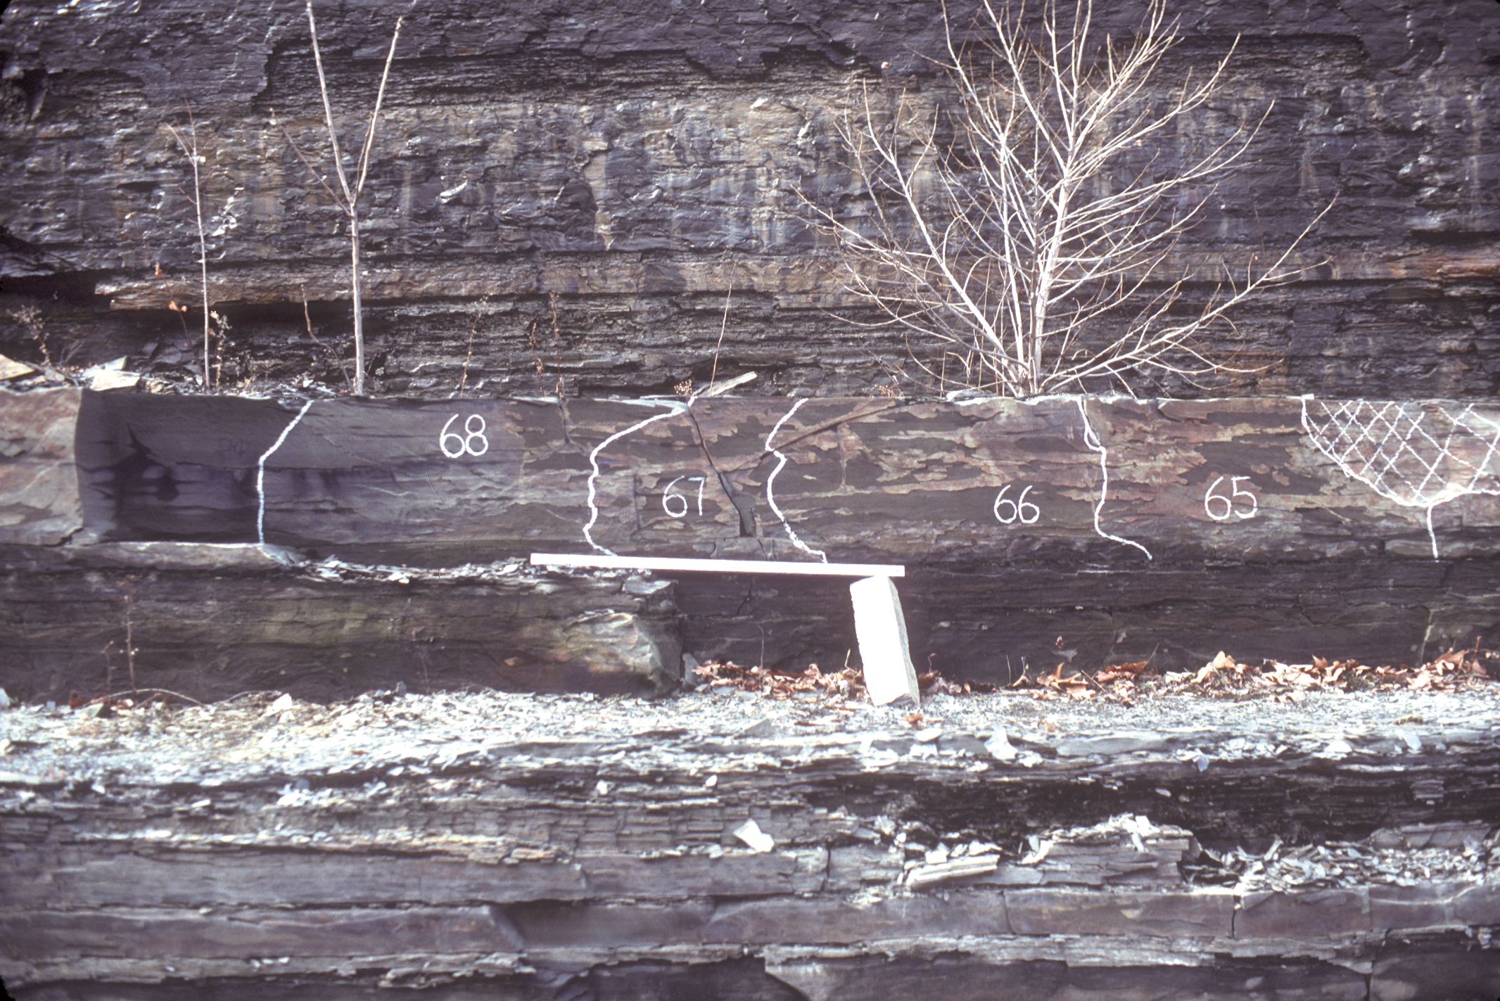
Termination of the Joint
¹J₂

Slide 16
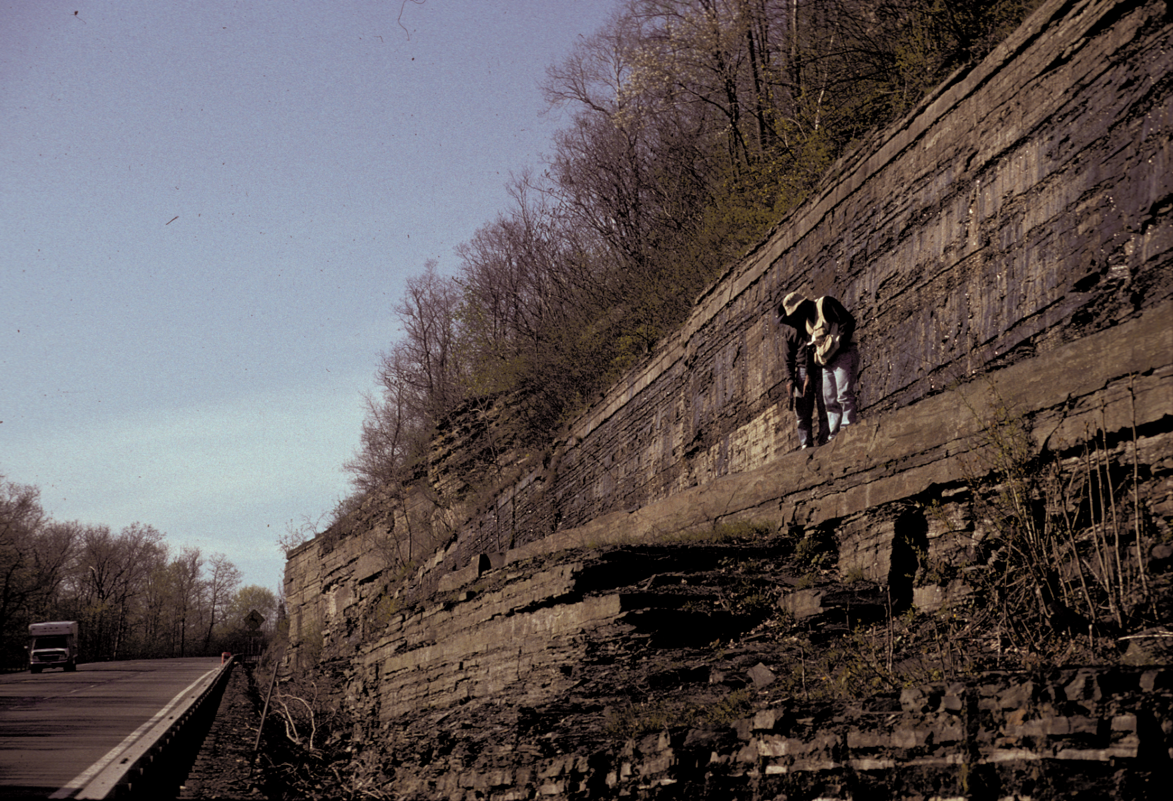
The Joint
²J₂
¹J₂
¹J₂
²J₂
Ithaca gray shale and siltstone, further upsection from Geneseo black shale.

Slide 17
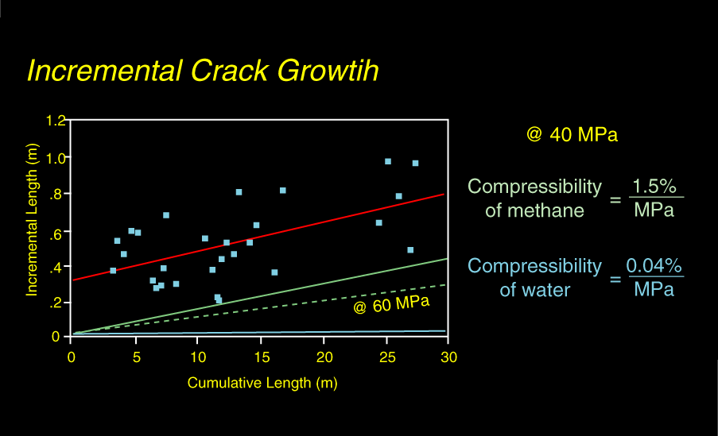
Compressibility of Methane
¹J₂

Slide 18

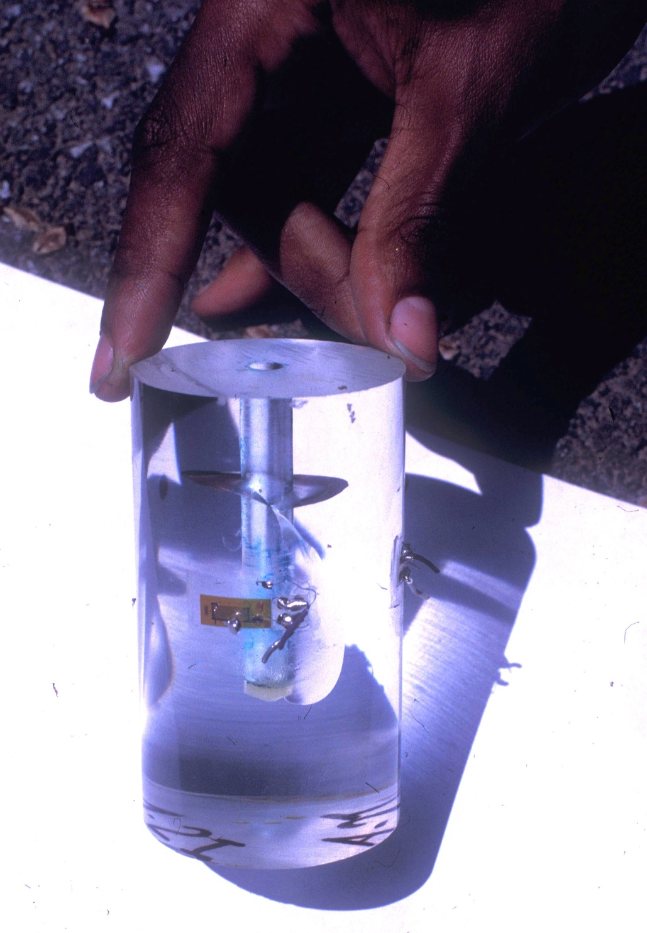
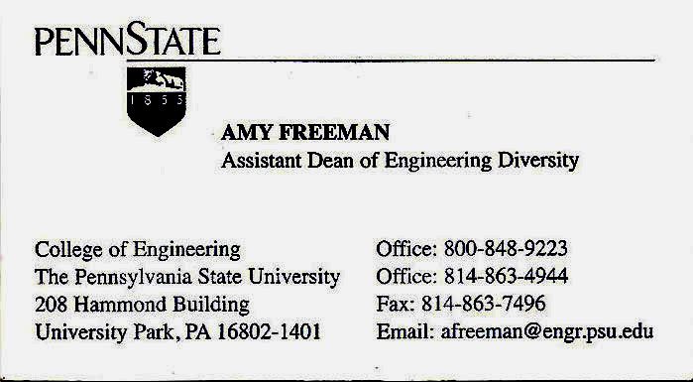
Amy Freeman

Slide 19
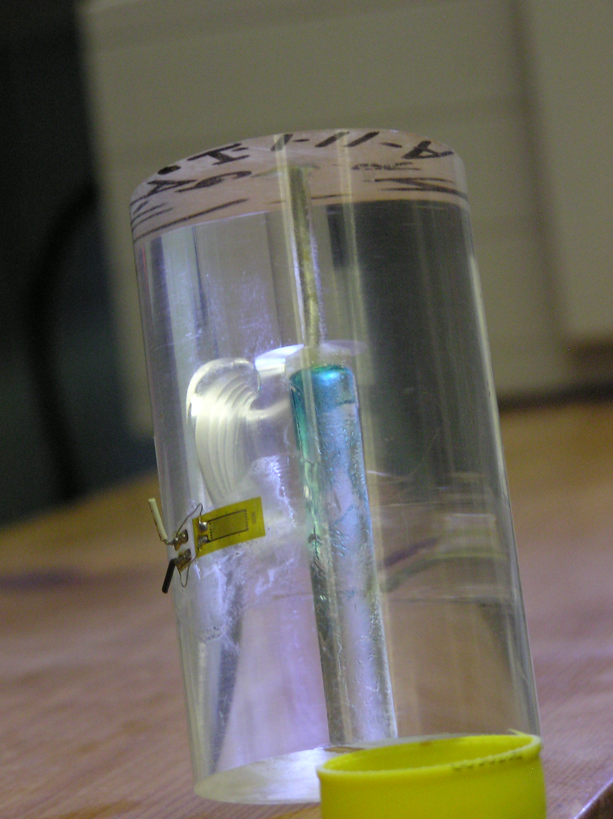
What is the cause of incremental fracturing?
Gas Law: PV = nRT = constant
discrete propagation events
PSU lab experiment:
plexiglass cylinder hydraulically fractured from internal hole

Slide 20
Hubbert’s Peak (American Natural Gas = 2001)
Discovery Curve + 23 years
Total Production
Conventional Production
Unconventional Production
SWEPI funds Engelder research on Antrim gas shale

Slide 21
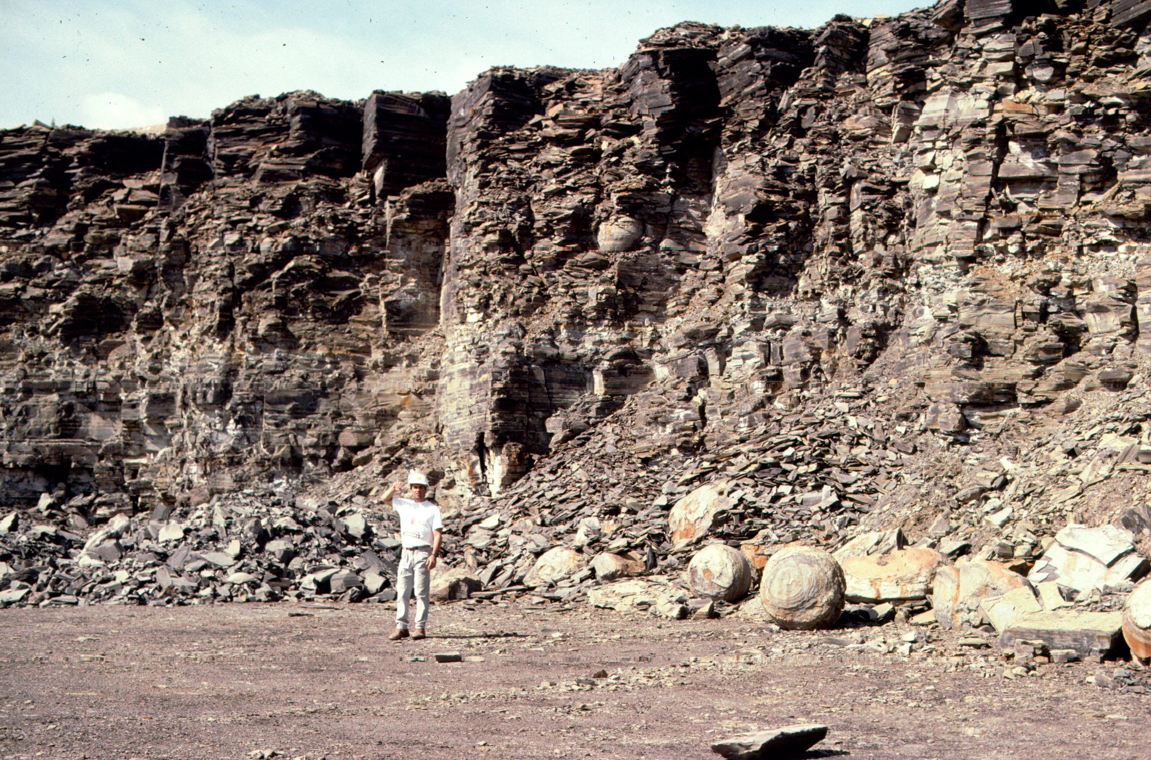
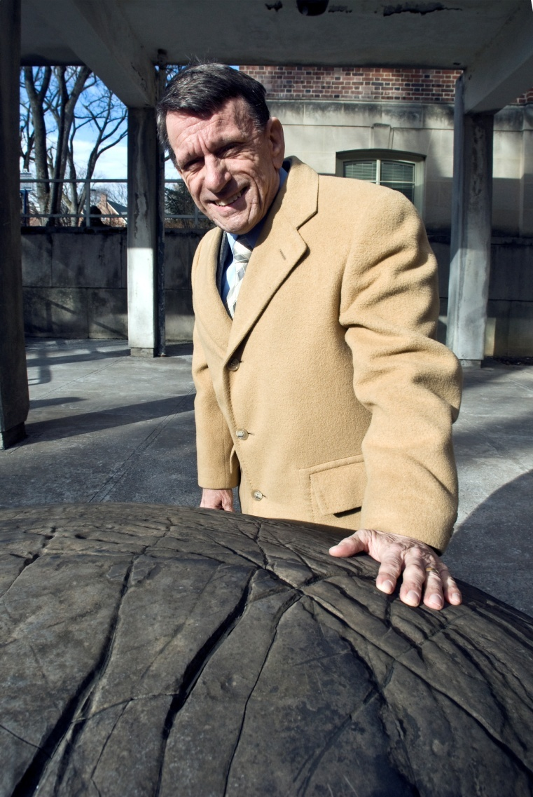
Antrim Black Shale, Paxton Quarry, Upper Michigan
Marcellus concretion
ca. 1990

Slide 22
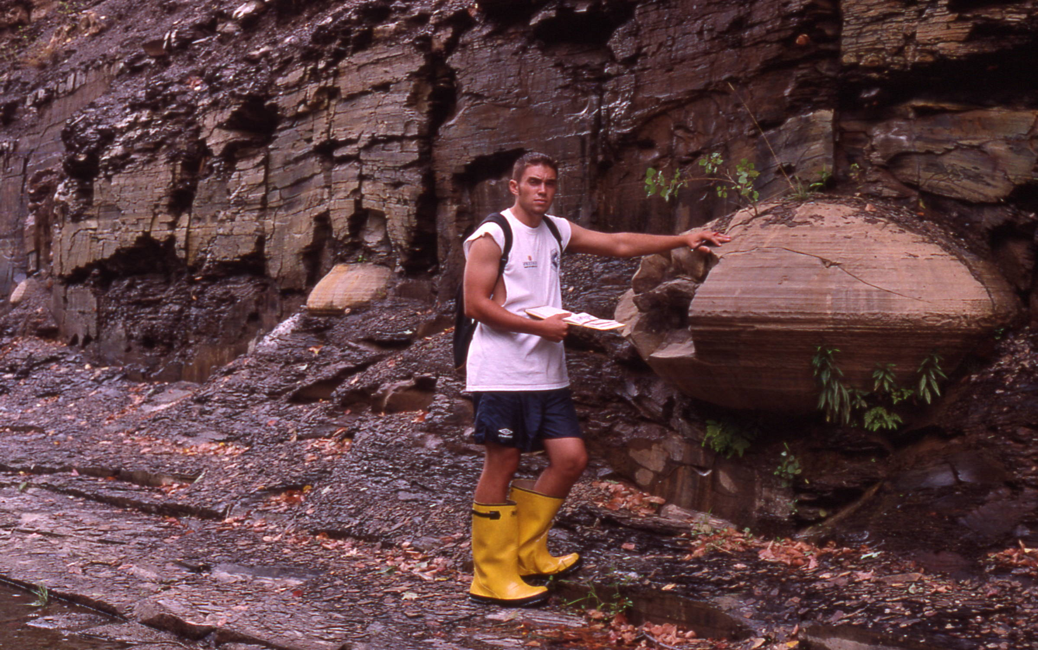
David McConaughy
Gary Lash student
Rhinestreet (Devonian black shale)
Recognized joints passing around concretions thereby giving independent evidence for hydraulic fracturing in Marcellus!
Lake Erie shoreline, Fredonia, N.Y.

Slide 23
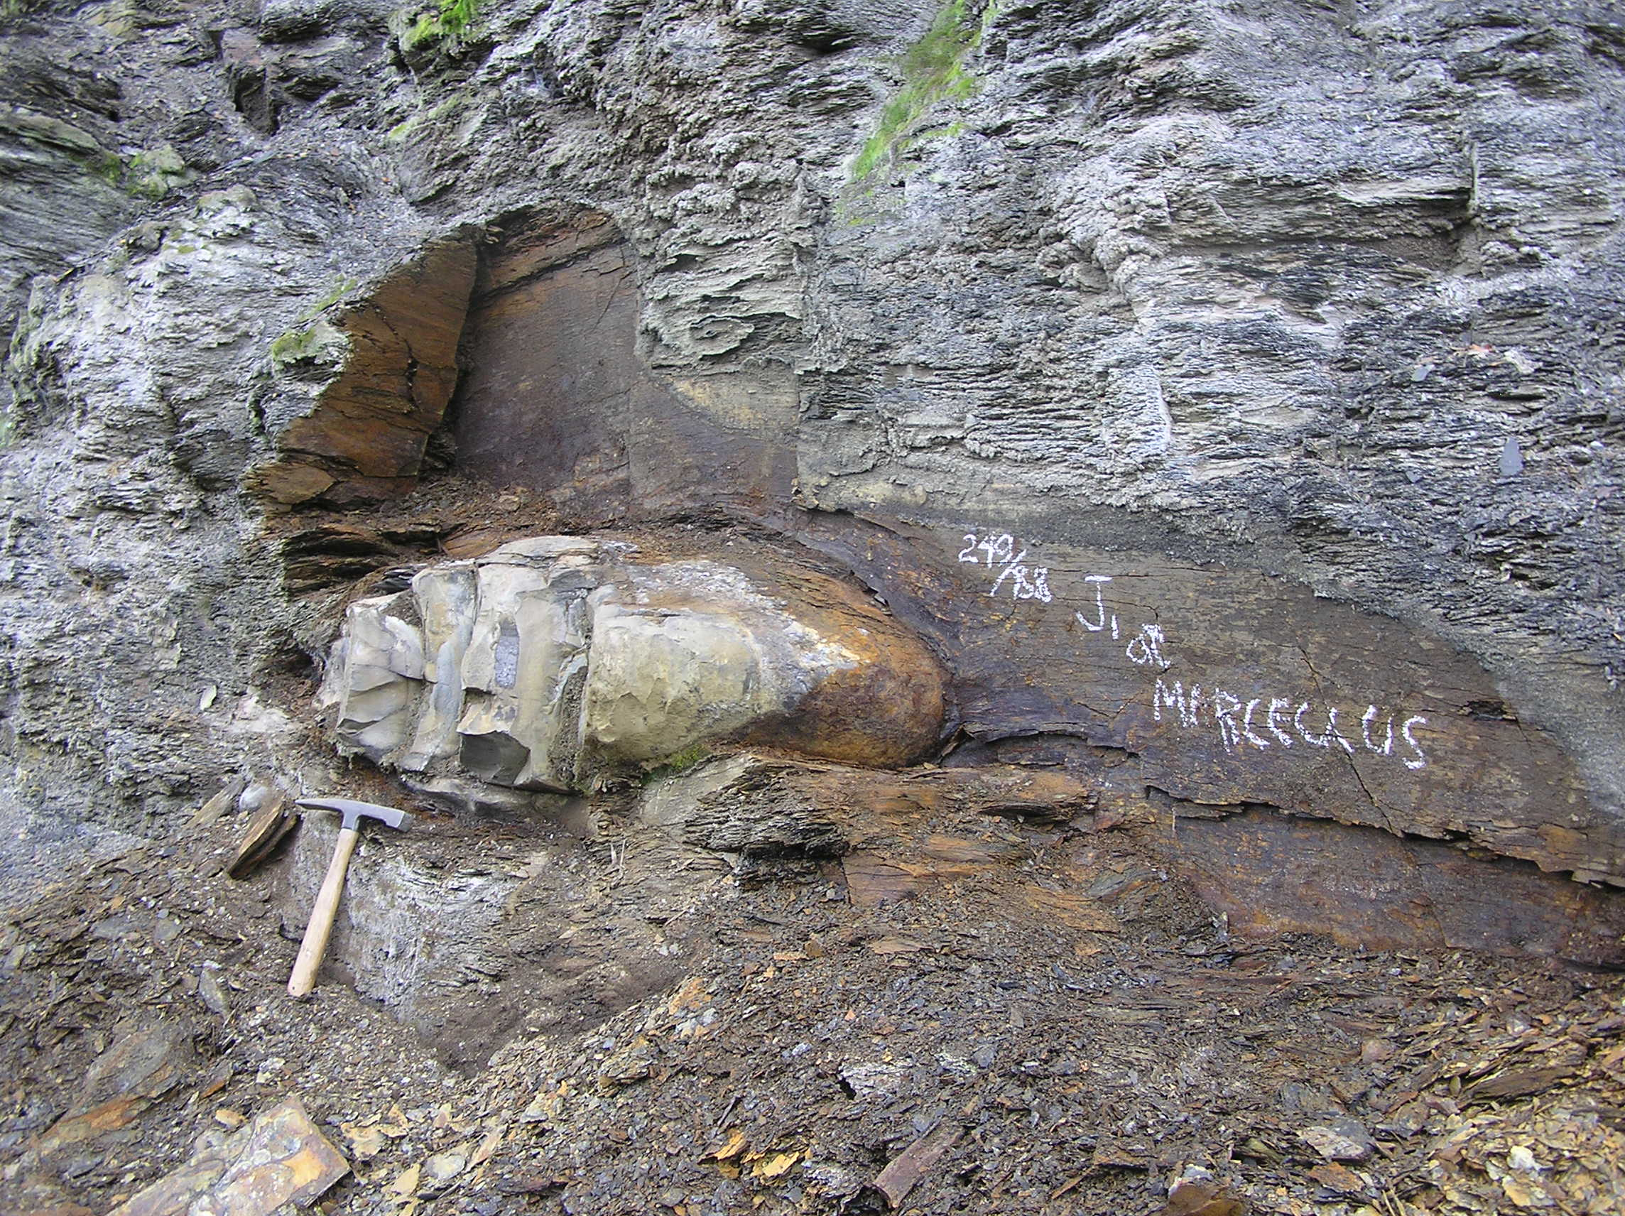
The type section for the Marcellus gas shale, Marcellus, NY

Slide 24
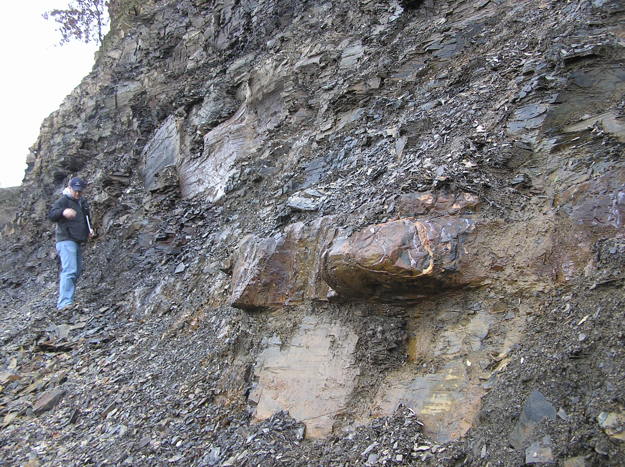
Recognized that hydraulic fracturing predates folding of the Marcellus in the Valley & Ridge
Marcellus: Elmsport, PA
David Cannon
Marcellus: Elmsport, PA

Slide 25
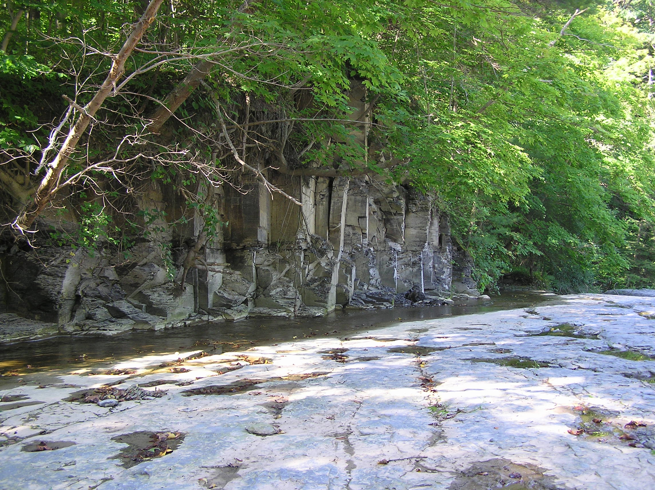
J₁
Levanna black shale
carbonates do act as frac barriers during downward propagation!
Stafford limestone

Slide 26
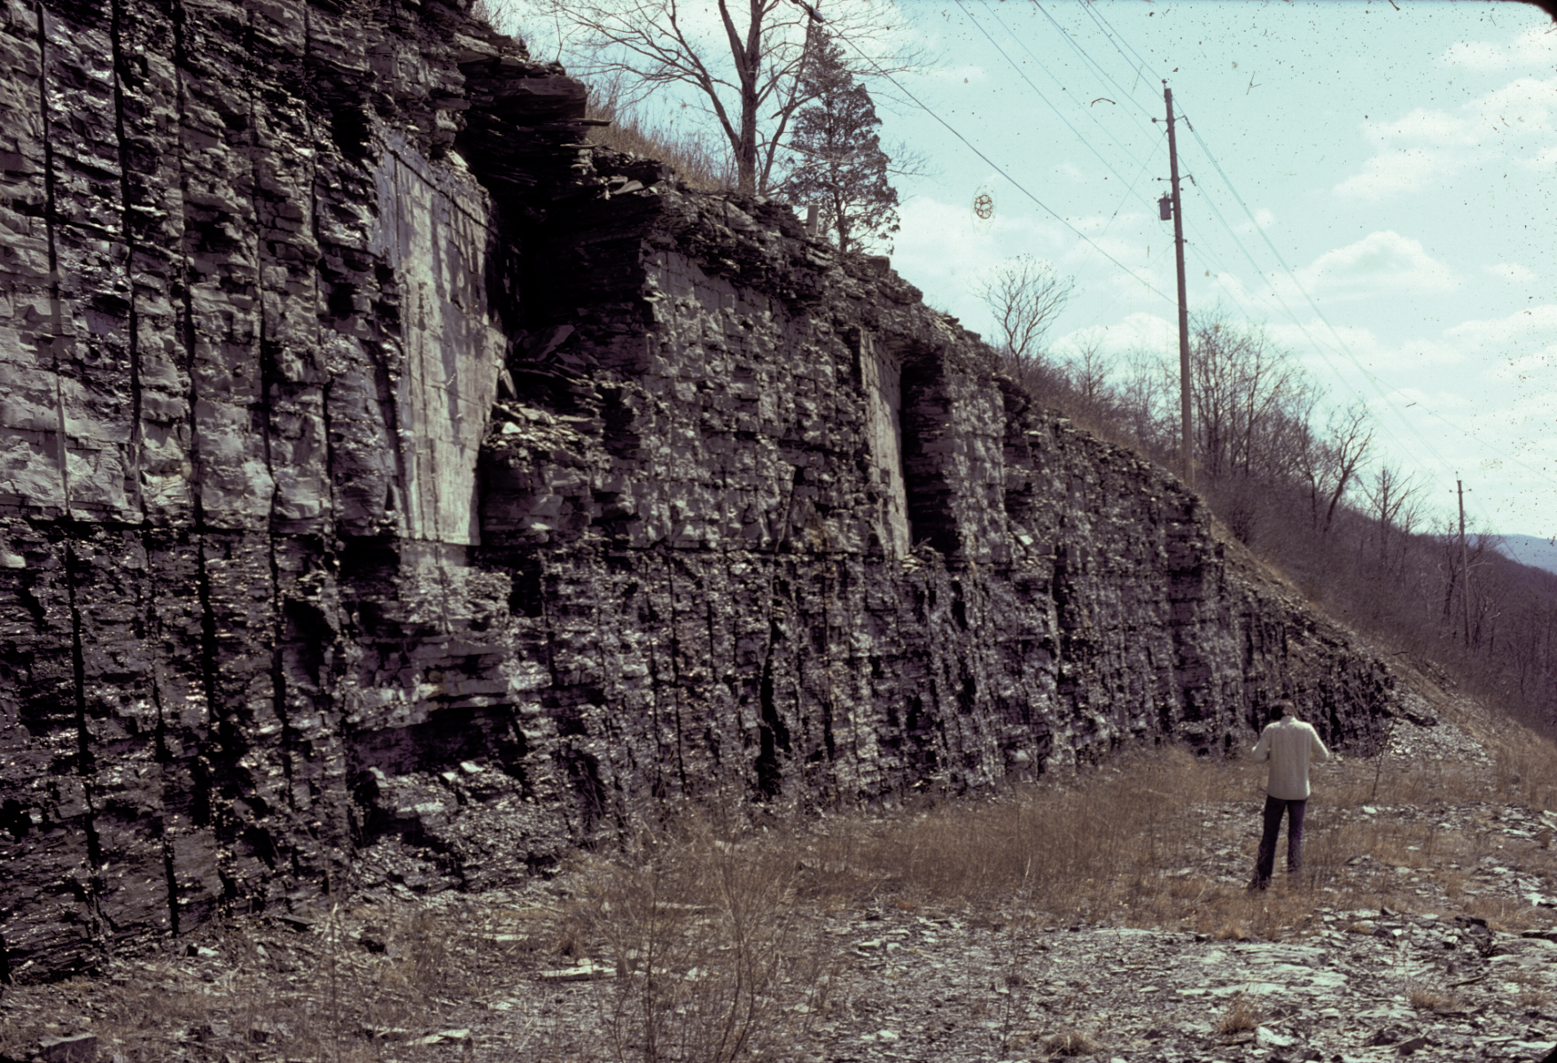
J₂
shale fracture barrier
shale
siltstone
shale
Siltstone of lower stress fractures before shale of higher stress

Slide 27
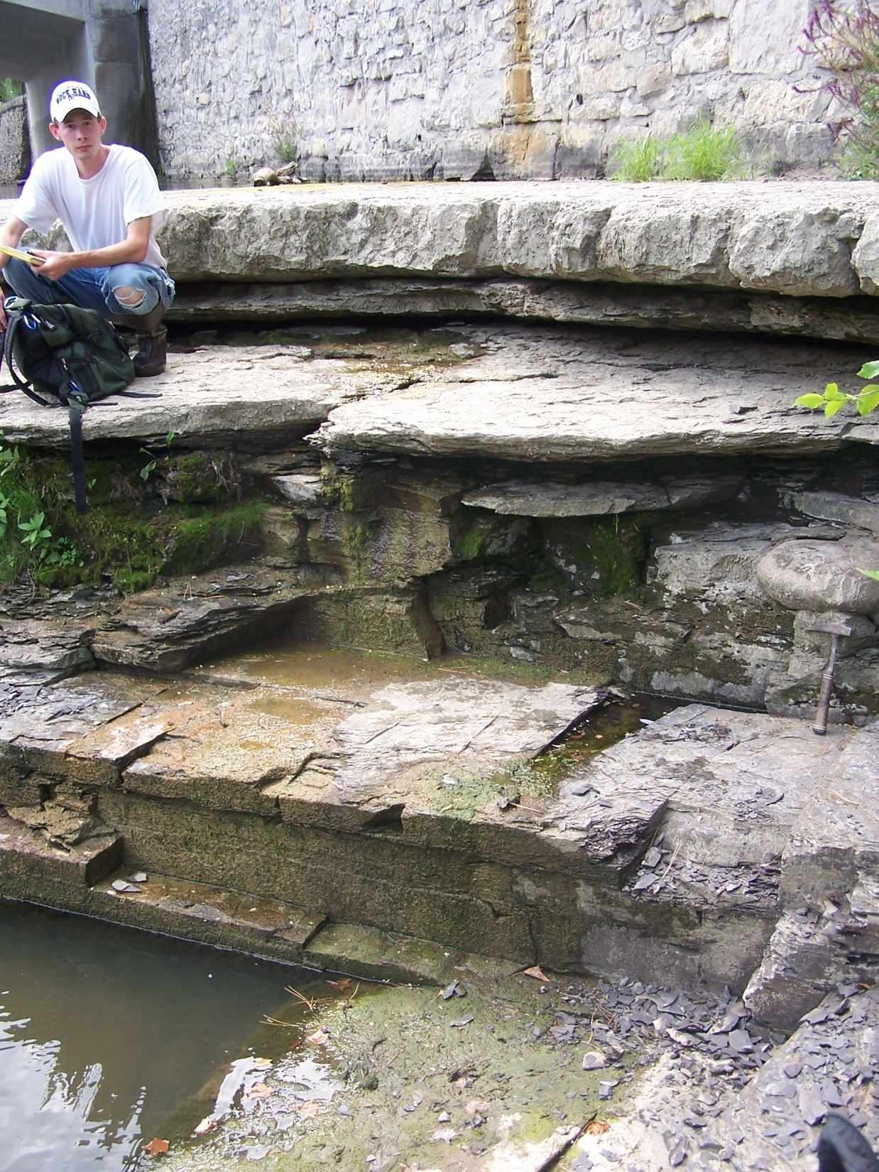
bridge abutment
limestone fracture barrier
Stafford
Limestone
J₁
Marcellus Shale
Oatka Creek Member
J₂
LeRoy, NY
Notes:
27

Slide 28
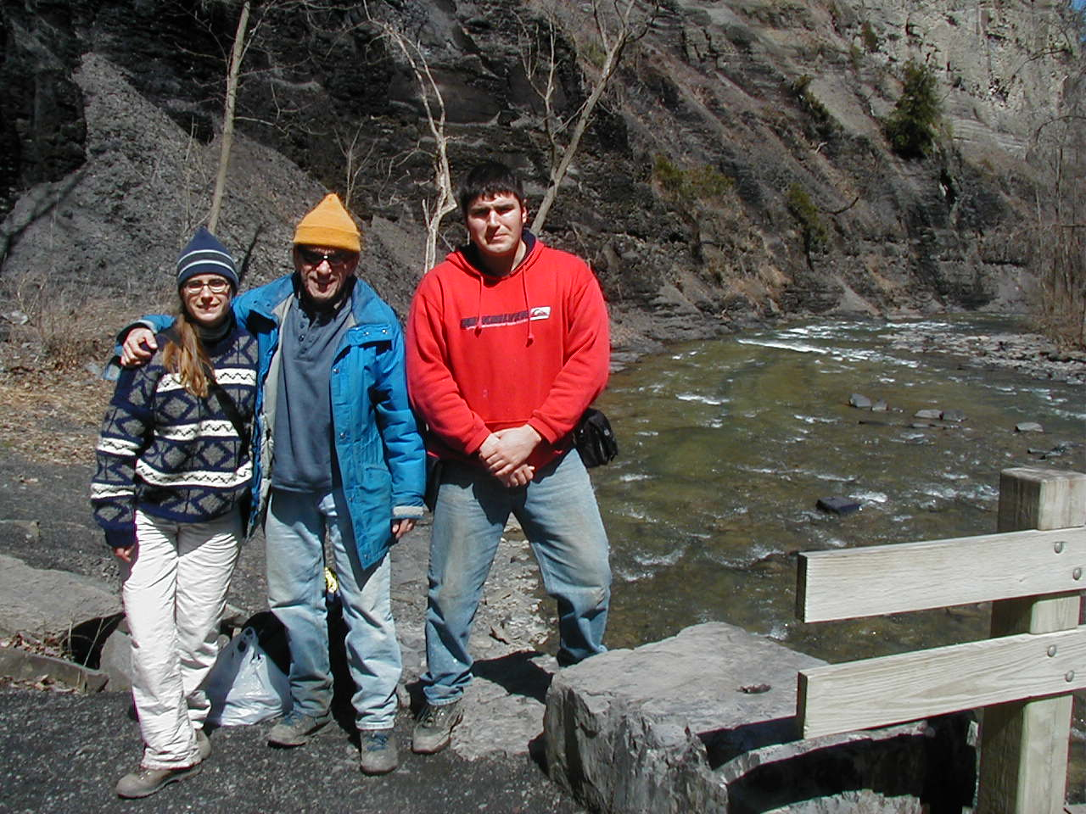

Amy Whitaker
Recognized that the early joint in Equitable’s Huron play was basin wide and related to plate tectonic stress

Slide 29
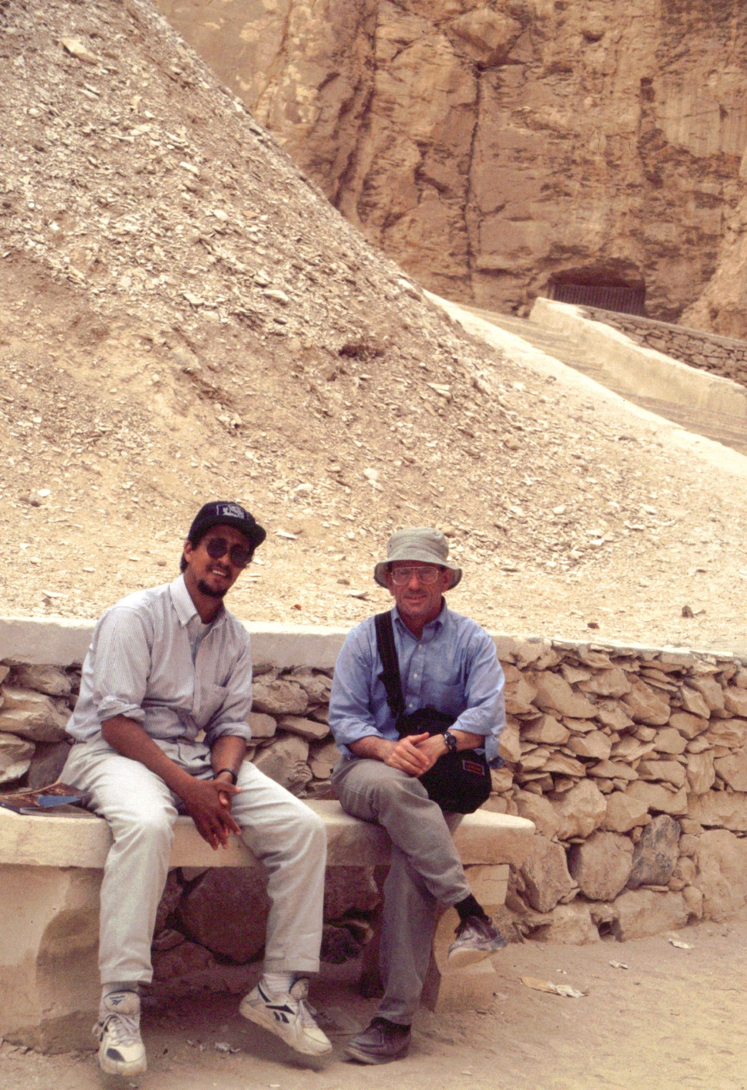

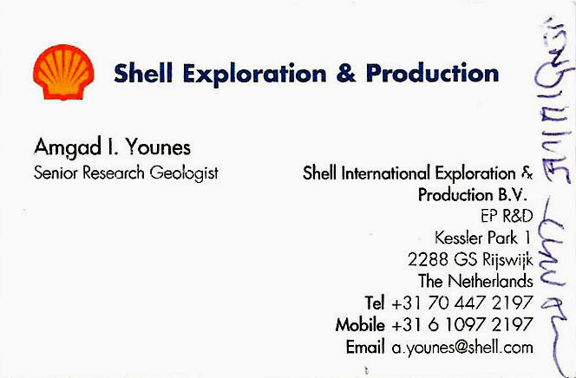
Amgad Younes
Recognized the role of stress reorientation during joint growth in the Appalachian Basin
Amgad Younes in Valley of Kings: 3 days before the discovery of KV 5

Slide 30
Map View of Two (2) Joint sets
Fringe Cracks
Parent Joint
Younes & Engelder (1999, Geological Society of America Bulletin)

Slide 31
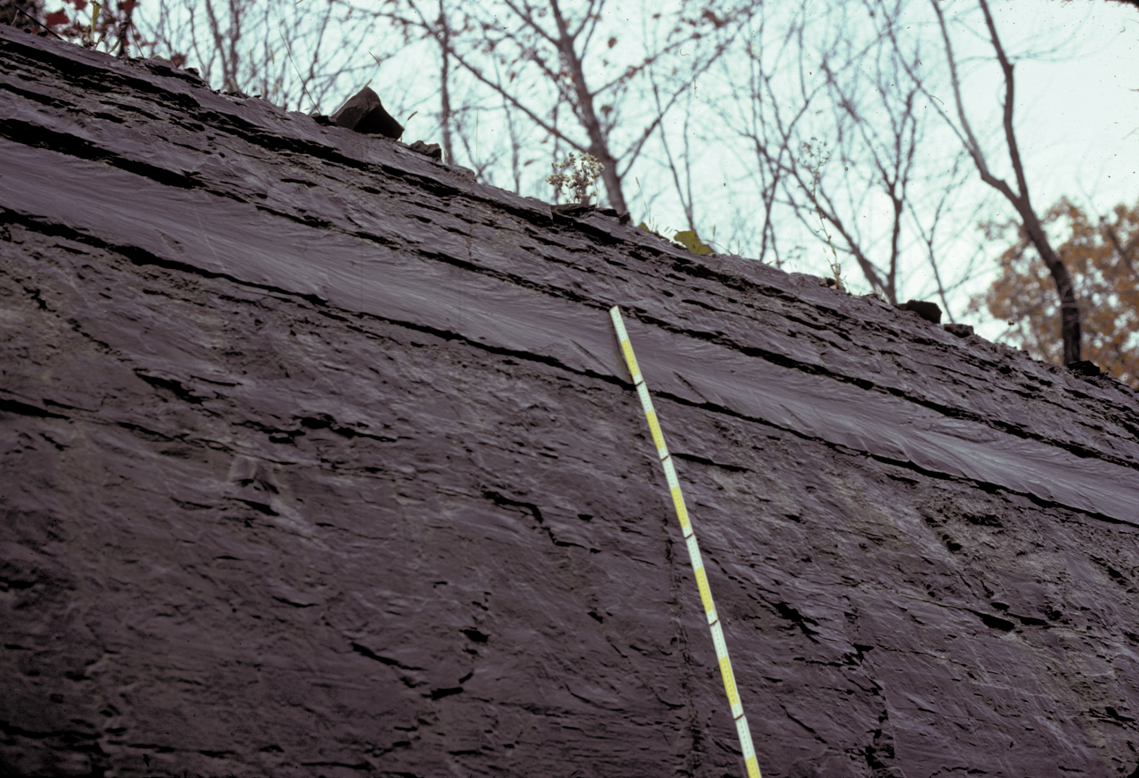
siltstone
shale
J₂
Siltstone bed within thick shale indicates NO incremental propatation (i.e. one continuous rupture)

Slide 32
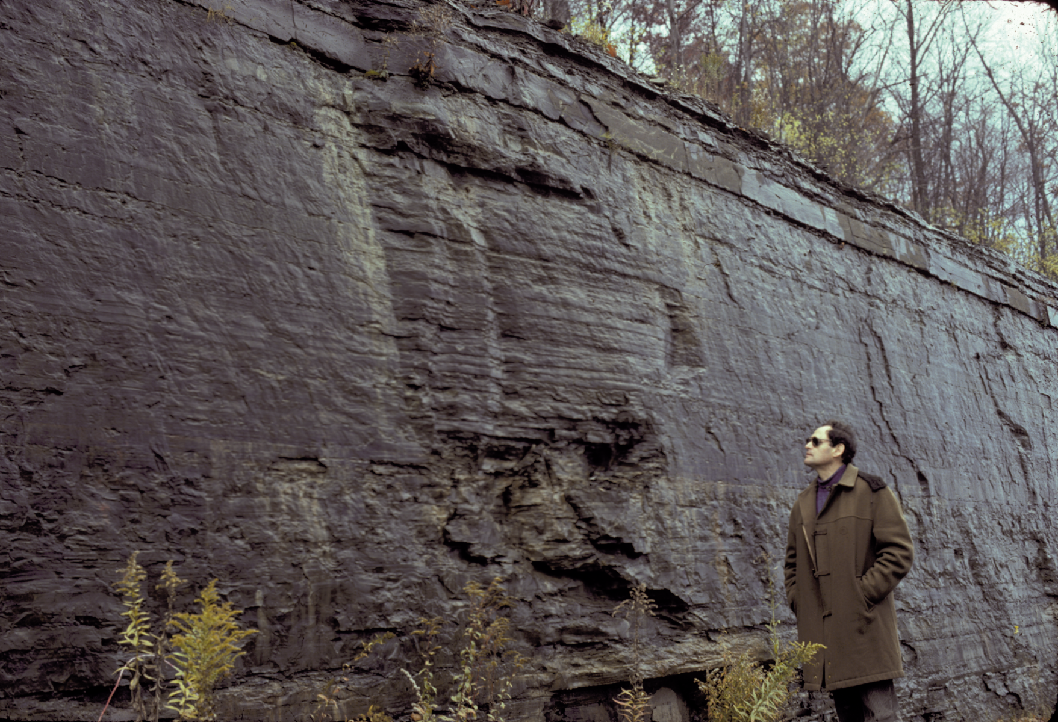
shale
J₂
Rib marks indicate end of massive rupture in thick shale bed

Slide 33
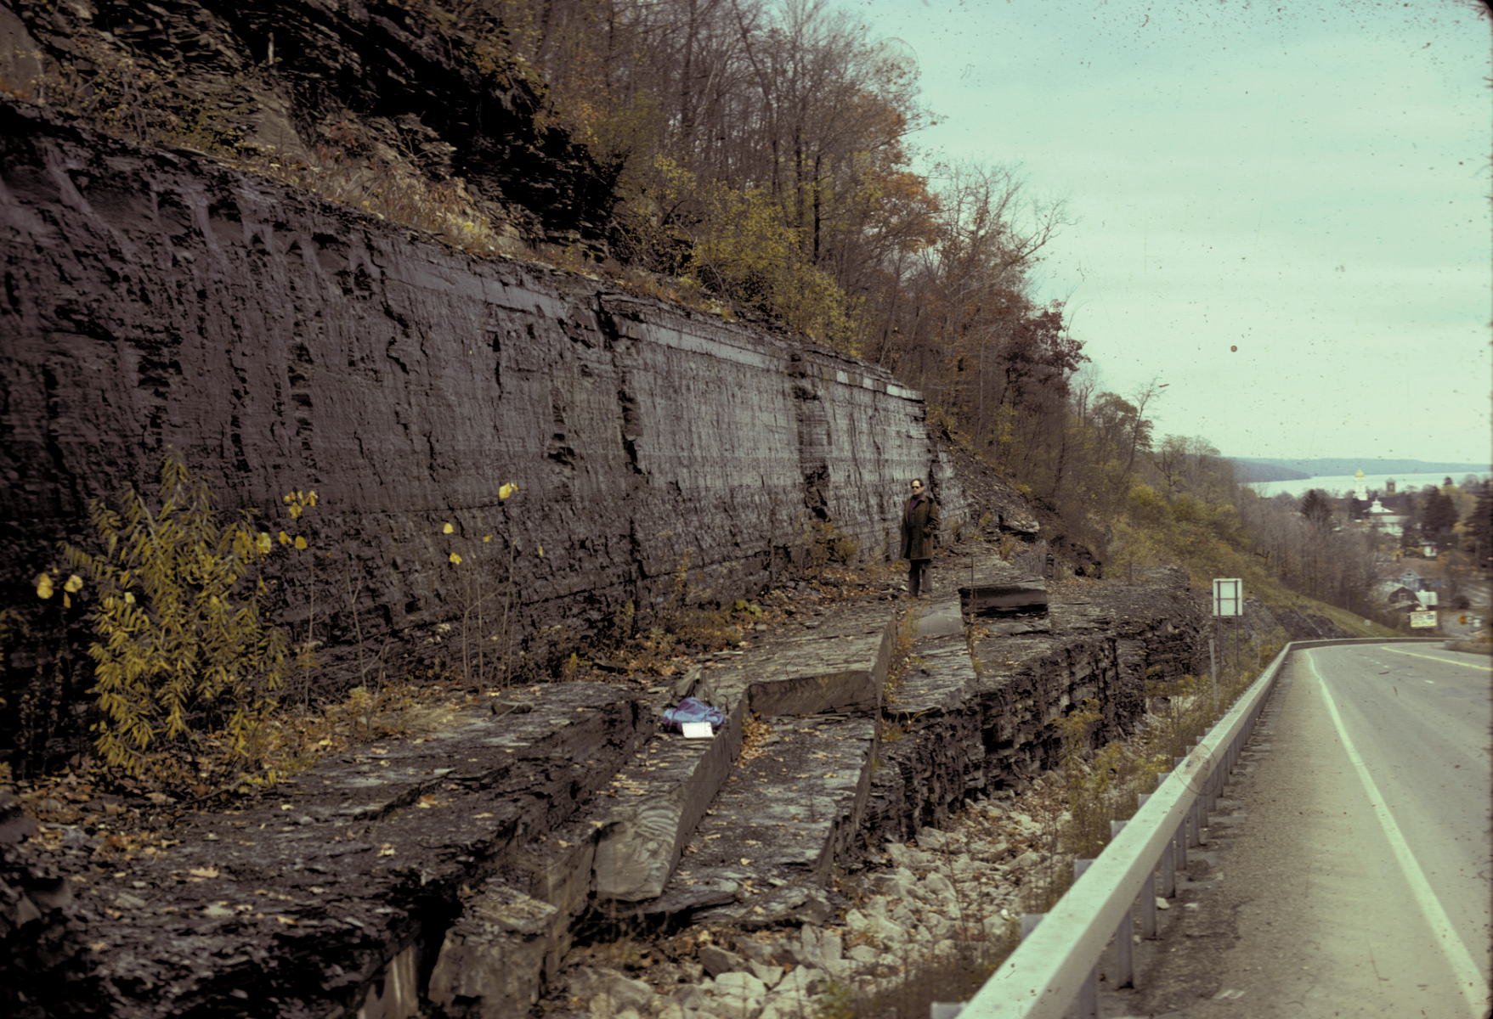
An example when a NHF are driven by large fluid volume!
By drawing from many tank trucks at the surface, industry can drive hydraulic fractures without interruption!
²J₂
Shale
siltstone
¹J₂

Slide 34
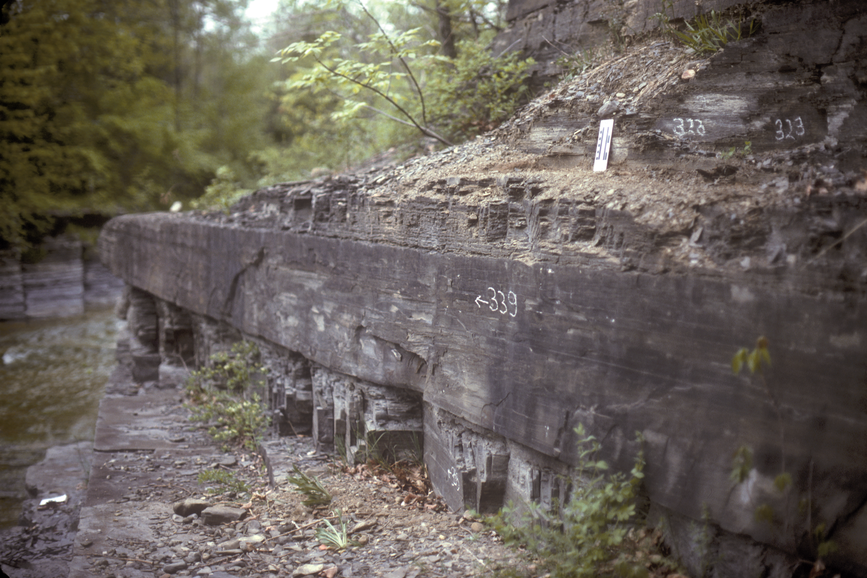
T-195
Parent joint serves as an analog for horizontal borehole!
Parent Joint

Slide 35
T-195
Increasing pressure eventually exceeds the frac gradient of shale!
Fringe Cracks
shale
siltstone
Parent Joint
shale

Slide 36
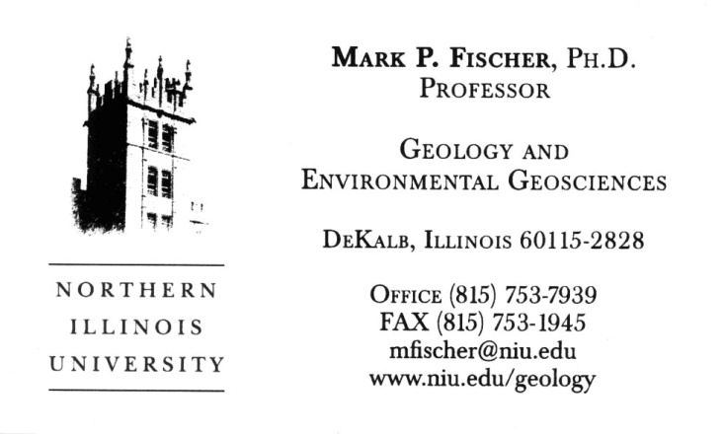
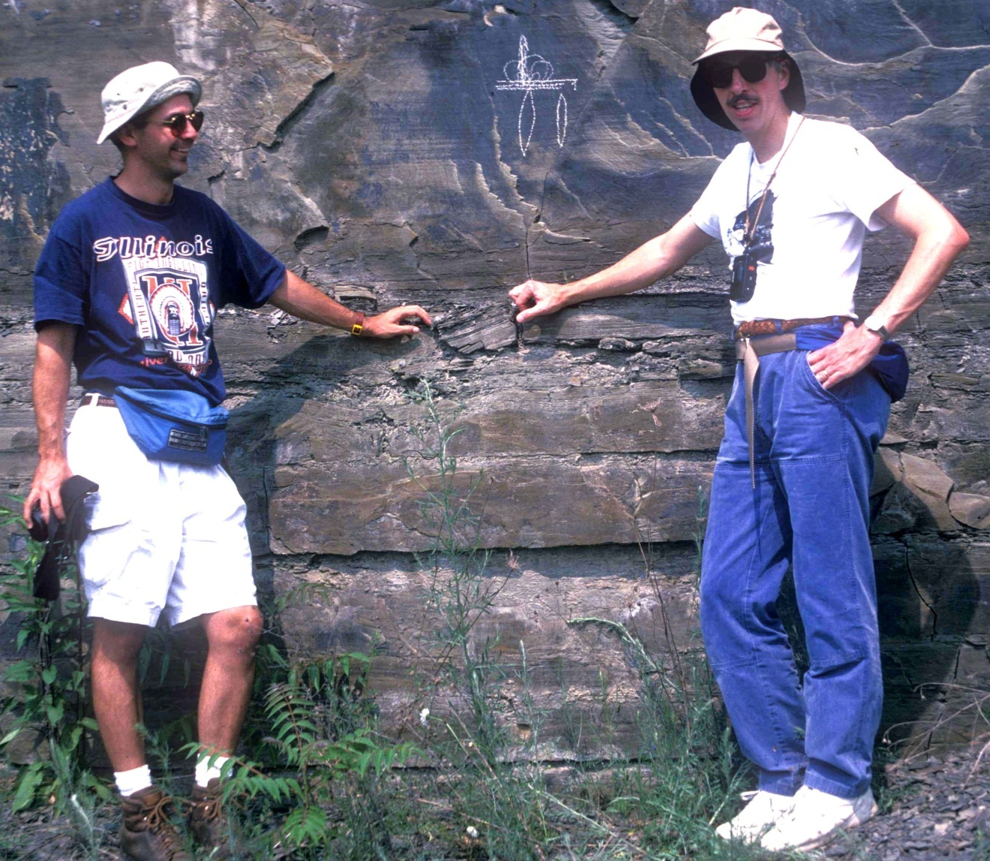
Mark Fischer
Recognized mechanism causing propagation pattern for hydraulic fractures!

Slide 37
What would happen when stimulating a horizontal well drilled at an acute angle to the stress field?
Stimulation Fractures
Horizontal Well
Maximum Stress

Slide 38
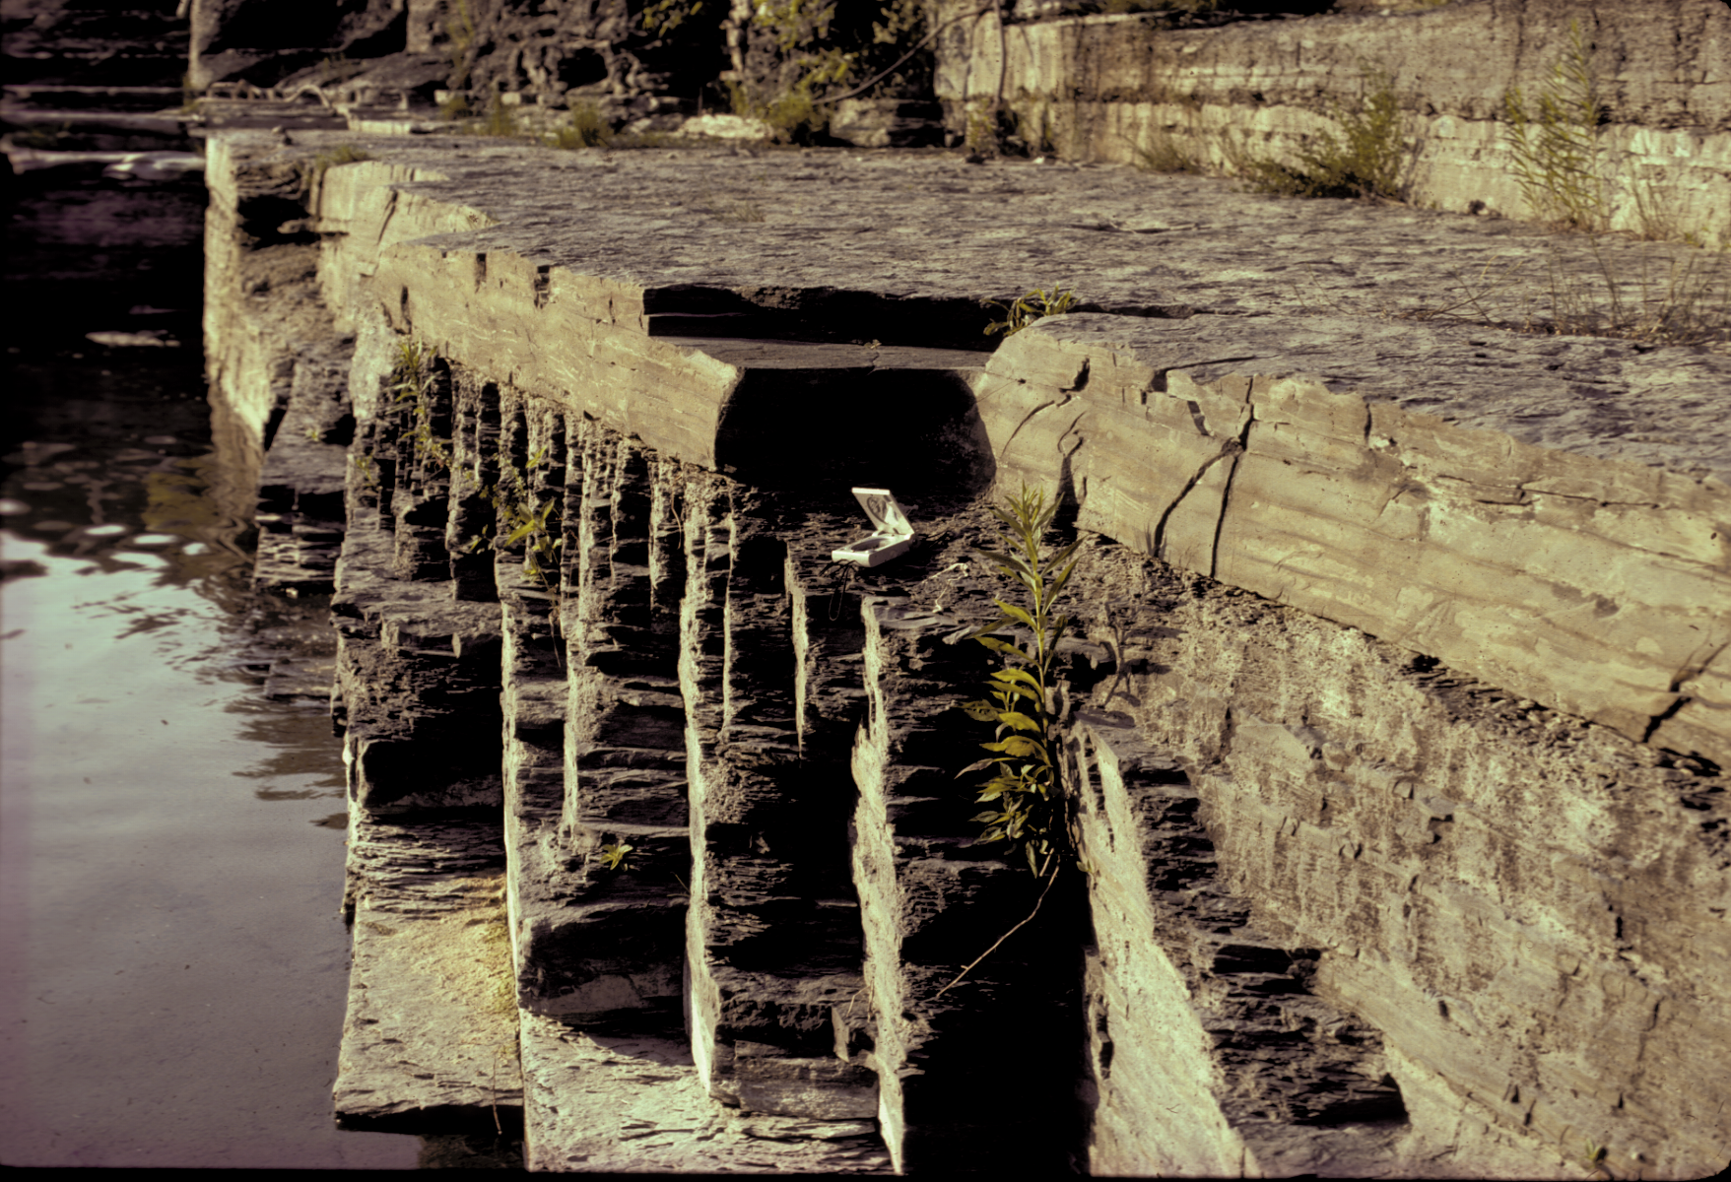
T-191
siltstone
shale

Slide 39
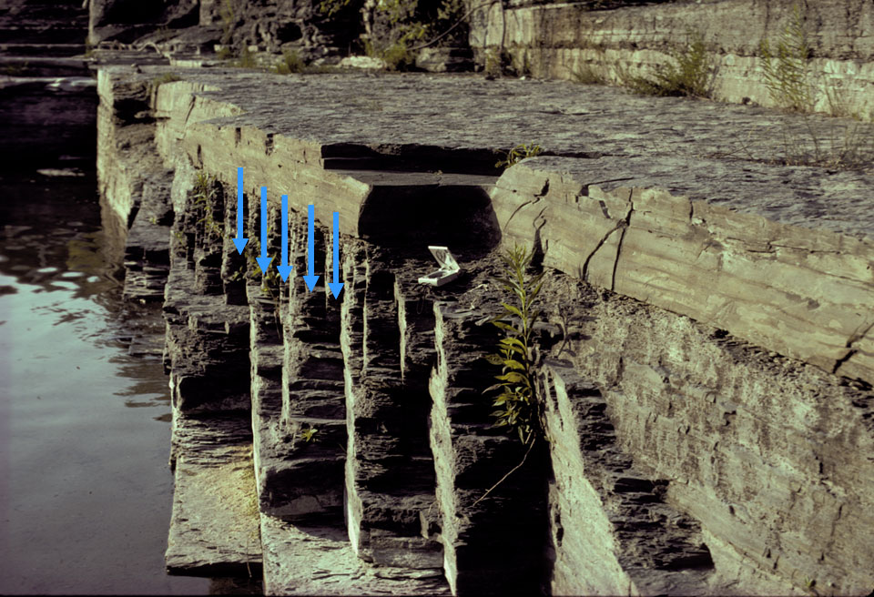

Slide 40
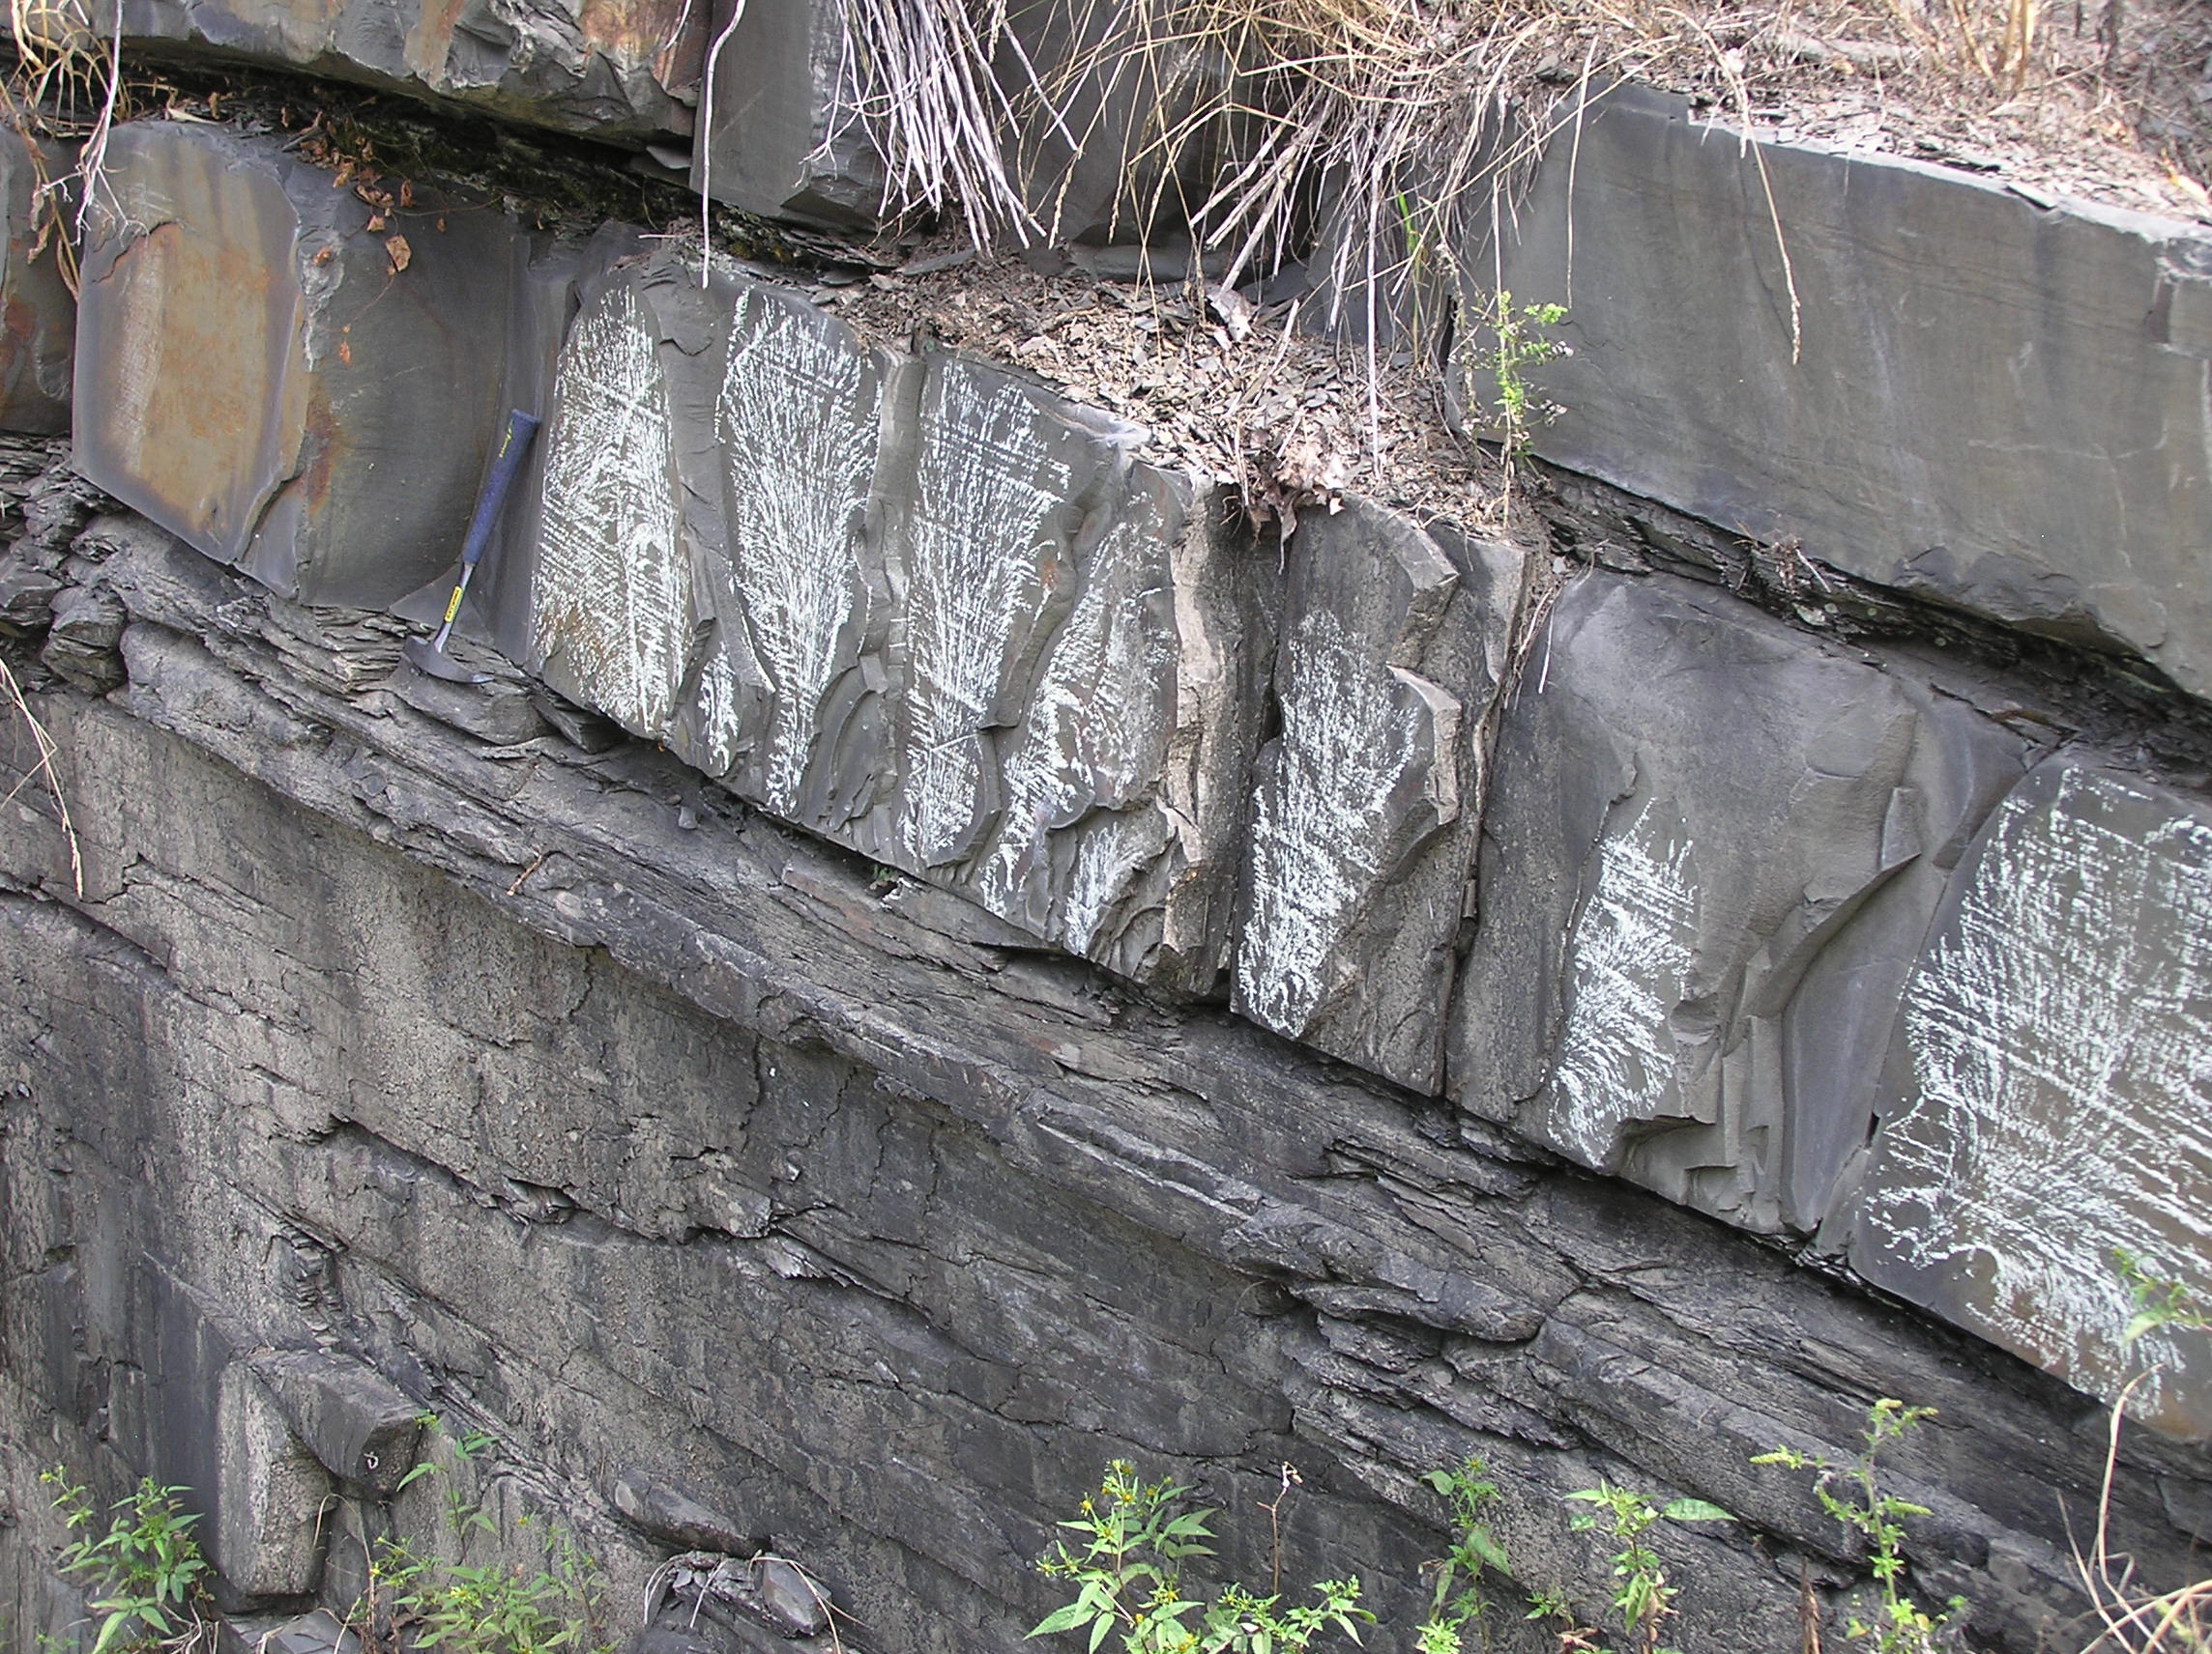
siltstone
Fringe Cracks
shale
Parent Joint

Slide 41
siltstone
shale
Not all fringe cracks propagate the full height of bedding

Slide 42
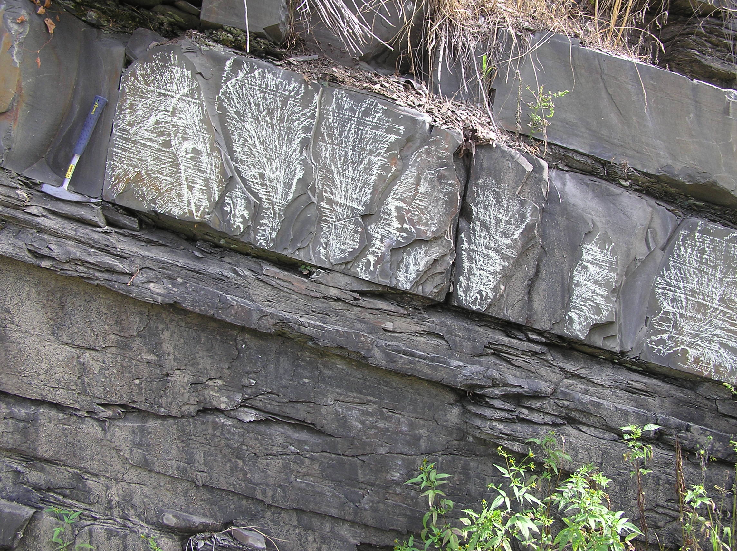
Fringe Cracks
Parent Joint

Slide 43
Stress shadow prevents simultaneous growth!
Crack
No grow zone
zone of high stress
Fischer et al. (1995, Tectonophysics)

Slide 44
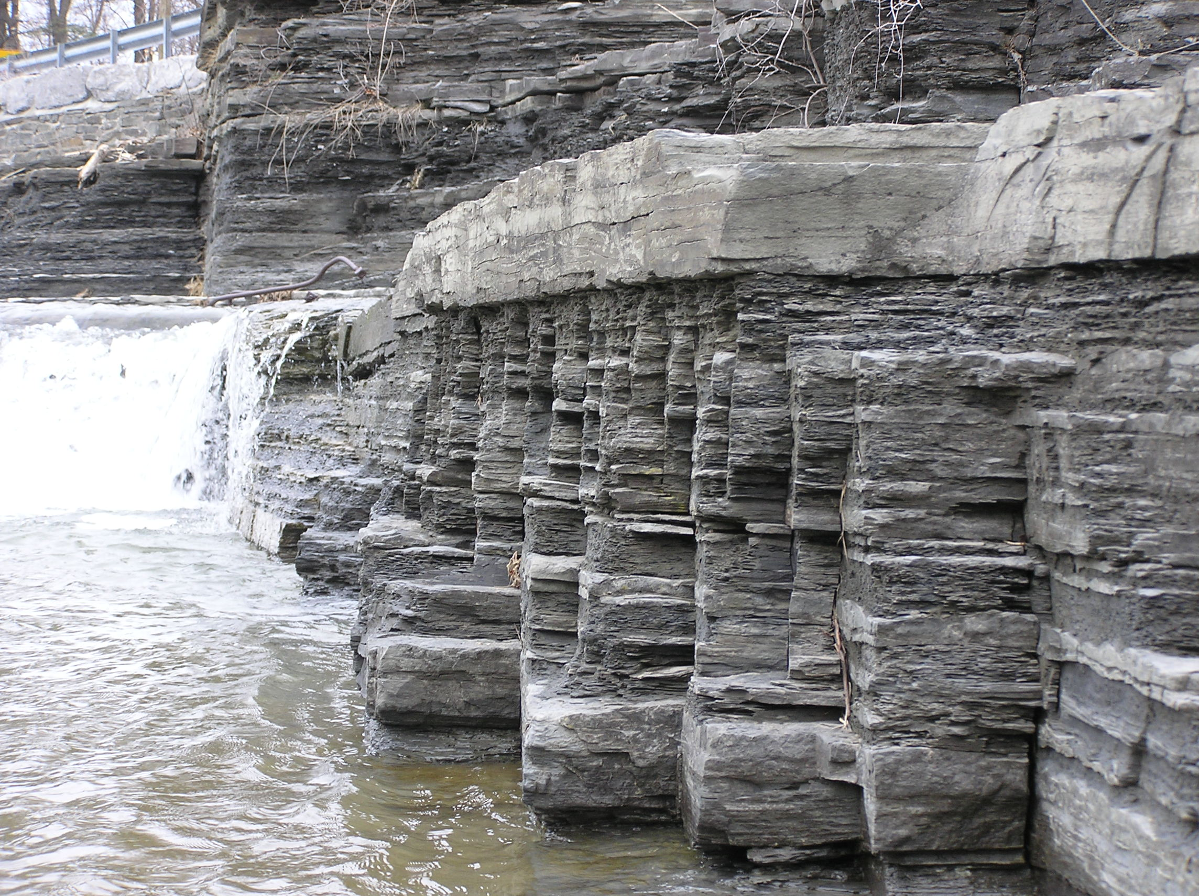
Horizontal well: Simultaneous propagation from open hole.
Stress Shadows: Neighbors compete for same ‘stress’ space during simultaneous propagation
Fischer et al. (1995, Tectonophysics)

Slide 45

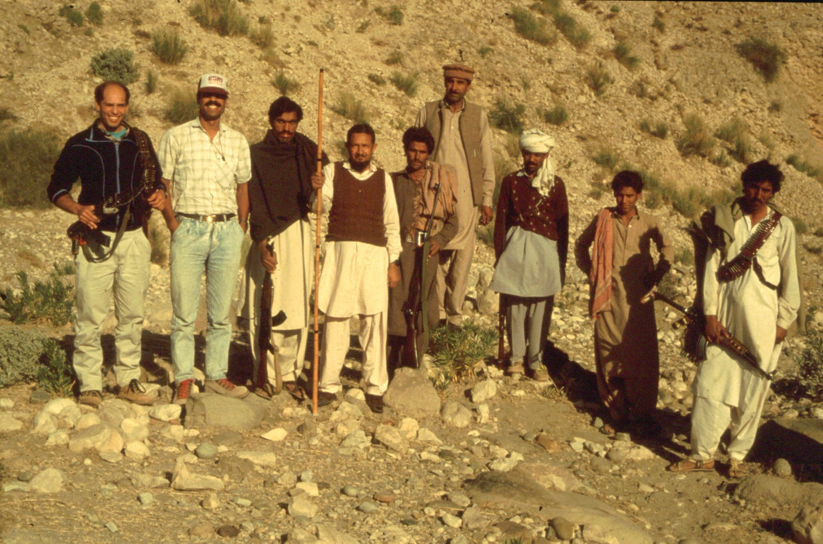
Michael Gross
Developed rules for spacing of joints
Mike Gross* up near the Afghan-Pakistan border
* One of the best fracture guys in America

Slide 46
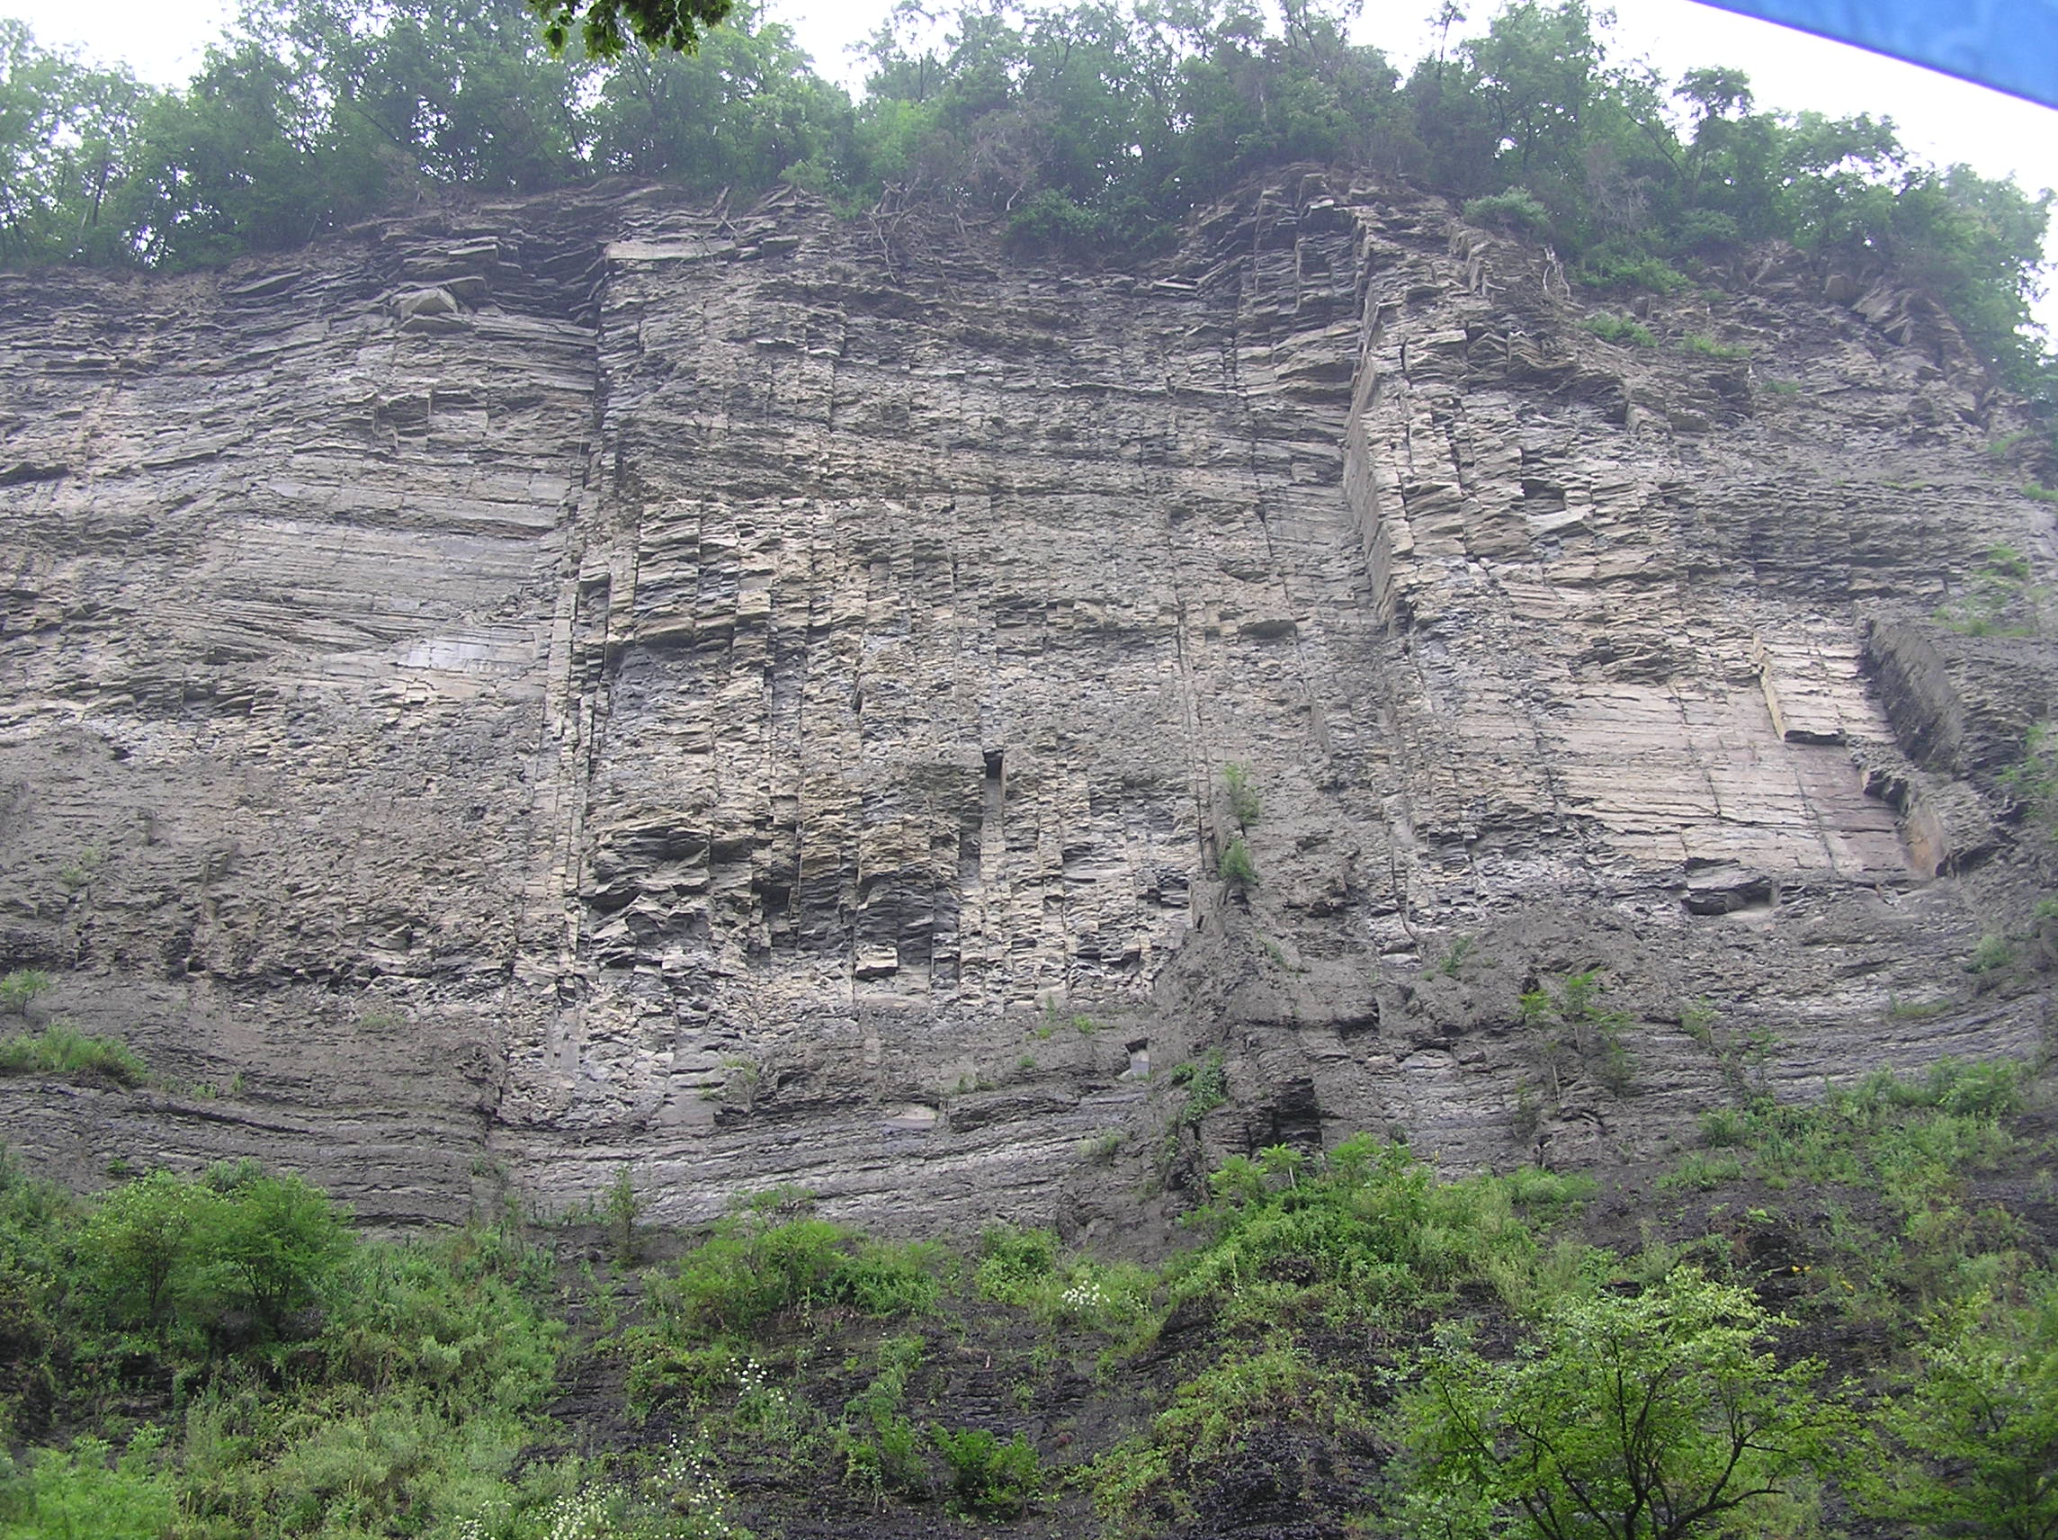
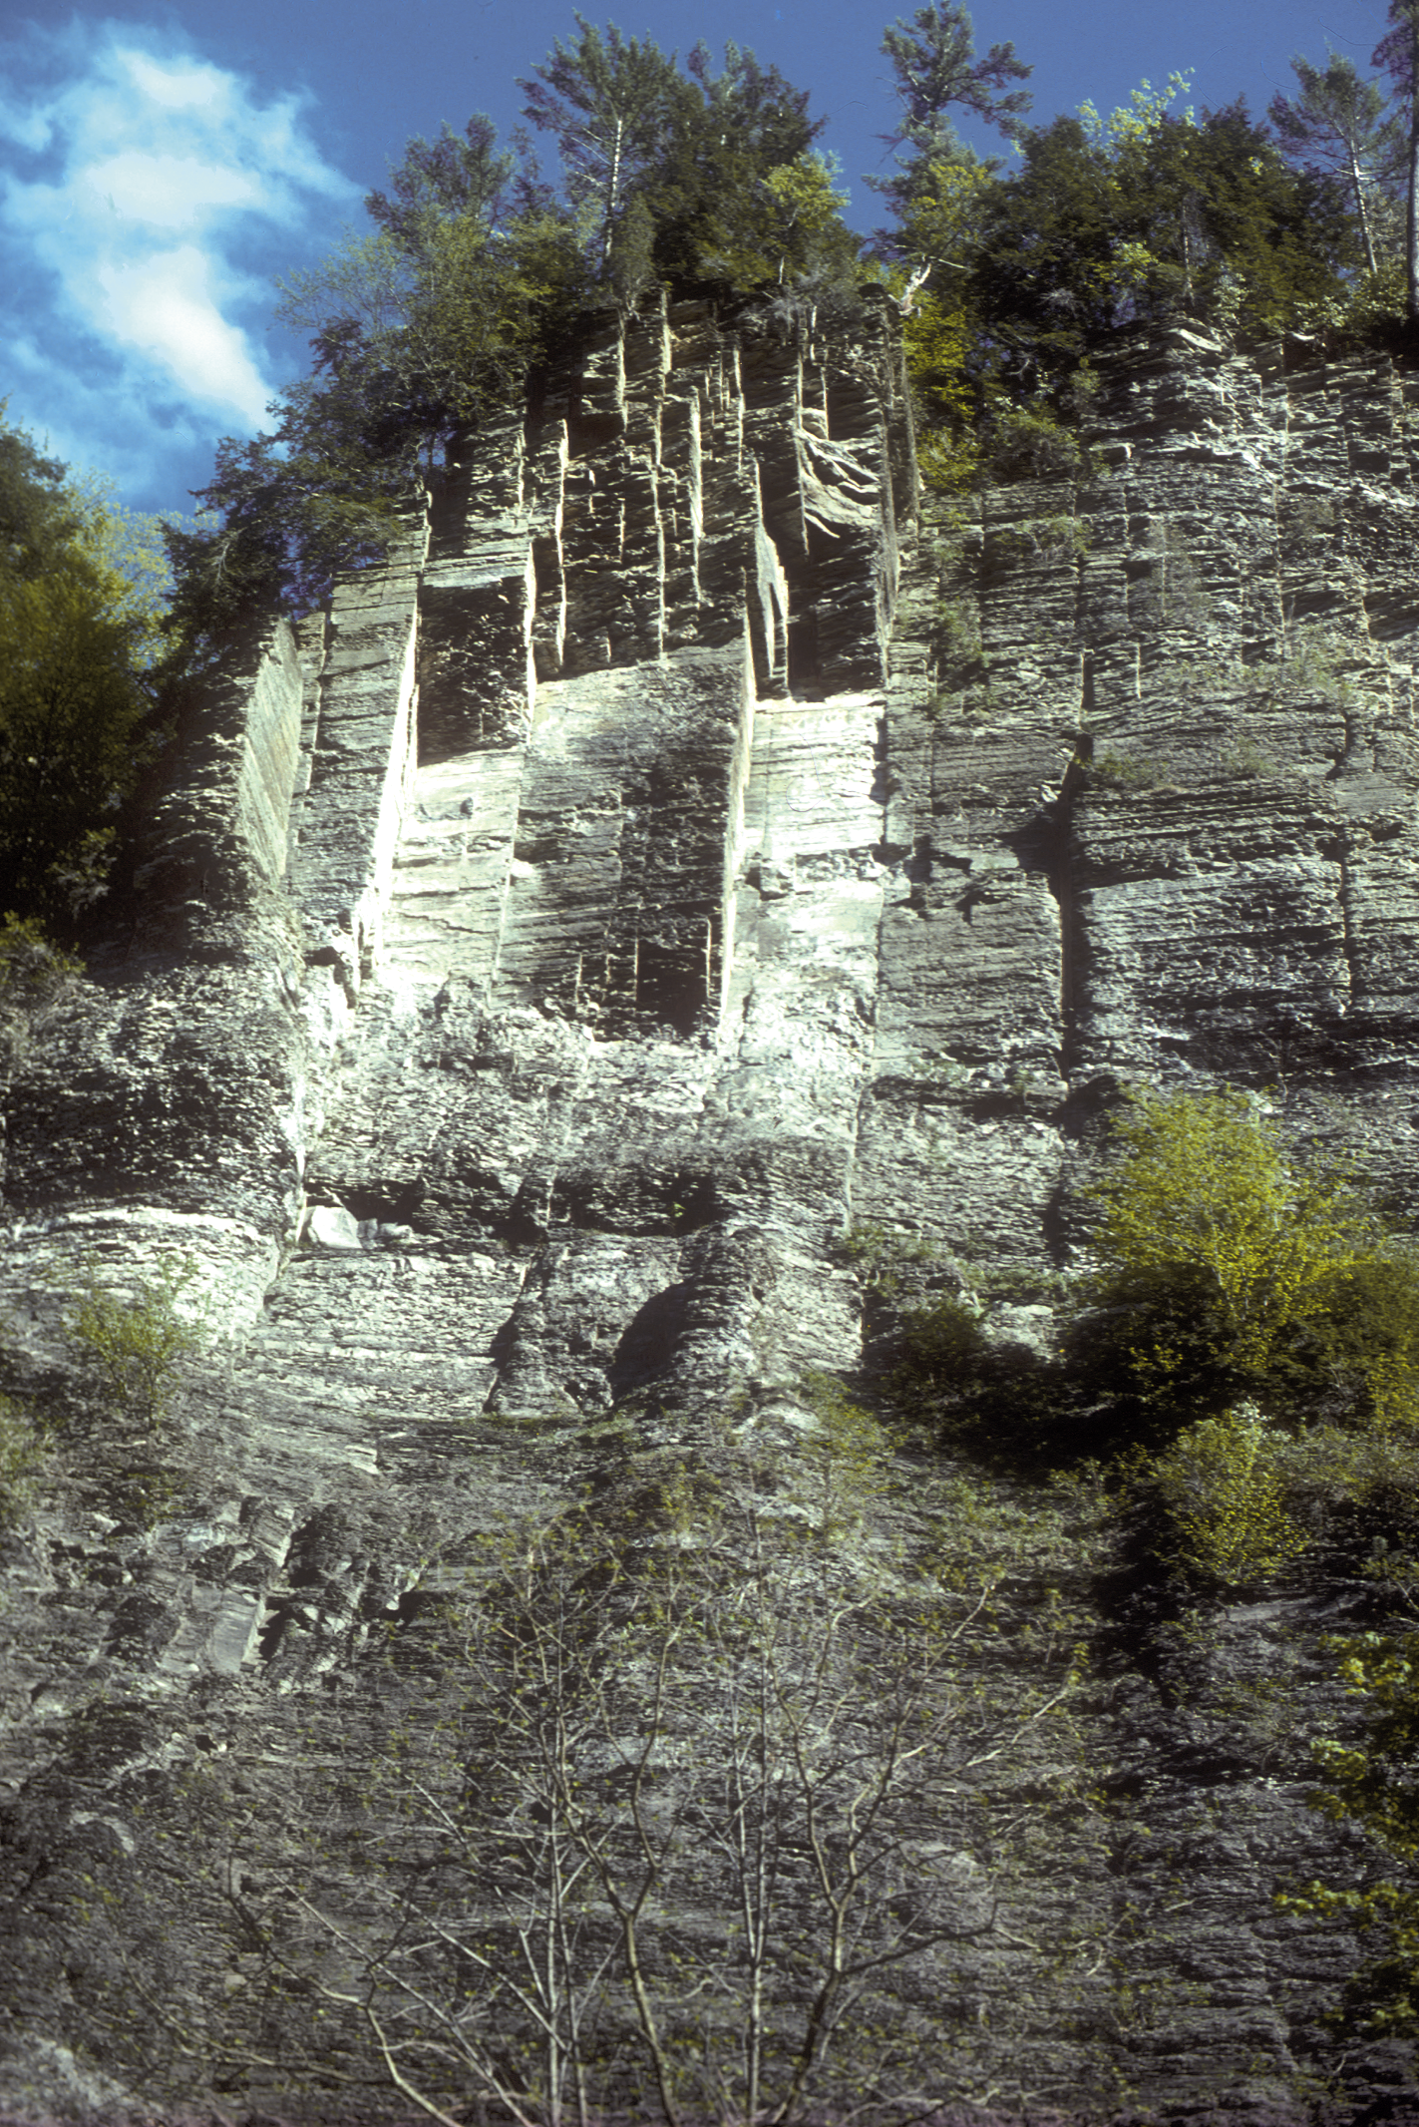
Taughannock Falls
Requires that joints not serve as permanent drains!
Lack of Stress Shadows: No competition for same ‘stress’ space during asynchronous propagation
Natural gas chimneys in gray shale (Cross-fold joints)

Slide 47
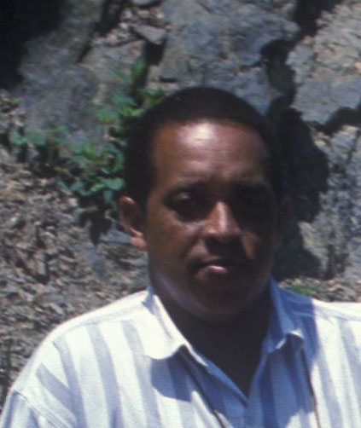
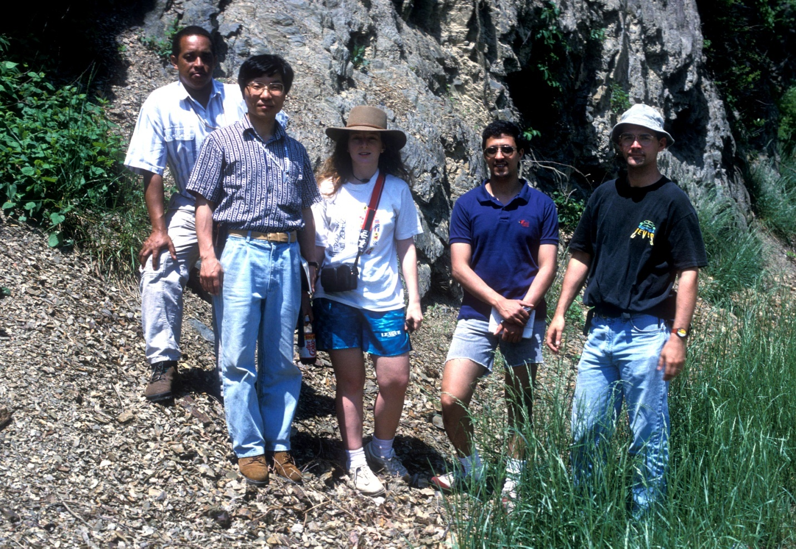
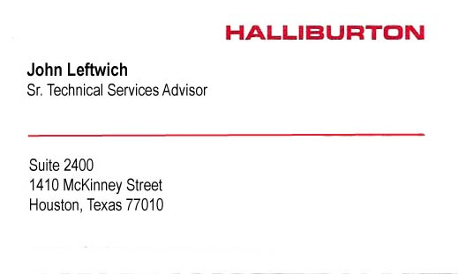
John Leftwich
Documented pore-pressure-depth profiles in basin including the Appalachian

