Slide 1
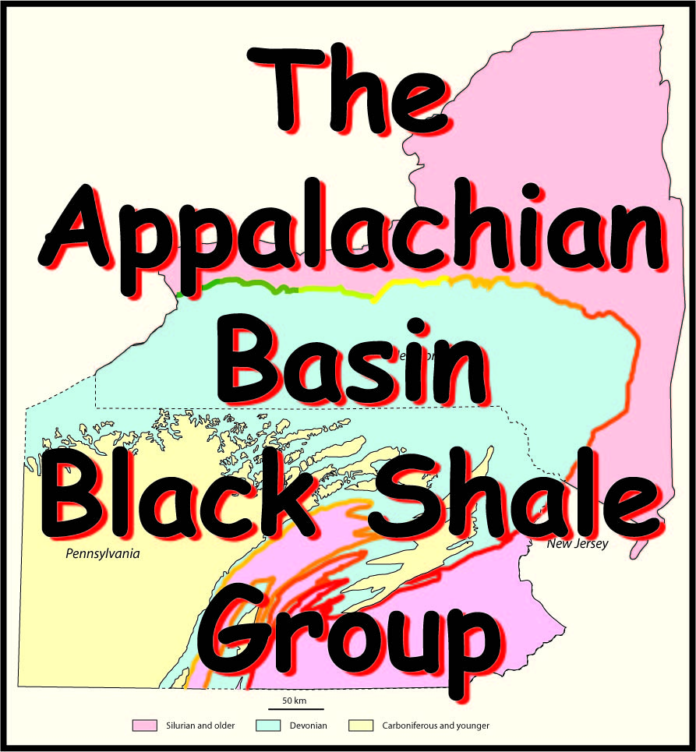
9. Fractures & Earth Stress

Slide 2
An Industrial Affiliates Group
To assist in the development of the emerging gas play in the Devonian black shale basin of Pennsylvania and New York.
All data including figures and maps that come with this collection of slides is proprietary and for the exclusive internal use of members of the ABBSG affiliates group.

Slide 3
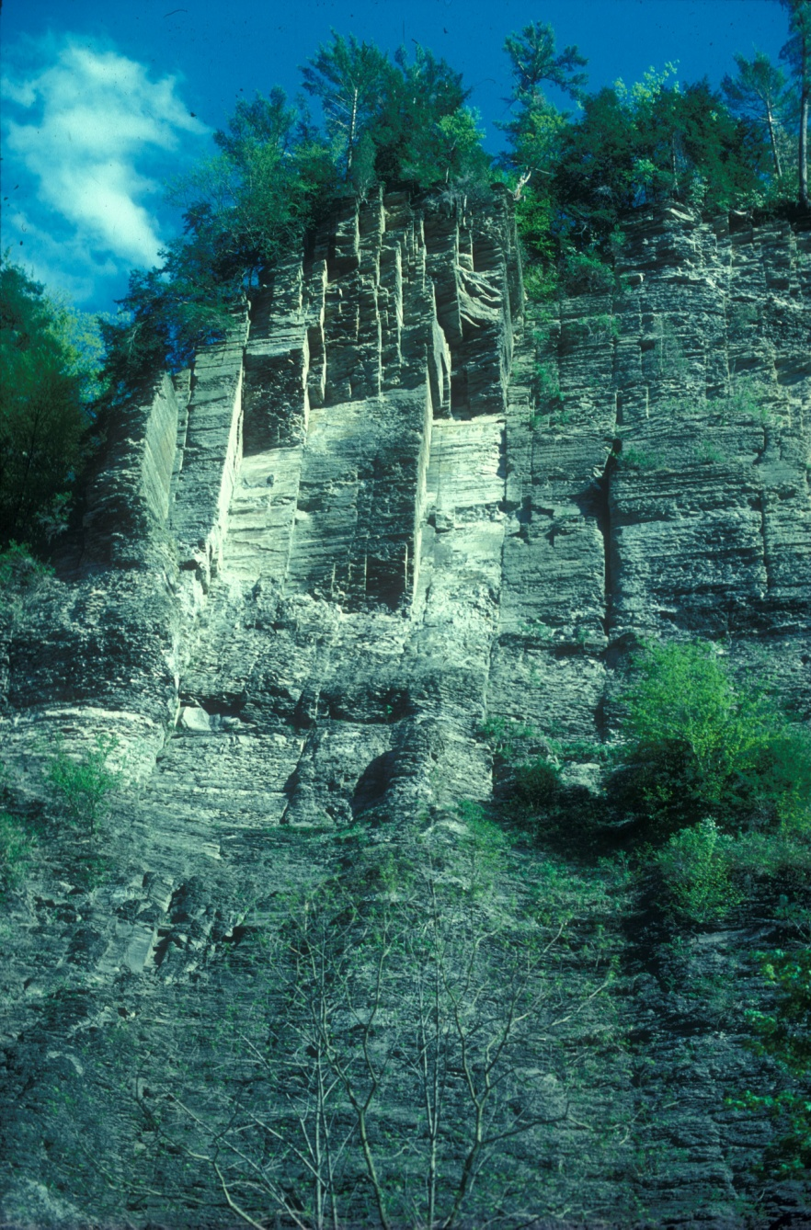
Setting the record straight
Production of gas from the Marcellus requires contact area
Contact area is generated through cracks in rocks
300 feet

Slide 4
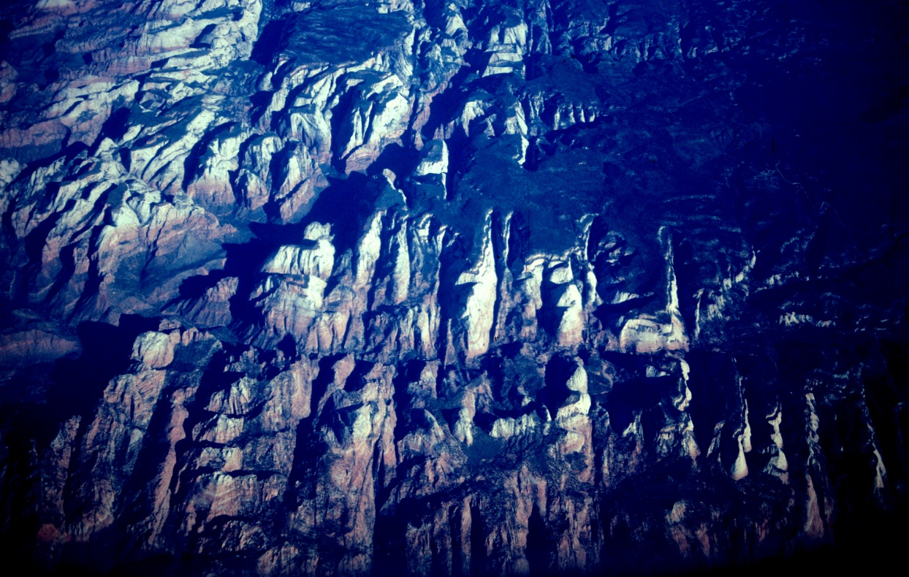
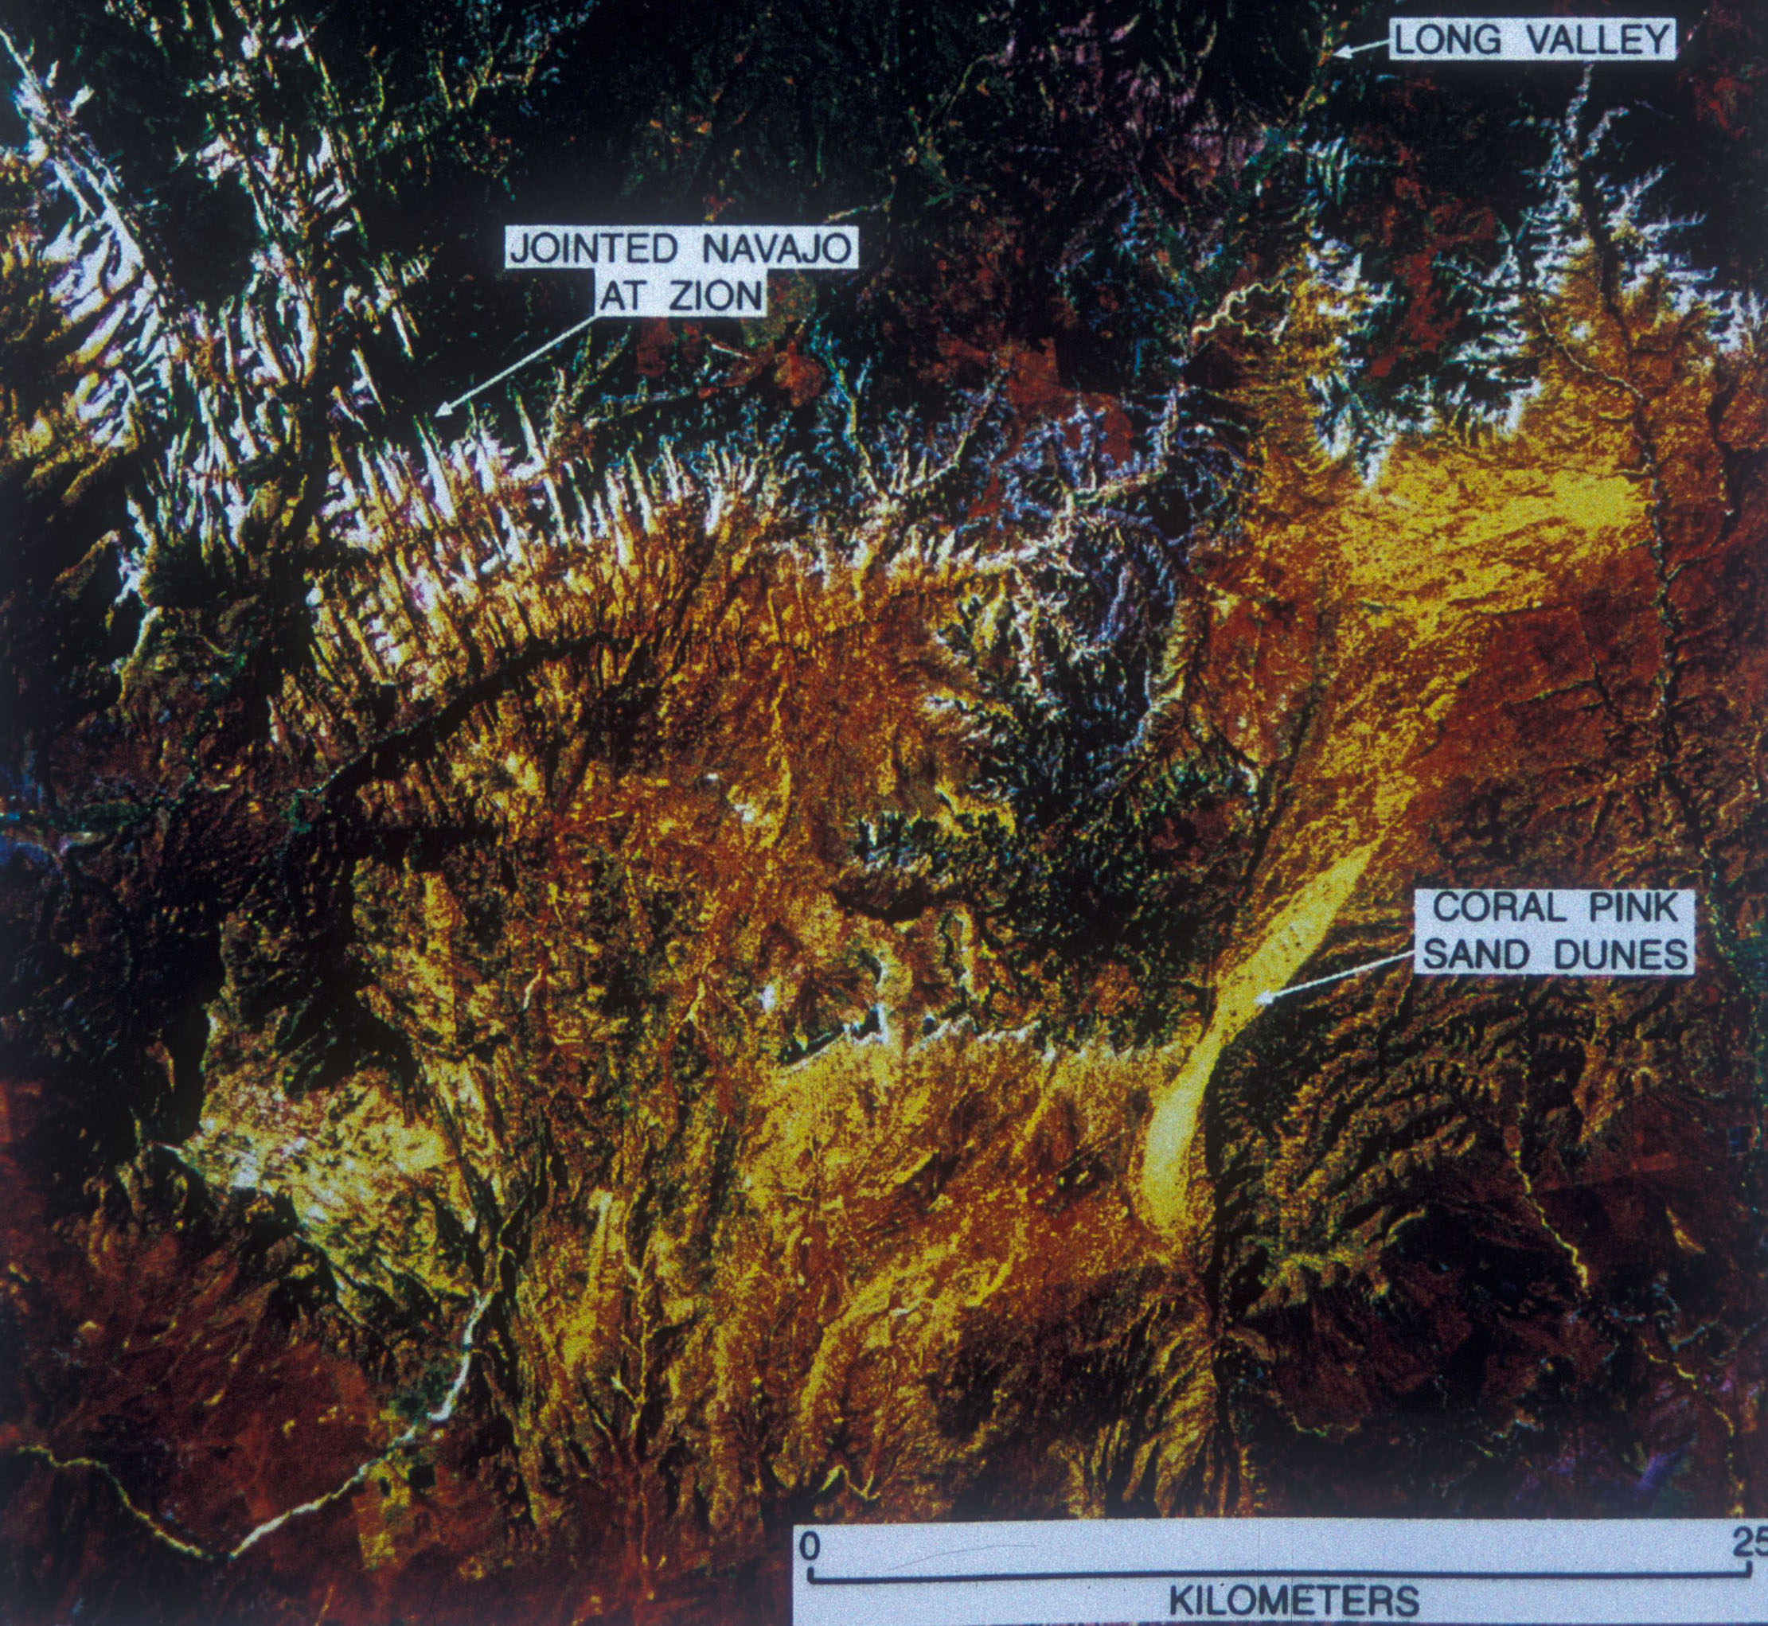
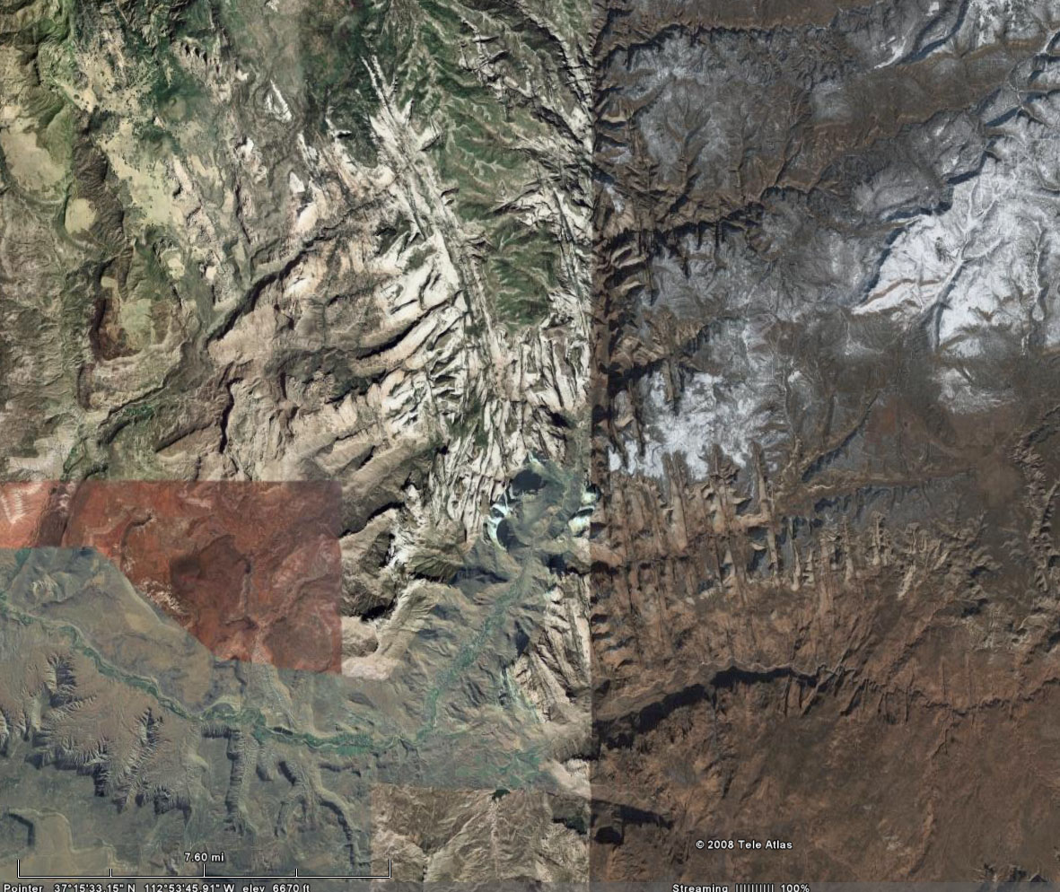
airplane window @ 30,000 feet
Zion National Park, Utah
Infrared satellite image
21 km
Cracks that are a central element of a National Park ?
Google Earth

Slide 5
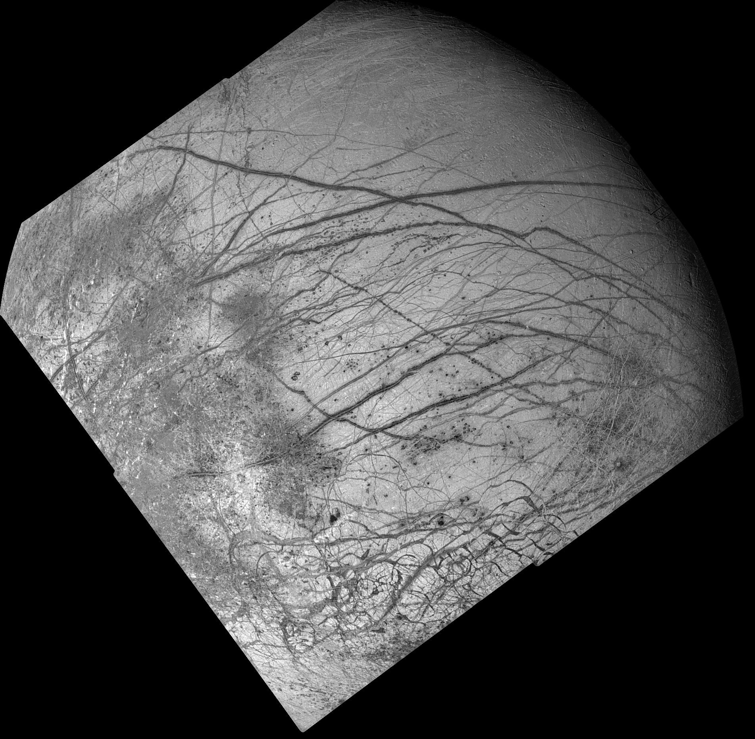
1600 km
Largest cracks in the solar system?
Europa: Cracks in outer shell of ice!

Slide 6
There is a connection between this famous painting and the Marcellus
Most valuable cracks in the Solar System?

Slide 7
Terminology
Geological Scientist
Art Conservationist
Fracture
Fracture
Crack
Crack
J₁
J₂
Joint
Fault
Craquelure

Slide 8
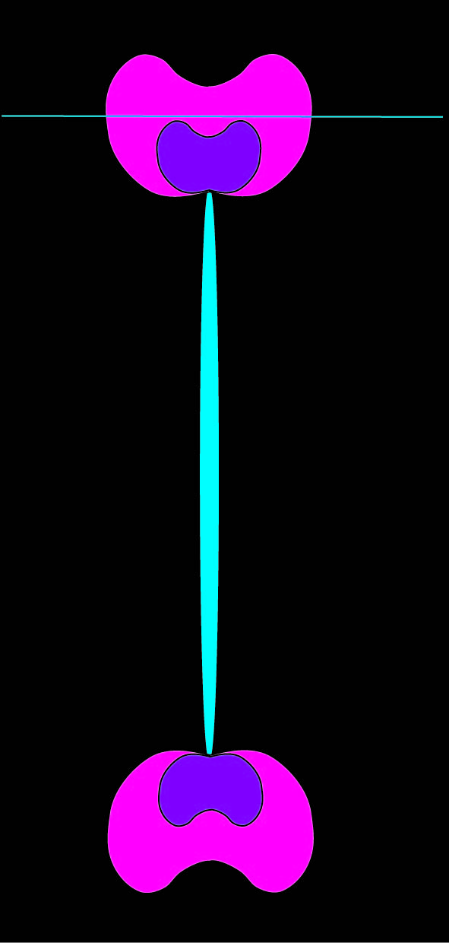
Joints may be distinguished by driving mechanisms
Map of stress at crack tip
Crack being forced open by water
tension
compression
S_{h}
-S_{h}
Mona Lisa Europa Zion NP
Marcellus
Crack being pulled open
Natural Hydraulic Fracture
Tensile Joint

Slide 9
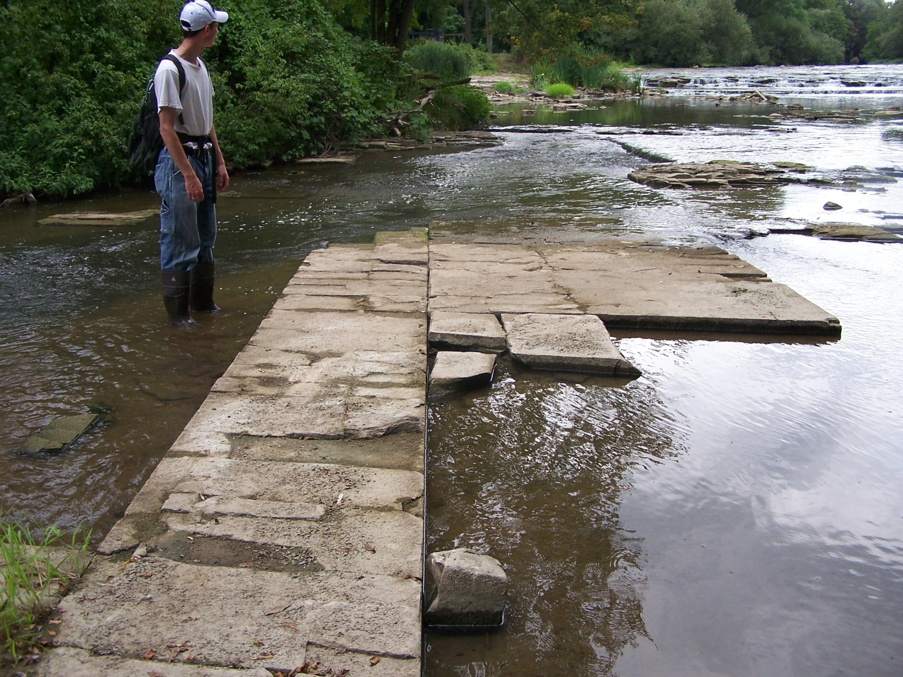
AAPG
March 2008
EXPLORER
Marcellus: Joints = $$$
Appalachian Spring
A new shale play emerges in the East

Slide 10
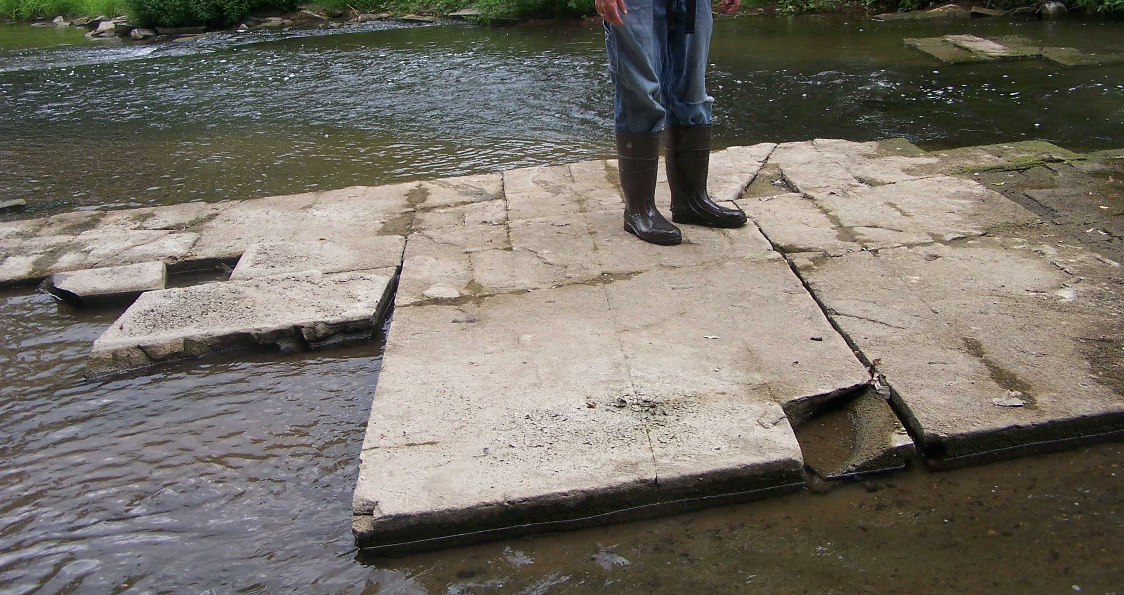
Contact Area
A shale is so impermeable that contact area (joint surfaces) is critical in allowing a flow rate of gas that makes economic sense!
Marcellus: Leroy, NY
J₁
J₁
J₁
J₁
J₁
J₁
J₁
J₂
J₂
High contact area!
J₂

Slide 11
Contact Area
A shale is so impermeable that contact area (joint surfaces) is critical in allowing a flow rate of gas that makes economic sense!
Marcellus: Leroy, NY
High contact area!
fracture porosity
matrix porosity

Slide 12
Contact Area
A shale is so impermeable that contact area (joint surfaces) is critical in allowing a flow rate of gas that makes economic sense!
Marcellus: Leroy, NY
vertical well
CH₄
matrix porosity
Uneconomic pathway: Flow to well bore too slow!

Slide 13
Contact Area
A shale is so impermeable that contact area (joint surfaces) is critical in allowing a flow rate of gas that makes economic sense!
Marcellus: Leroy, NY
vertical well
CH₄
fracture porosity
matrix porosity
Economic pathway: Flow to well bore very fast!

Slide 14
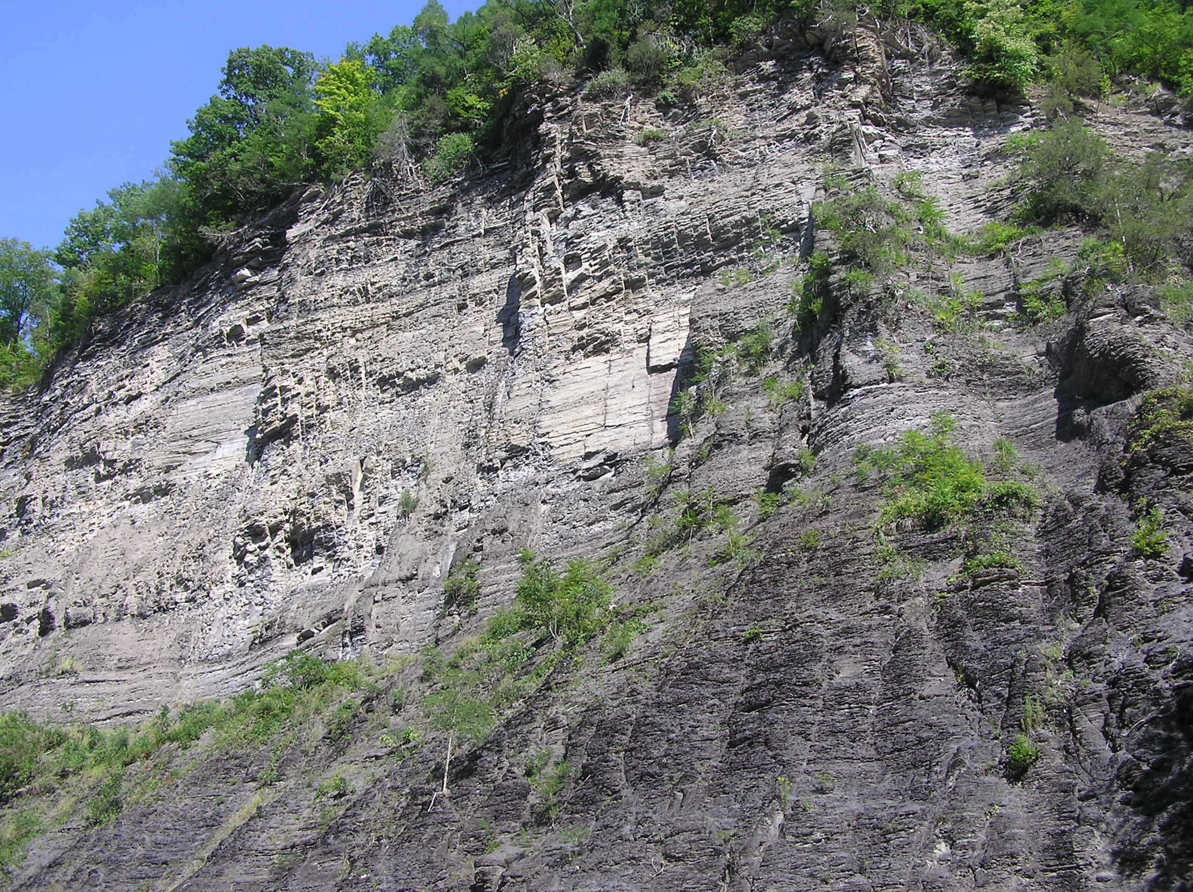
Contact Area
Two possibilities for contact area in Marcellus: 1.) Natural hydraulic fractures: Joints 2.) Fracture stimulation using high pressure water
200 feet

Slide 15
Contact Area
Natural fractures illustrate what hydraulic fractures might look like after stimulation of a horizontal well!

Slide 16
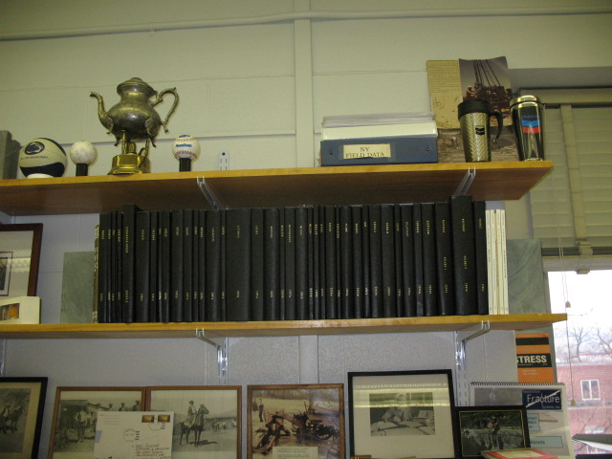
Setting the record straight 4. the role of graduate students
334A Deike Building (chez Engelder)
1.01 meters
White arrow covers much of what we know about natural hydraulic fracturing in the Marcellus

Slide 17
Christie Rogers
Using the fracture pattern at Zion National Park, she demonstrated that joint formation was scale-independent

Slide 18
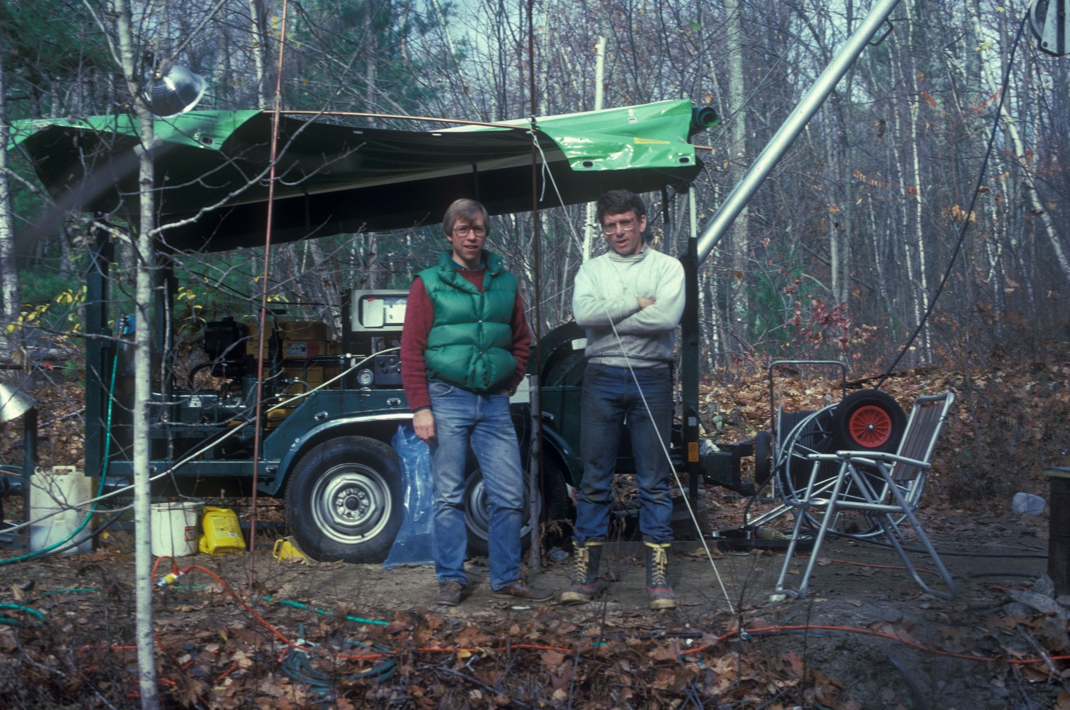
Richard Plumb
Key player in documenting orientation of Earth stress in the Appalachian Basin

Slide 19
Maximum horizontal rock stress (S_{H}) in Marcellus
S_{H}
S_{H}

Slide 20
Maximum horizontal rock stress (S_{H}) in Marcellus
S_{H}
S_{H}
Location Plat: 081-20102

Slide 21
Hydraulic fractures grow in the direction of S_{H}
S_{H}
S_{H}
3.4 Mmcf/d
6.4 Mmcf/d
Location Plat: 081-20102

Slide 22
“General Rule of Thumb”
1 mi² = 1 section
Estimated Ultimate Recovery (EUR) =
IP (6.4 Mmcf/d) x 10³
EUR = 6.4 Bcf
EUR (10 laterals)
64 Bcf/section
Location Plat: 081-20102

Slide 23
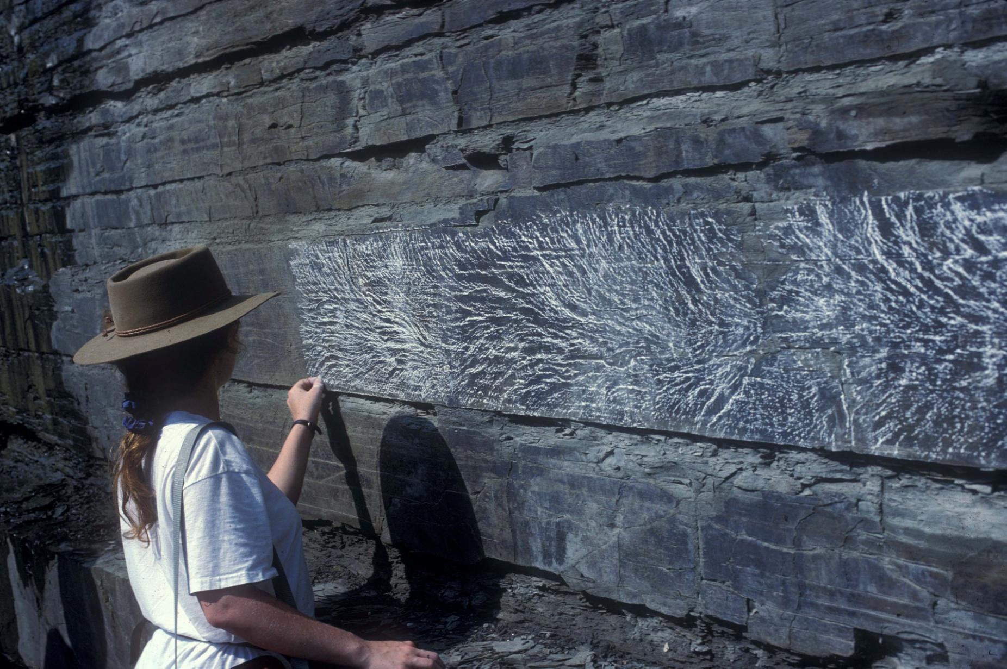
Staci Loewy
S_{H}
S_{H}
joint face
bedding layer
Made the connection between joints growth and organic content in black shale!

Slide 24
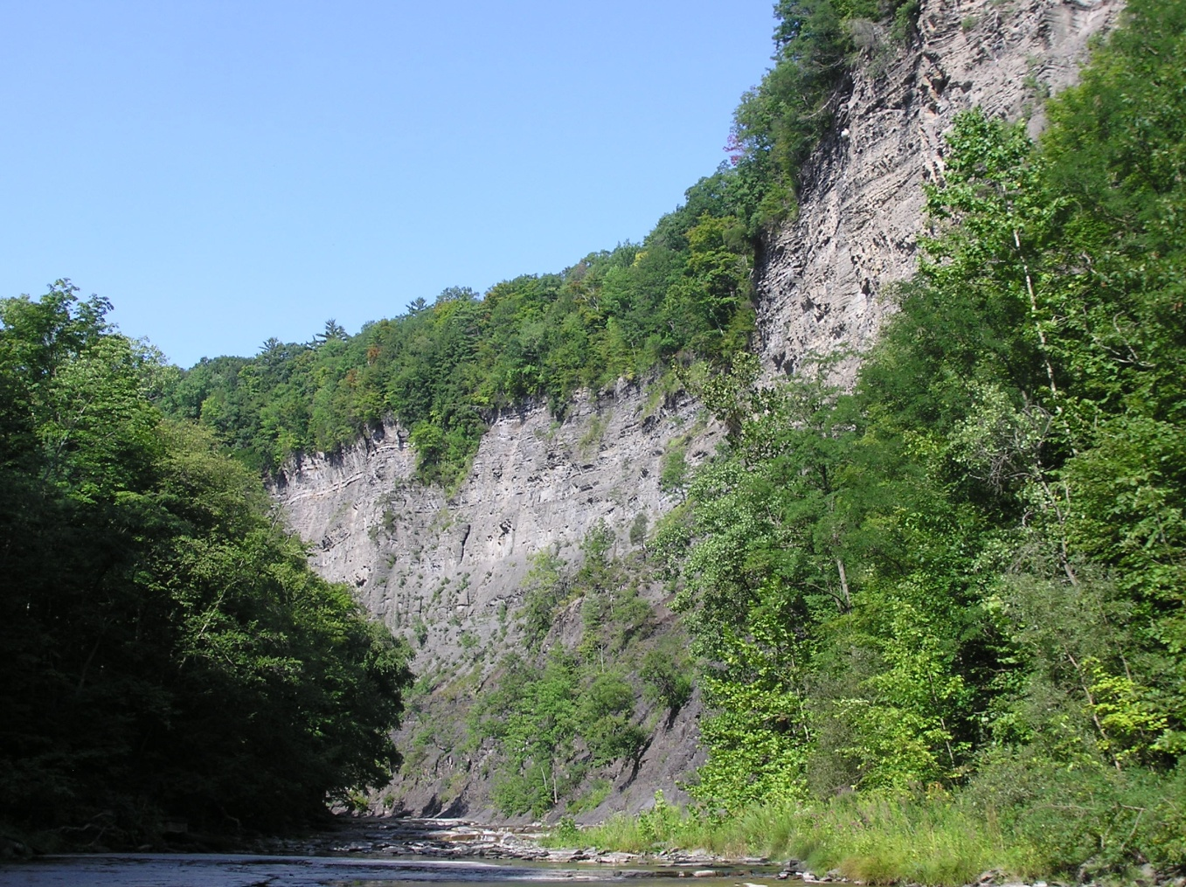
Spacing at Taughannock
AWSF (ENE) Joints
Ithaca
Geneseo
Alleghanian Joints
AWSF (ENE) Joints
J₁
more joints
less joints

